Slide 1



An Overview of Longitudinal
Spin Structure Measurements from Jefferson Lab
Vincent Sulkosky
Massachusetts Institute of Technology
The 7th International Workshop on Chiral Dynamics
August 10th, 2012
Newport News, VA

Slide 2
Outline
Review of Polarized Inclusive Scattering on Nucleon
targets and Spin Sum Rules
Comparison of χPT with high-precision data at
Q² ≈ 0.1 GeV²
Recent Experimental Progress:
  Q² down to 0.02 GeV²
Recent Theoretical Developments
Notes:
A(e,e’p) reactions. HRS: High resolution spectrometers

Slide 3
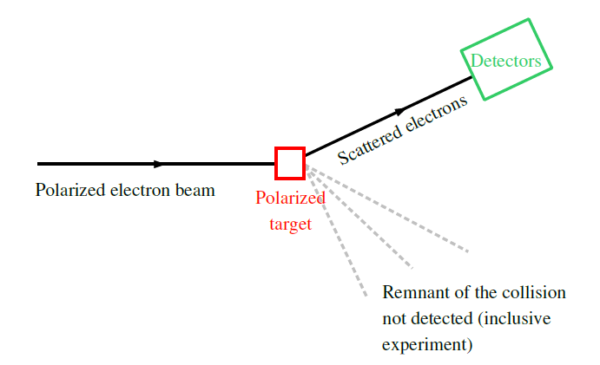
Polarized Inclusive Scattering
Notes:
A(e,e’p) reactions. HRS: High resolution spectrometers

Slide 4
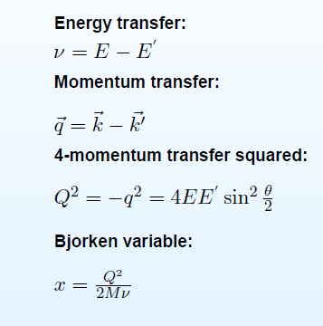
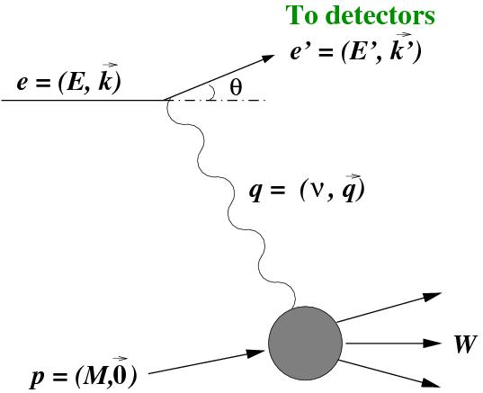
Inclusive Scattering Kinematics
Notes:
A(e,e’p) reactions. HRS: High resolution spectrometers

Slide 5
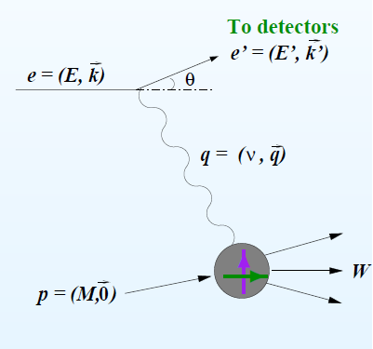
Inclusive Cross Sections
Cross section: likelihood of an
interaction between particles.
σ_{Mott}: scattering from a point-like
object
structure functions:
  spin-averaged (unpolarized): F₁ and F₂
  spin-dependent (polarized): g₁ and g₂
  electron and target spins are
  parallel (antiparallel) or
  their spins are perpendicular
Notes:
A(e,e’p) reactions. HRS: High resolution spectrometers

Slide 6
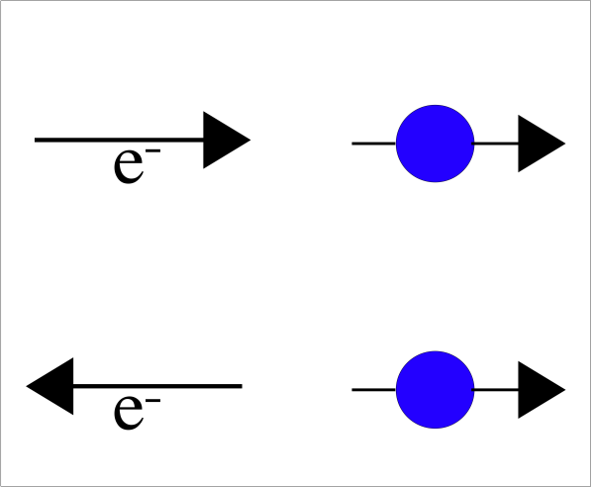
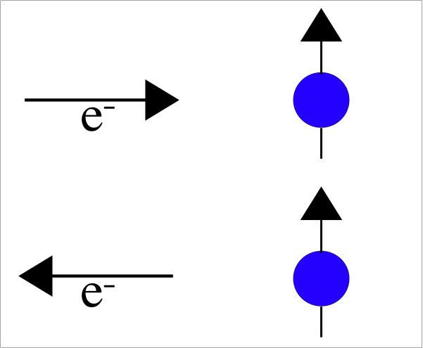


Experimental Technique
−
−

Slide 7

Gerasimov-Drell-Hearn (GDH) Sum Rule
Circularly polarized photons incident on a
longitudinally polarized spin-1/2 target.
σ_{1/2} (σ_{3/2}) Photoabsorption cross sections.
The sum rule is related to the target’s
anomalous part of the magnetic moment κ.
Solid theoretical predictions based on general
principles.

Slide 8

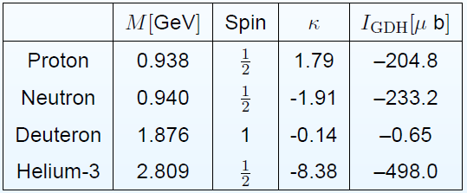
GDH Measurements
The sum rule is valid for any target with a given spin:
Proton: verified (7%): Mainz, Bonn, LEGS.
Measurements for the neutron (²H and ³He) are in progress:
Mainz, Bonn, LEGS, HIGS.
Measurements on Deuteron and ³He are also interesting.

Slide 9
The Generalized GDH Integral (Q² > 0)
For virtual photons,
Can be expressed as the integral of g₁(x,Q²)
Can be linked to the forward spin-dependent Compton amplitude S₁(0,Q²)
by the extended GDH sum rule:
$$I_{GDH}\left(Q^{2}≠0\right)=\frac{16π^{2}α}{Q^{2}}\int_{0}^{x_{th}}{g_{1}}\left(x,Q^{2}\right)dx=\frac{16π^{2}α}{Q^{2}}Γ_{1}=2π^{2}αS_{1}\left(0,Q^{2}\right)$$
Ji and Osborne, J. Phys. G27, 127 (2001)
At Q² = 0, the GDH sum rule is recovered.
At Q² → ∞, the Bjorken sum rule is recovered.
At Q² = 0, the GDH sum rule is recovered.
At Q² → ∞, the Bjorken sum rule is recovered.

Slide 10
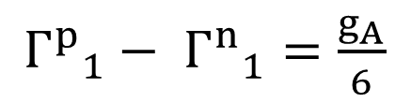
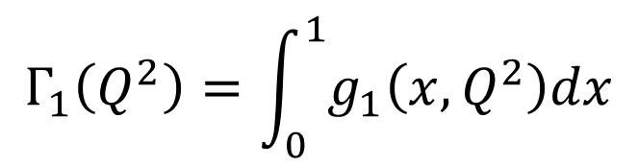
First Moment of g₁
The first moment, Γ₁
$$Γ_{1}\left(Q^{2}\right)=\int_{0}^{1}{g_{1}\left(x,Q^{2}\right)dx}$$
Connected to the total spin carried by the quarks.
Related to the generalized GDH integral as Q² → 0
Bjorken Sum rule (Q² → ∞)
${Γ^{p}}_{1}^{}− {Γ^{n}}_{1}^{}=$ $\frac{g_{A}}{6}$
g_{A} is the nucleon axial charge.
The sum rule has been measured and agrees with expected
value (at the 10% level).
At Q² = 0, the GDH sum rule is recovered.
At Q² → ∞, the Bjorken sum rule is recovered.

Slide 11
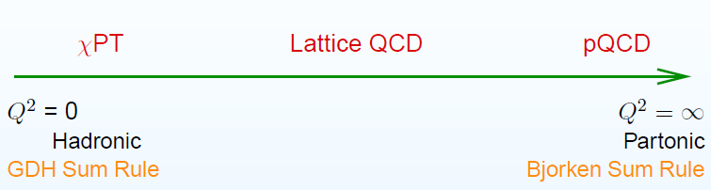
Importance of Generalized GDH Sum Rule
Constrained at the two ends of the Q² spectrum by known
sum rules: GDH (Q² = 0) and Bjorken (Q² → ∞)
In principle, Generalized GDH integral is calculable at any Q².
Compare theoretical calculations to experimental
measurements over the measurable Q² range.
Useful tool to study the transition from non-perturbative to
pertubative QCD.

Slide 12
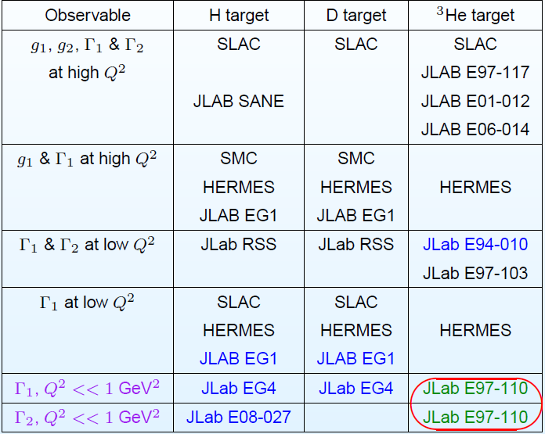
Experiment Summary (Q² > 0)

Slide 13
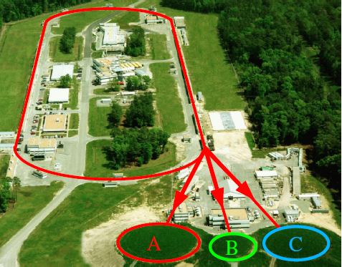
Jefferson Lab
Continuous e⁻ beam
Energy: 0.4 to 6 GeV
Polarization: ~ 85%
Beam current: up to 200 μA
Beam energy being upgraded to 12 GeV!

Slide 14
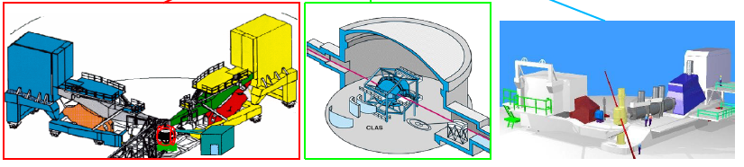
Jefferson Lab
Continuous e⁻ beam
Energy: 0.4 to 6 GeV
Polarization: ~ 85%
Beam current: up to 200 μA
Beam energy being upgraded to 12 GeV!

Slide 15
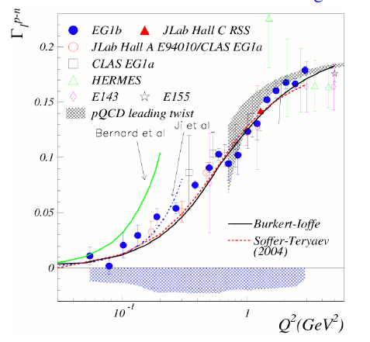
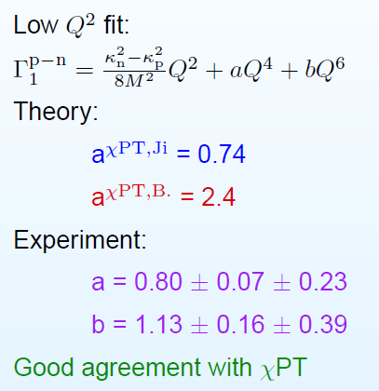
The Bjorken Sum
Proton - Neutron
Δ resonance suppressed => easier check of χPT

Slide 16
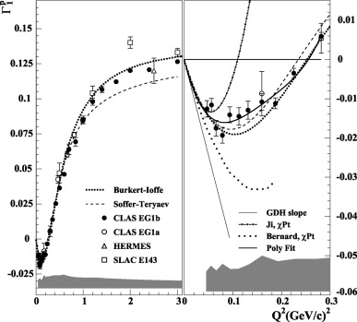
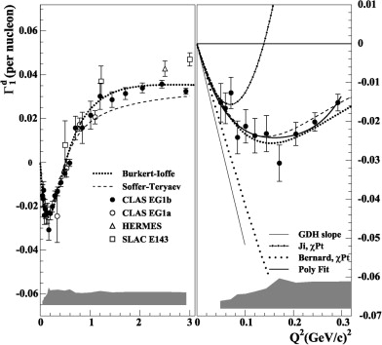
Measurements of Γ₁
Proton
Deuteron
Measurements from EG1 (a and b), SLAC, Hermes
EG4 will push to lower Q² (0.02)
Other low Q² data from EG1b
Y. Prok et al. Phys. Lett. B672 12, 2009

Slide 17
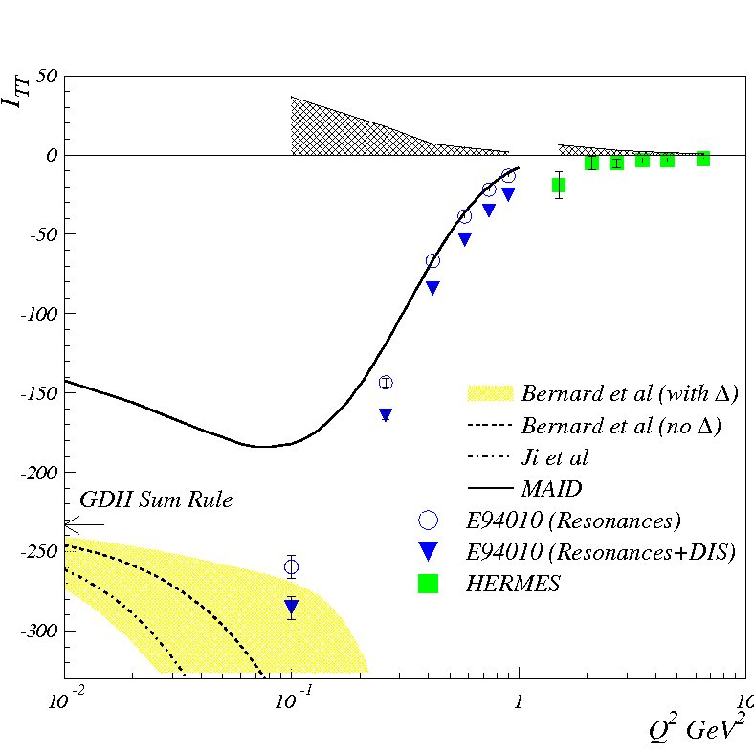
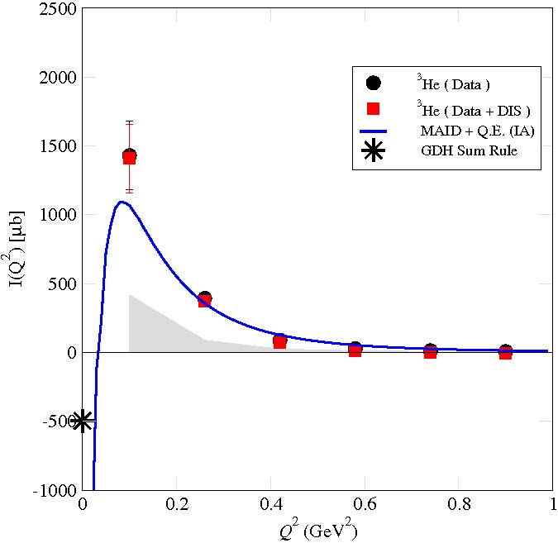
Neutron and ³He Results
Neutron
Helium-3
Need theory calculations
PRL 89, 242301 (2002)
PRL 101, 022303 (2008)
MAID: phenomenological model with only resonance contributions.

Slide 18
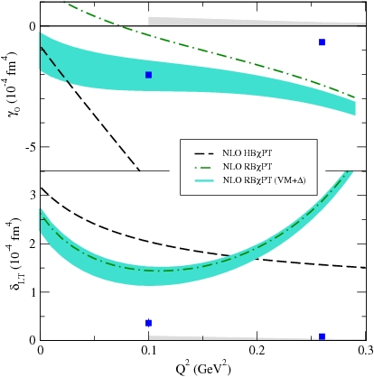
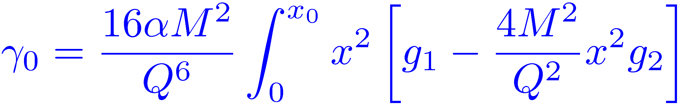
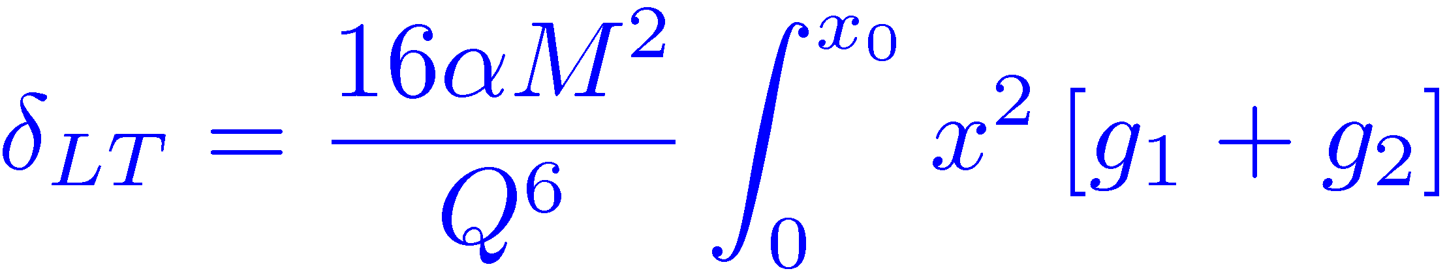
Neutron Forward Spin Polarizabilities
PRL 93: 152301 (2004)
Failure of χPT?
Heavy Baryon χPT Calculation
  Kao, Spitzenberg, Vanderhaeghen
  PRD 67:016001(2003)
Relativistic Baryon χPT
  Bernard, Hemmert, Meissner
  PRD 67:076008(2003)

Slide 19
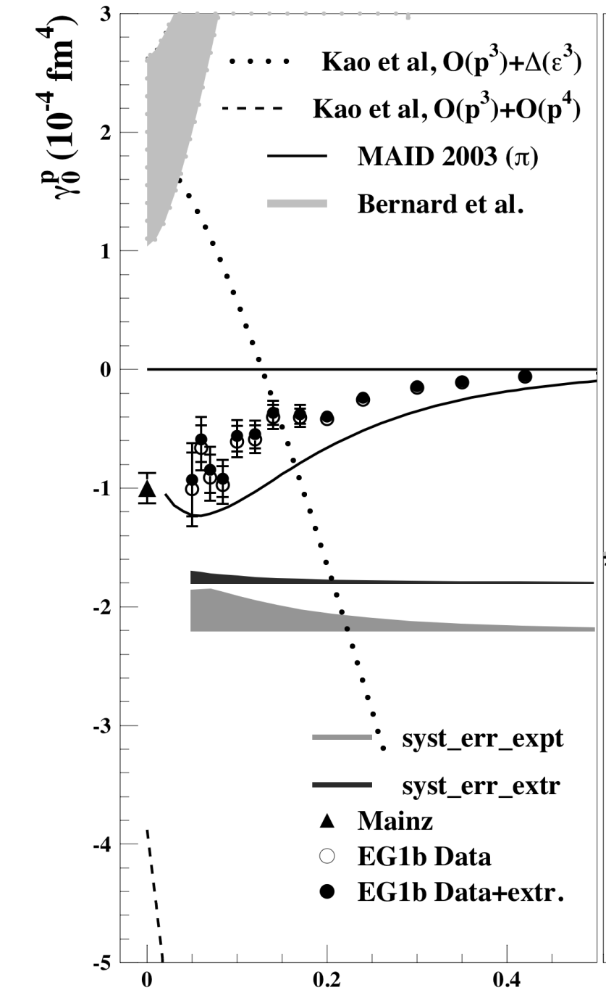

Proton γ₀
Calculations also fail for proton γ₀
Proton
PLB672 12, 2009
$$Q^{2}$$

Slide 20
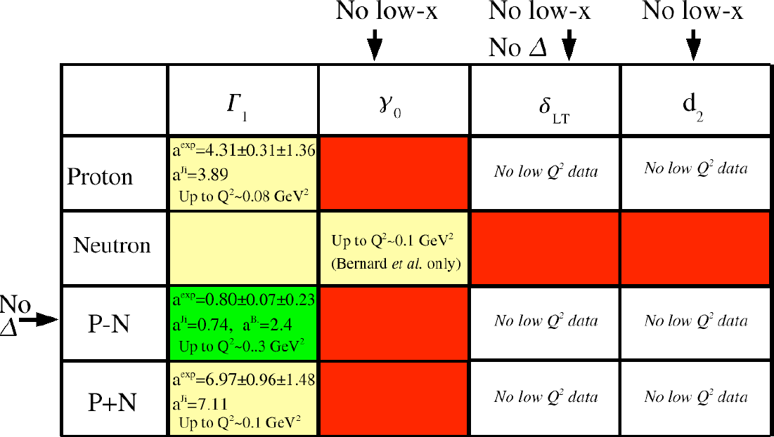
Summary of Data Comparison with χPT
White: no data available
Red: poor agreement
Yellow: some agreement
Green: good agreement
Not sensitive to unmeasured high energy part

Slide 21
Recent Experimental Efforts at JLab
EG4 (CLAS): NH₃ and ND₃ to measure g₁
E08-027 (Hall A): NH₃ to measure g₂
E97-110 (Hall A): ³He to measure g₁ and g₂
All measurements down to at least
Q² ~ 0.02 GeV²

Slide 22
The EG4 Experiment
The CLAS EG4 experiment is focused on the measurement of the generalized GDH sum rule for the proton and neutron (deuteron) at very low Q² (0.02 – 0.5 GeV²)
Measured polarized electrons scattered off polarized
targets down to 6° scattering angles
Will extract g₁ from the measured absolute cross-section
differences
Test of ChPT as Q² → 0
Spokespersons
NH_{3:} M. Battaglieri, A. Deur, R. De Vita, M. Ripani (Contact)
ND_{3:} A. Deur(Contact), G. Dodge, K. Slifer
Ph.D. Students
K. Adhikari, H. Kang, K. Kovacs
Measured polarized electrons scattered off polarized targets down to 6° scattering angles
Will extract g₁ from the helicity dependent inclusive cross sections
NH_{3:} M. Battaglieri, A. Deur, R. De Vita, M. Ripani (Contact)
ND_{3:} A. Deur (Contact), G. Dodge, K. Slifer

Slide 23
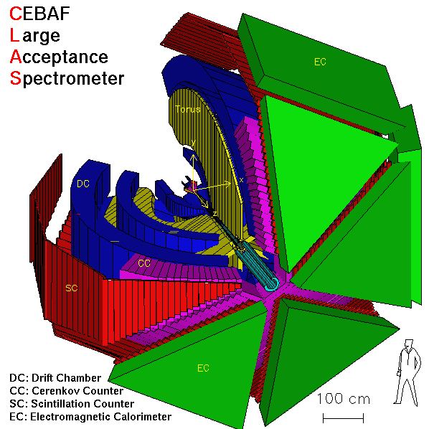
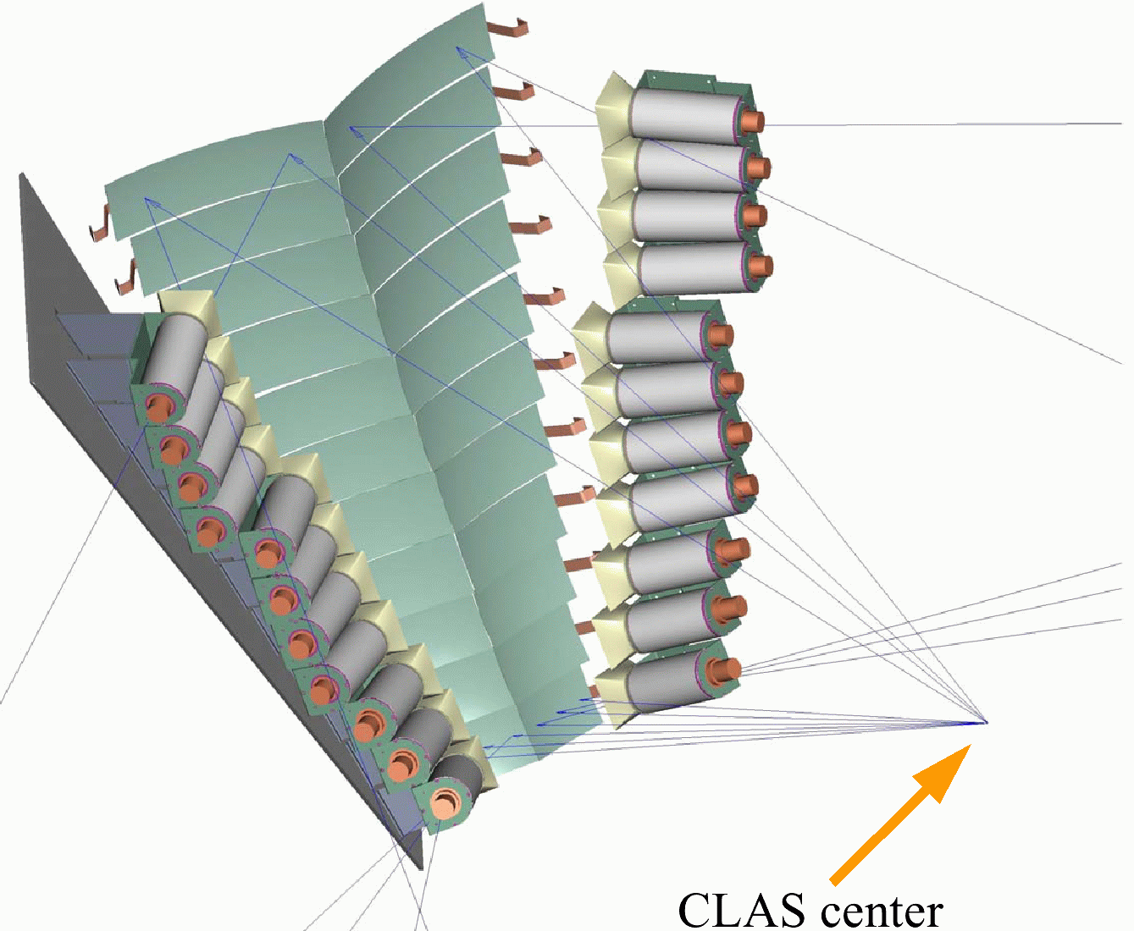
EG4 Experimental Set-Up
EG4 ran from February to May 2006 in Hall B using CLAS.
Longitudinally polarized NH₃ and ND₃ targets at -1m w.r.t. CLAS center.
Longitudinally polarized electron beam (P_{b} ~ 80%) at low energies (1-3 GeV); outbending torus field.
Cross section measurement requires uniform detection efficiency at low Q².
New Cherenkov detector (INFN – Genova) installed in sector-6 for detecting small angle scatterings down to 6º with uniform and high efficiencies.
EG4 ran from February to May 2006 in Hall B using CLAS.
Longitudinally polarized CLAS NH₃ and ND₃ targets at -1m w.r.t. CLAS center.
Longitudinally polarized electron beam (P_{b} ~ 80%) at low energies (1-3 GeV); outbending torus field.
Notes:
EG4:
● Pol. e- & pol. NH3, ND3
● Main trigger: special CC in sector 6 & ECtot & ECin thr.
● Secondary trigger: EC (all sectors).
● Torus: outbending only. Target: -1m.
● E: 1 to 3 GeV.
● Focus: Inclusive analysis at small angles.
● Exclusive pion analysis.
● For analysis: using ntuples (or root trees) only.

Slide 24
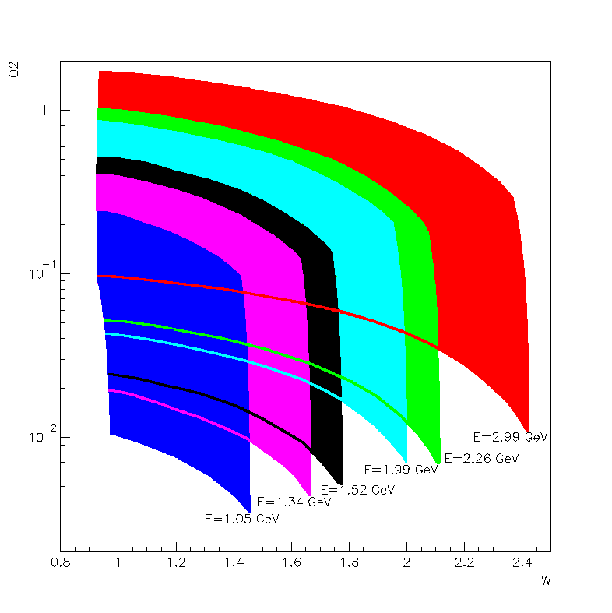
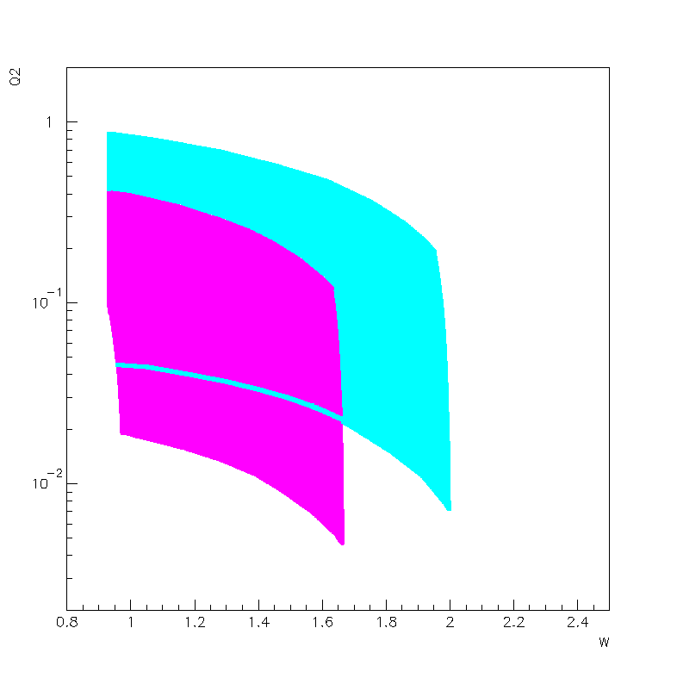




EG4 Kinematics
NH₃ target (P_{t} = 80 – 90 %)
ND₃ target (P_{t} = 30 – 45 %)
$$Q^{2}$$
$$Q^{2}$$
E_{beam} = 1.3 and 2.0 GeV
$$W$$
$$W$$
E_{beam} = 1.1,1.3,1.5,2.0,2.3,3.0 GeV
Good coverage of the resonance region:
0.015 < Q² < 0.5 GeV²

Slide 25
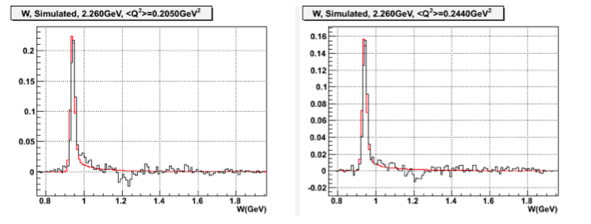


EG4 Preliminary Results
$$W$$
$$W$$
Very Preliminary Cross Section difference; analysis by H. Kang
Proportional to g₁
Only small subset of total statistics

Slide 26
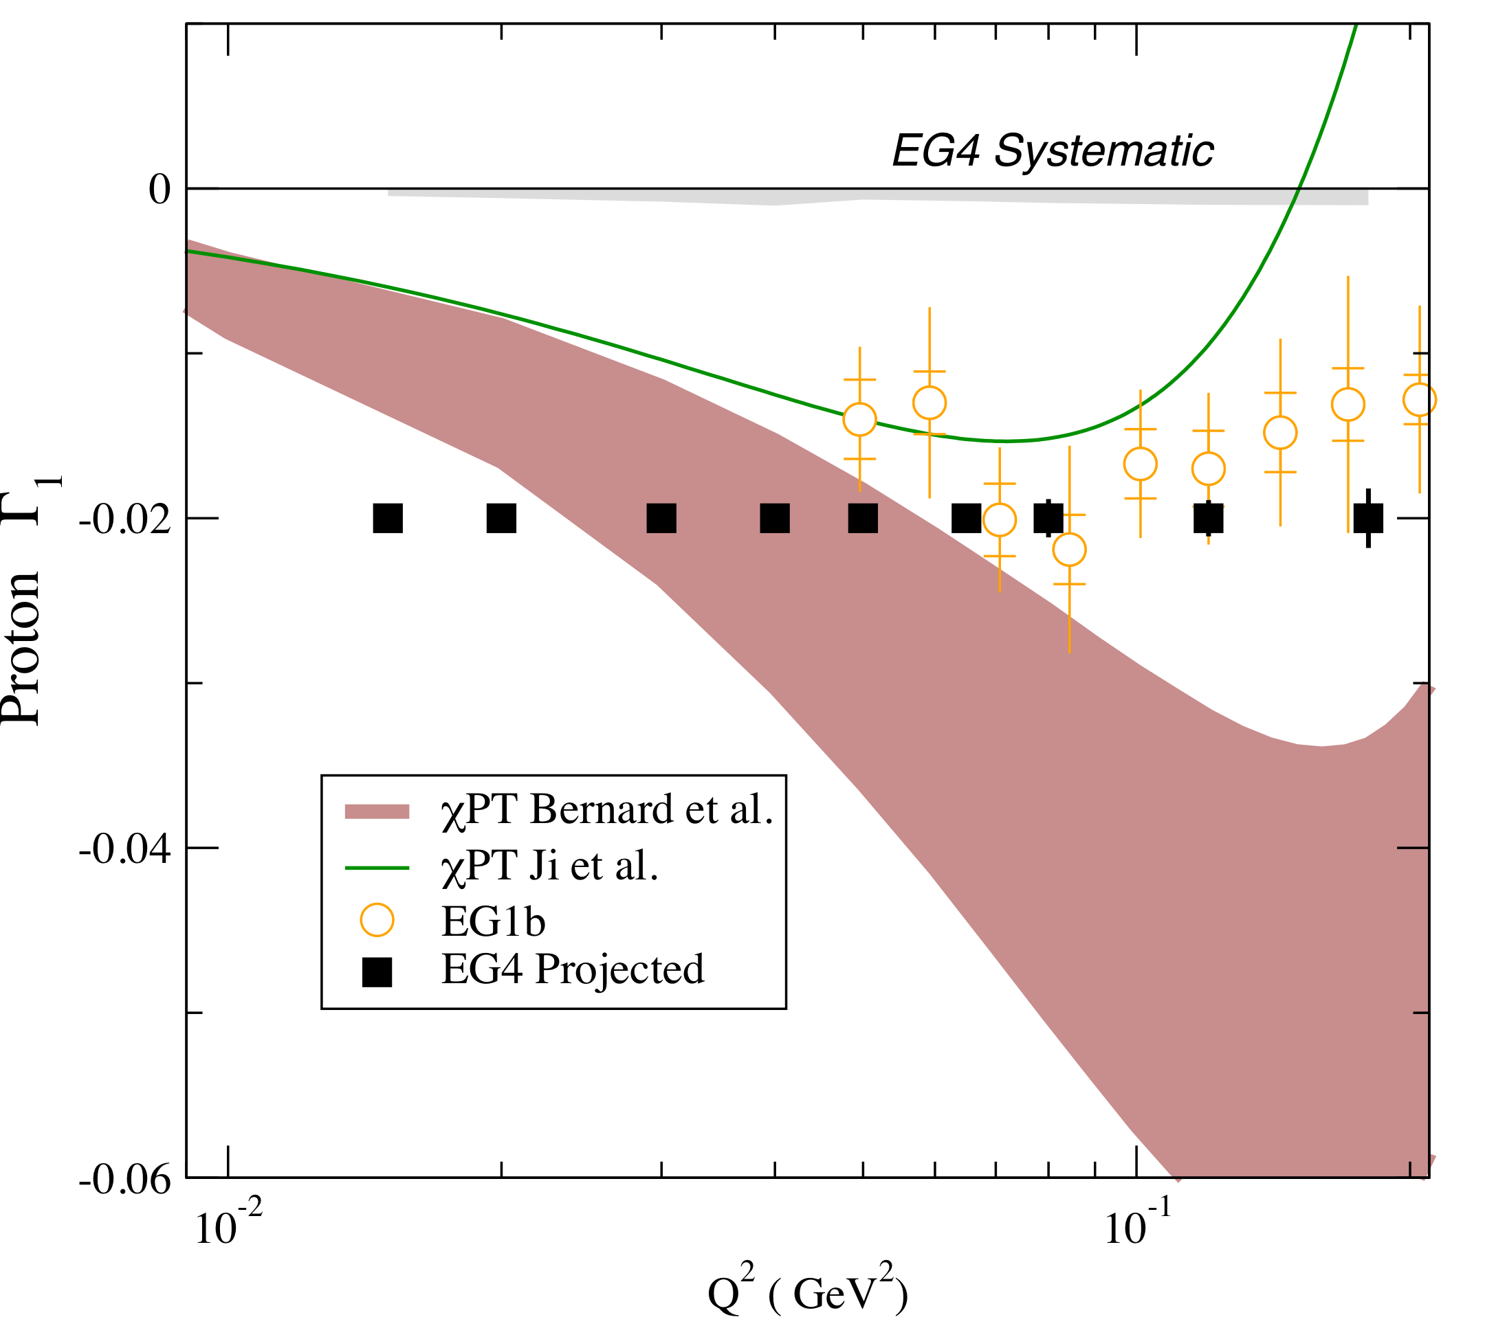
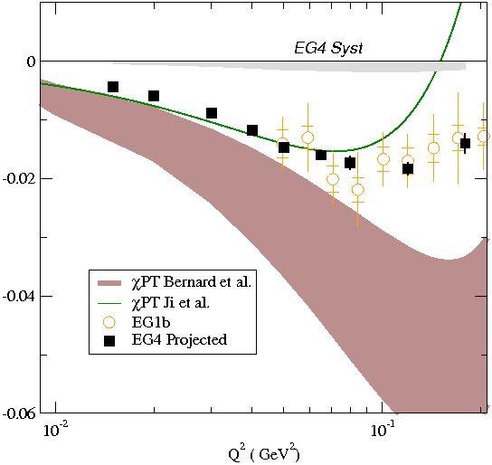
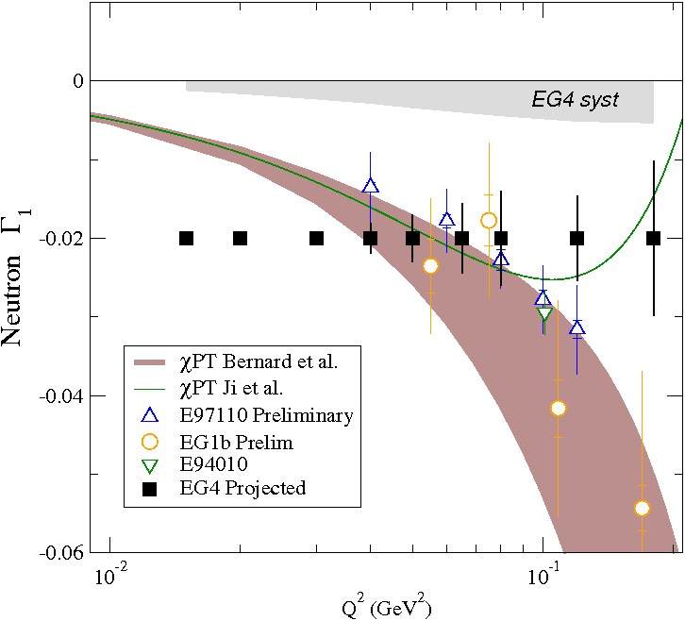
EG4 Expected Results
Proton
Neutron

Slide 27
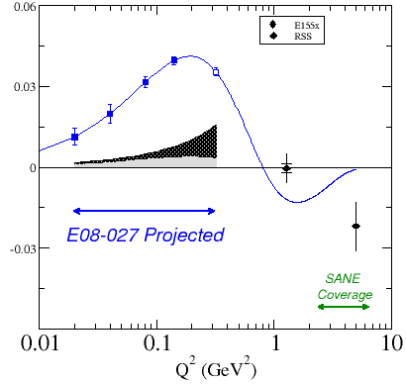
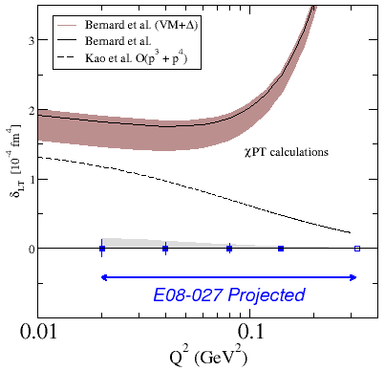
E08-027 : Proton g₂ Structure Function
Fundamental spin observable was never measured at low or moderate Q²
Spokesmen: A. Camsonne, D. Crabb, J.-P. Chen, K. Slifer
Test the Burkhardt-Cottingham (BC) Sum Rule at low Q²
Extract the generalized spin polarizability, δ_{LT}, to provide a bench-mark test
of χPT
Improve the calculation of proton Hyperfine splitting
Proton charge radius from μP lamb shift disagrees with eP scattering result
g₂ data strongly anticipated by theorists
BC Sum Rule
Spin Polarizability δ_{LT}

Slide 28
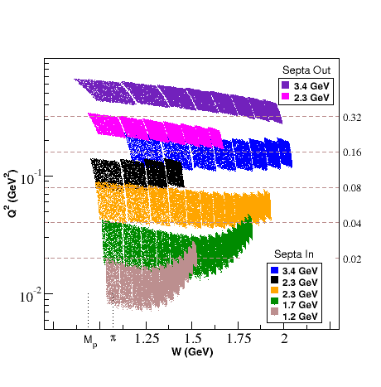
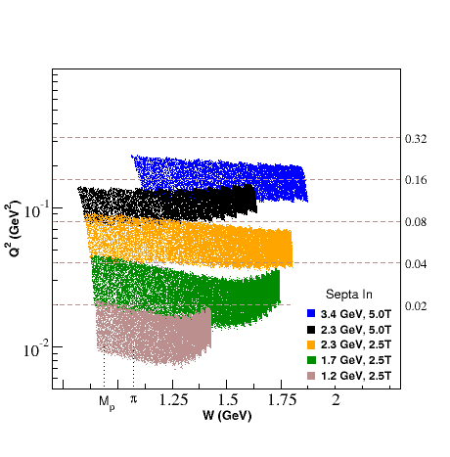
Major Challenges
149 days lost to mechanical failures and design issues:
  Polarized target magnet repair
  Septa magnet redesign and later deterioration
Major Achievements
  Despite major challenges, achieved about 60% of planned data.
  Polarized target performance was outstanding :
  <P_{T}> > 30% @ 2.5T and > 75% @ 5T
Planned
Achieved

Slide 29
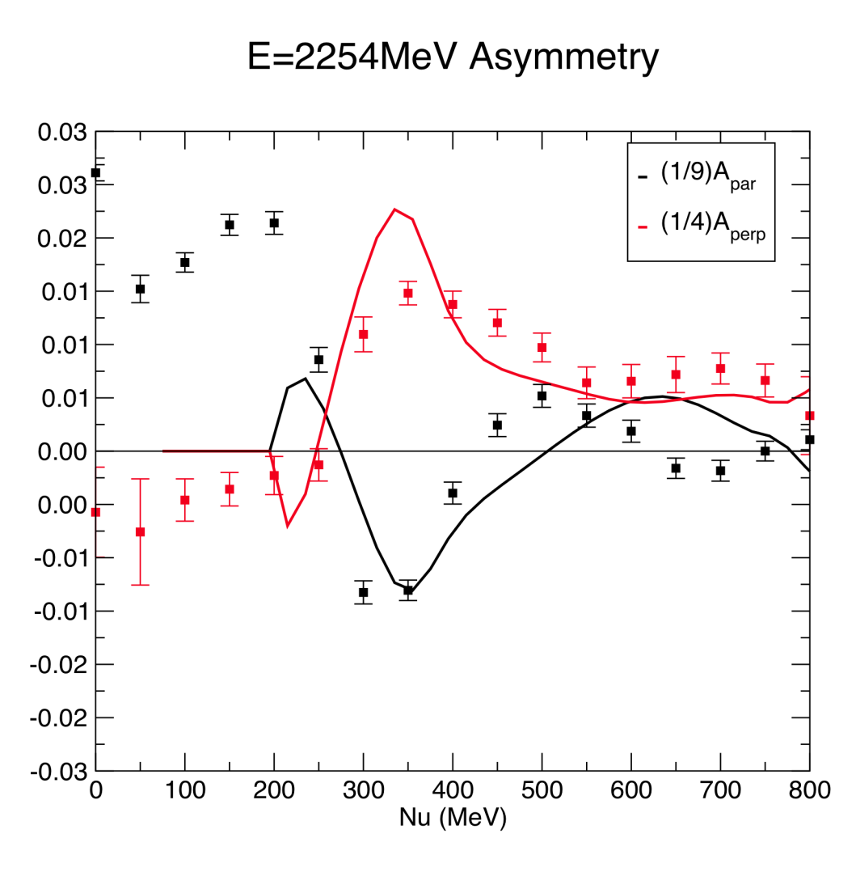
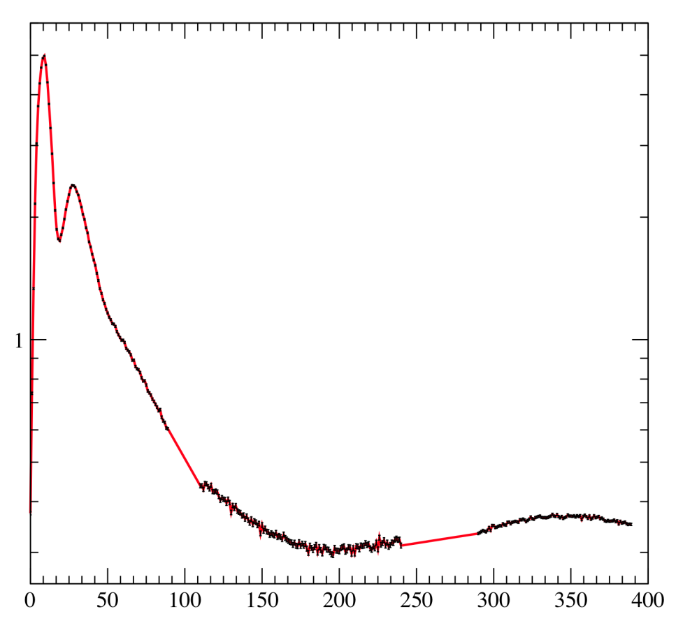
Very Preliminary Results
Experimental Details presented by Chao Gu and Pengjia Zhu
Normalized Yield (Arb units)
Nitrogen Elastic
Proton Elastic/Nitrogen Q.E.
Δ-Resonance
VERY VERY PRELIMINARY!
ν (MeV)
Ph.D. Students: T. Badman, M. Cummings, C. Gu, J. Liu, M. Huang, P. Zhu, R. Zielinski

Slide 30
E97-110: Small Angle GDH
Precision measurement of the moments of spin
structure functions at low Q², 0.02 to 0.24 GeV² for
the neutron (³He)
Covered an unmeasured region of kinematics to test
theoretical calculations (Chiral Perturbation theory)
Complements data from experiment E94-010
covered region from 0.1 to 0.9 GeV²
First publication expected this year

Slide 31
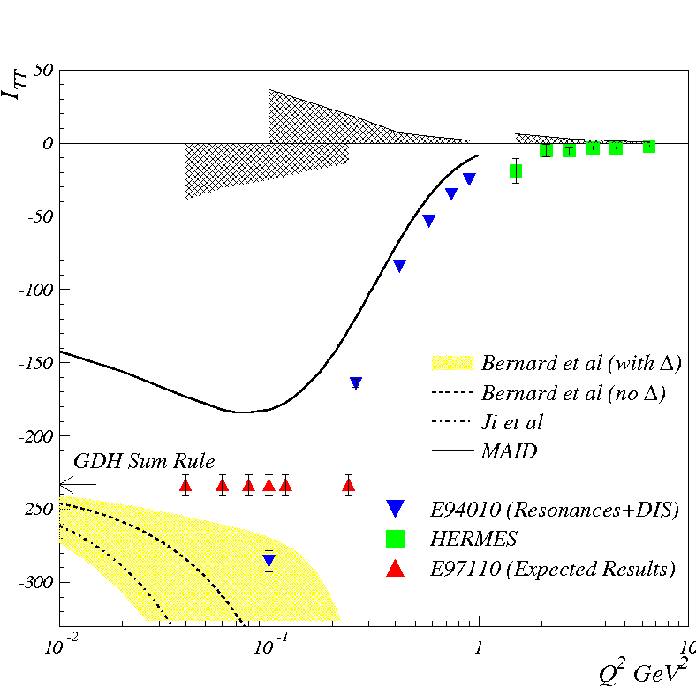
Experimental Details
Inclusive experiment:
  Scattering angles of 6◦ and 9◦
  Polarized electron beam:
  Avg. P_{beam} = 75%
  Pol. ³He target (para & perp):
  Avg. P_{targ} = 40%
Measured polarized cross-
section differences
M. Amarian et al., PRL 89, 242301 (2002)
Spokesmen: J.-P. Chen, A. Deur, F. Garibaldi

Slide 32
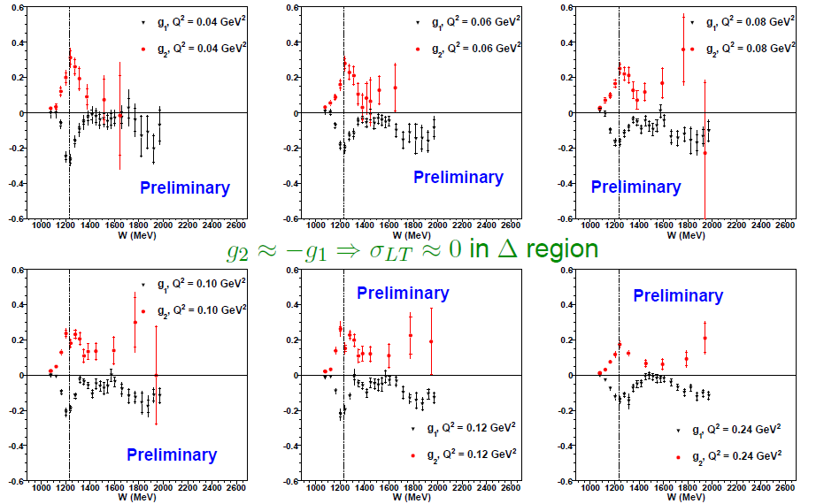
³He: g₁, g₂ versus W at Constant Q²

Slide 33

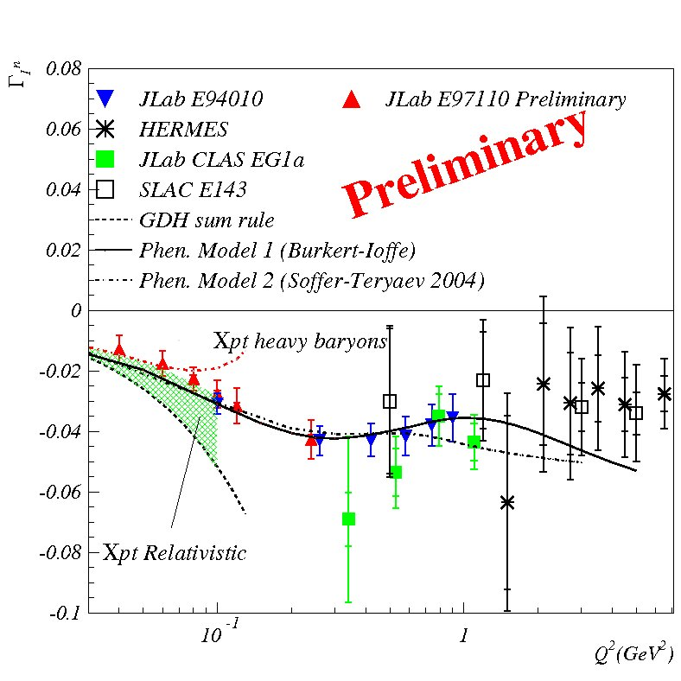
First Moment of g₁
χpt – Chiral Perturbation Theory

Slide 34
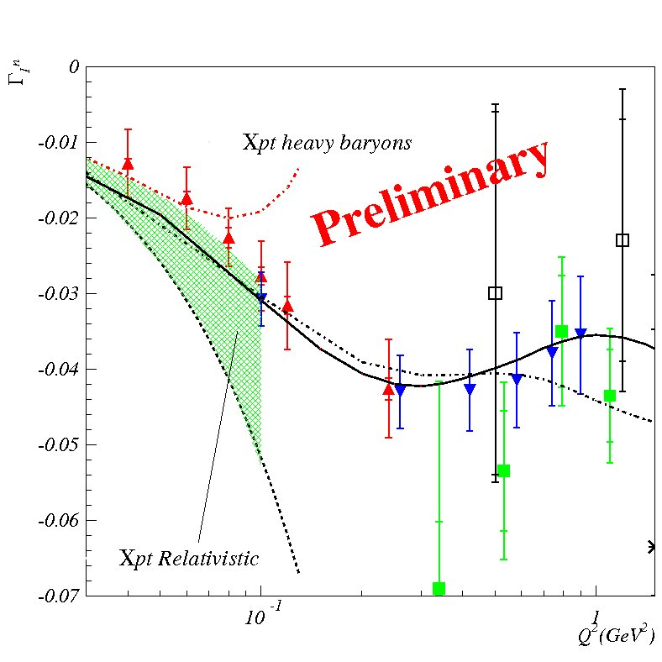
First Moment of g₁
χpt – Chiral Perturbation Theory

Slide 35
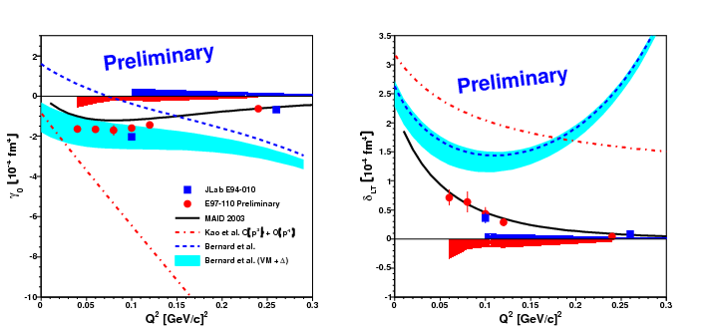
New Results for Spin Polarizabilities
Δ resonance is suppressed for δ_{LT}
More robust prediction

Slide 36
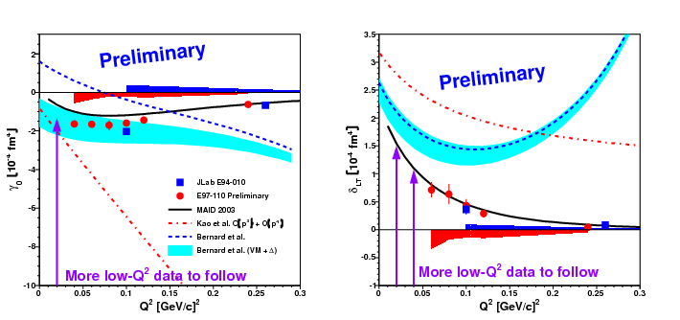
New Results for Spin Polarizabilities
Δ resonance is suppressed for δ_{LT}
More robust prediction

Slide 37
Theoretical Developments
HBχPT: progress on including higher-order (beyond
NL)
RB χ PT: progress on properly including Δ contribution
Effect from axial anomaly
See H. Krebs talk on Wednesday (Few Body Physics WG)

Slide 38
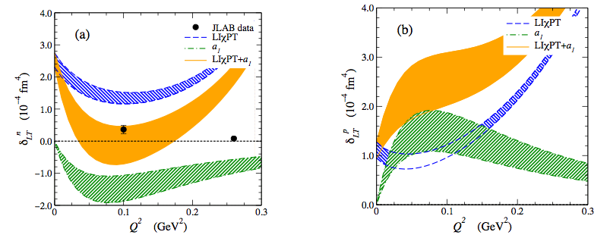
Axial Anomaly and the δ_{LT} Puzzle
Neutron
Proton
N. Kochelev and Y. Oh, Phys. Rev. D 85, 016012 (2012)

Slide 39
Summary
Comparison of high precision data on the moments
of the spin structure functions at low Q² and
predictions from χPT show mixed results in terms of
agreement with each other.
The Δ (1232) resonance cannot fully explain the
disagreements.

Slide 40
Summary
New high precision experiments at lower Q²:
  E97-110: g₁ and g₂ on neutron (soon to be published)
  EG4: g₁ on proton and deuteron (being analyzed)
  E08-027: g₁ and g₂ on proton (recently acquired)
The new neutron data still indicate a discrepancy for δ_{LT}
Exciting new results expected in the next few years
Major challenges remain on the theory side:
  Need strong theory support to solve
  Calculations for light nuclear targets (deuteron and ³He) are
  also desired

Slide 41
Thank You!

