Slide 1
Update on High Precision Measurement of the Neutral Pion Decay Width
Rory Miskimen
University of Massachusetts, Amherst
The neutral pion has a special status in our field:
Lightest strongly interacting particle observed in nature
QCD symmetries are decisive in describing π⁰ properties
First elementary particle to be discovered with an accelerator
Outline
π⁰→γγ and the chiral anomaly
Review results for the π⁰ radiative width from the JLab PRIMEX I experiment
Update on PRIMEX II analysis
Impact on the PDG average for π⁰ radiative width

Slide 2
Theory for π⁰→γγ in the era of “current algebra”
The soft-pion limit of PCAC predicts A_{γγ} = 0
π⁰ should be stable against EM decays!
Adler, Bell, and Jackiw discover triangle diagrams that alter PCAC predictions for πº decay
k₁
p
k₂

Slide 3
Theory for π⁰→γγ in the era of QCD effective interactions
Wess, Zumino and Witten construct anomalous O(p⁴) lagrangian that permits transitions between even and odd numbers of pseudo-scalar mesons
The chiral anomaly has special status in QCD: there are no low energy constants in lagrangian. The O(p⁴) prediction is

Slide 4
The most important NLO correction is due to isospin symmetry breaking m_{u} ≠ m_{d}
Causes a mixing of the π⁰, η and η´ states, amplitudes and decay constants.
Arguably the most comprehensive NLO ChPT calculation is by Goity, Bernstein and Holstein, calculated in the 1/N_{c} expansion up to O(p⁶) †
≈ 5% higher than LO, with uncertainty of less than 1%
† J. Goity, A. Bernstein, and B. Holstein, Phys. Rev. D66:076014, 2002

Slide 5
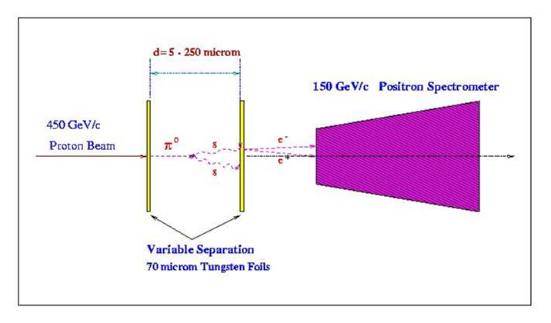
Direct Measurement of Lifetime (CERN 1984)
τ_{π}∼1x10⁻¹⁶ sec ⇒too small to measure
Solution: Create energetic π⁰ ‘s,
L = vτ_{π}E/m
Γ(π⁰→γγ) = 7.34eV±3.1%(total)
Dominant systematic error:
Uncertainty in P_{π} (±1.5%)
Measure π⁰ decay length
For E= 1000 GeV, L_{mean} ∼ 100 μm

Slide 6
Primakoff Method
1951: H. Primakoff suggests an indirect way to measure τ_{π} by the photo-production of π⁰’s at forward angles in the Coulomb field of a nucleus
1965: the first successful measurement of τ_{π} by the Primakoff effect at Frascati; result agrees with modern accepted value

Slide 7
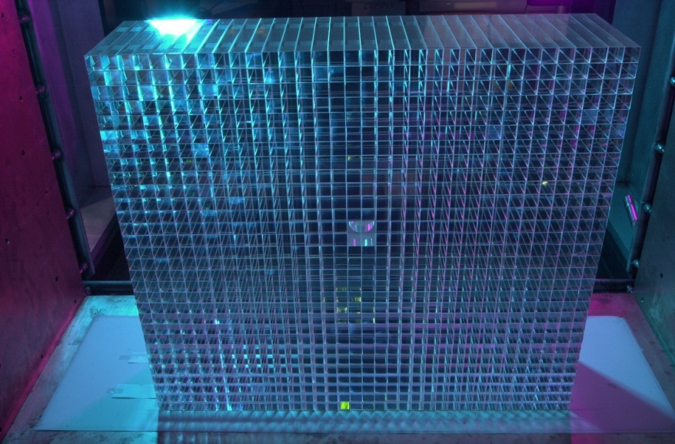
Jefferson Lab Primakoff
experiment: PRIMEX I

Slide 8
Carbon
Lead
Γ(π⁰→γγ)=7.79±0.18 eV
Γ(π⁰→γγ)=7.85±0.23 eV
Average of carbon and lead
Γ(π⁰→γγ)=7.82±0.14±.17 eV

Slide 9
Experiment
Theory
DESY 70
DESY proton 70
Cornell 74
Tomsk 70

Slide 10
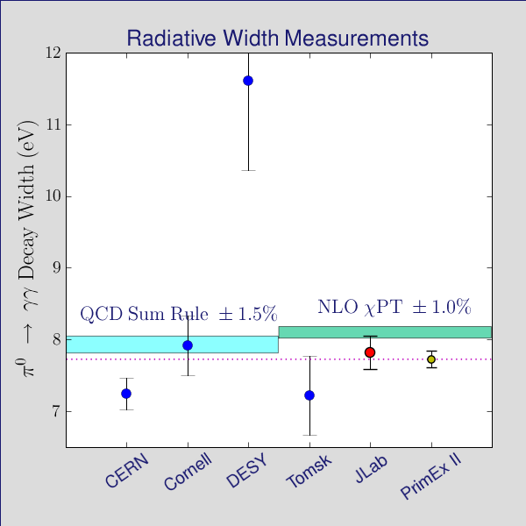
Goal for the PRIMEX-II experiment
PrimEx-I has achieved 2.8% precision (total):
Γ(π⁰→γγ) = 7.82 eV ±1.8% (stat) ±2.2% (syst.)
PrimEx-II
projected ±1.4%
PrimEx-I
7.82eV±2.8%
Task for PrimEx-II is
to obtain 1.4% precision
Projected uncertainties:
±0.5% (stat.) ±1.3% (syst.)

Slide 11
Improvements for PrimEx-II
1.4 % Total
1.3 % Syst.
0.5 % Stat.
Better control of Background:
  Add timing information in HyCal (~500 chan.)
  Improve photon beam line to reduce Bkg
  Improve PID in HyCal (add horizontal veto
  counters to have both x and y detectors)
  More empty target data
Double target thickness (factor of 2 gain)
Hall B DAQ with 5 kHz rate,
(factor of 5 gain)
Double photon beam energy interval in the trigger

Slide 12
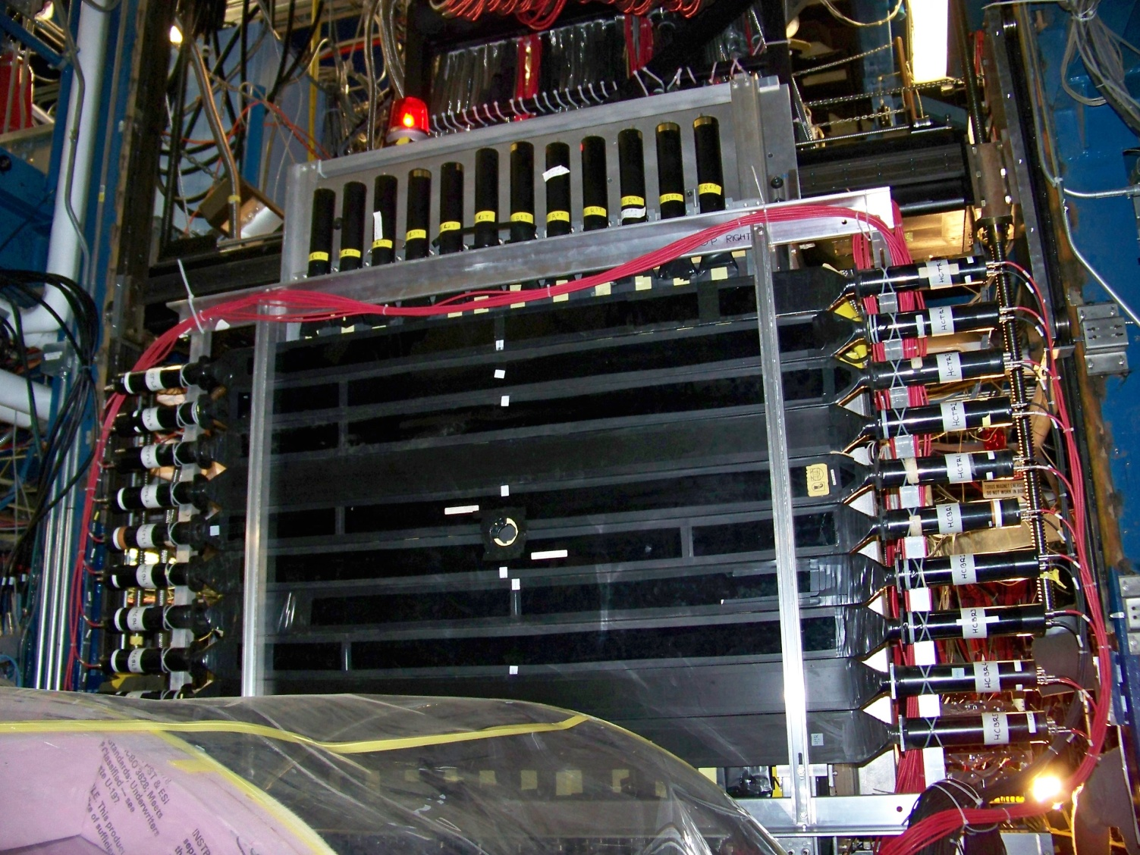
Improvement in PID
Additional horizontal veto

Slide 13
PRIMEX-II Status
Experiment was performed from Sep. 27 to Nov. 10 in 2010.
Physics data collected:
  π⁰ production run on two nuclear targets: ²⁸Si (0.6% statistics)
  and ¹²C (1.1% statistics).
  Good statistics for two well-known QED processes to verify the
  systematic uncertainties: Compton scattering and e⁺e⁻ pair
  production.
Analysis is in progress
Ilya Larin, ITEP
Lingling Ma, UNCW
Yang Zhang, Duke

Slide 14
PrimEx-II Experimental Yield (preliminary)
( Eγ = 4.4-5.3 GeV)
Primakoff
Primakoff
¹²C
²⁸Si
~8K Primakoff events
~20K Primakoff events

Slide 15
Measurements used in the 2011 PDG average
DESY 70
4.8 % error
Cornell 74
Tomsk 70

Slide 16
Measurements used in the 2012 PDG average
2.1 % error
Cornell 74

Slide 17
Theory is ahead of experiment: can we “break” the 1% uncertainty level in measurements of Γ(π⁰→γγ) ?
There are plans to do a direct measurement of the π⁰ lifetime at COMPASS. Important to measure the π⁰ momentum distribution
There are plans for measurements of e⁺e⁻→ e⁺e⁻ π⁰ at Frascati and Belle.
The “dream” Primakoff experiment would use electrons as the target. Need E_{γ} > 20 GeV, and do the measurement relative to a known QED process, such as atomic Compton scattering. EIC experiment?

Slide 18
Summary
PRIMEX-I measured Γ(π⁰→γγ) with a total uncertainty of 2.8%
The PRIMEX-I result is in good agreement with NLO ChPT
The PRIMEX-II result is projected to have a total uncertainty of 1.4%. Analysis is in progress.
Error on the updated PDG average for τ_{π} has been reduced by a factor of × 2.3
References:
A.M. Bernstein and Barry R. Holstein, commissioned article submitted to RMP, and
R. Miskimen, Annu. Rev. Nucl. Part. Sci. 2011, 61:1-21

