Slide 1

Departamento de Física Teórica II. Universidad Complutense de Madrid
Present status of Light Flavoured
Scalar Resonances
J. R. Peláez
7th Intl. Workshop on Chiral Dynamics CD12 . Thomas Jefferson National Accelerator Facility.
August 9th 2012

Slide 2
Outline
1) Scalar Mesons: motivation & perspective
2) The σ or f0(500)
I will focus on progress
since last CD2009
or after PDG2010
Following two points of view:
3) The f0(980)
4) The κ or K(800) and a0(980)
i) PDG
Consensual, conservative
5) Summary
ii) My own
Probably closer to the dominant
view in the community
working on light scalars

Slide 3
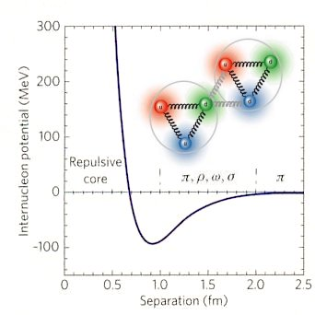
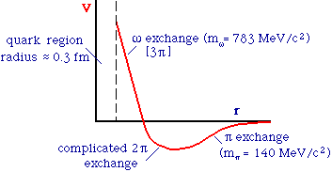
Motivation: The f₀(600) or σ, half a century around
I=0, J=0 ππ exchange very important for nucleon-nucleon attraction!!
Crude Sketch of NN potential:
From C.N. Booth
Scalar-isoscalar field already proposed by Johnson & Teller in 1955
Soon interpreted within “Linear sigma model” (Gell-Mann) or Nambu Jona Lasinio - like models, in the 60’s.

Slide 4
The longstanding controversy ( situation ca. 2002)
The σ, controversial since the 60’s.
σ
“not well established” 0⁺ state in PDG until 1974
Removed from 1976 until 1994.
Back in PDG in 1996, renamed “f₀(600)”
The reason: The σ is EXTREMELY WIDE and has no “BW-resonance peak”.
Usually quoted by its pole:
The “kappa”: similar situation to the σ, but with strangeness.
Still out of PDG “summary tables”
Narrower f₀(980), a₀(980) scalars well established but not well understood.
Even more states: f₀(1370), f₀(1500), f₀(1700)

Slide 5
Motivation: The role of scalars
The f₀’s have the vacuum quantum numbers.
Relevant for spontaneous chiral symmetry breaking.
Glueballs: Feature of non-abelian QCD nature
The lightest one expected with these quantum numbers
Why lesser role in the saturation of ChPT parameters?
SU(3) classification. How many multiplets? Inverted hierarchy?
Non ordinary mesons? Tetraquarks, molecules, mixing…
First of all it is relevant to settle their existence, mass and width

Slide 6
Outline
1) Scalar Mesons: motivation & perspective
2) The σ or f0(500)

Slide 7
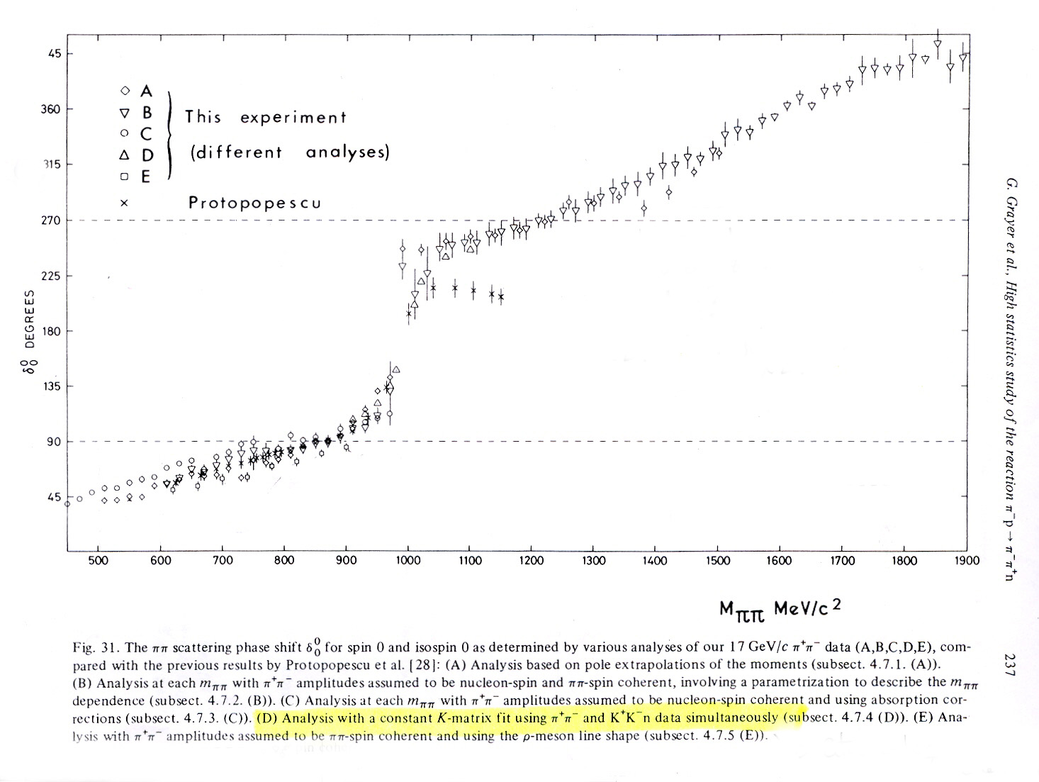
The σ until 2010: the data
Unfortunately….NN insensitive to details… need other sources
1) From πN scattering
Initial state not well defined, model dependent off-shell extrapolations (OPE, absorption, A₂ exchange...) Phase shift ambiguities, etc...
Systematic errors of 10º !!
π
π
π
π
N
N
Definitely not
a Breit-Wigner
Example:CERN-Munich
5 different ππ→ππ
analysis of same
πp→ππn data !! Grayer et al. NPB (1974)
2) From K→ππeν (“K_{l4} decays”)
Geneva-Saclay (77), E865 (01)
Pions on-shell. Very precise, but δ₀₀-δ_{11.}
2010 NA48/2 data

Slide 8
The σ until 2010: the data
3) Decays from heavier mesons
Fermilab E791, Focus, Belle, KLOE, BES,…
“Production” from J/Ψ, B- and D- mesons, and Φ radiative decays.
Very good statistics Clear initial states and different systematic uncertainties.
Strong experimental claims for wide and light σ around 500 MeV
“Strong” experimental claims for wide and light κ around 800 MeV
Very convincing for PDG, but personal caveats on parametrizations used,
which may affect the precision and meaning of the pole parameters
PDG2002: “σ well established”
However, since 1996 until 2010 still quoted as
Mass= 400-1200 MeV
Width= 600-1000 MeV
?

Slide 9
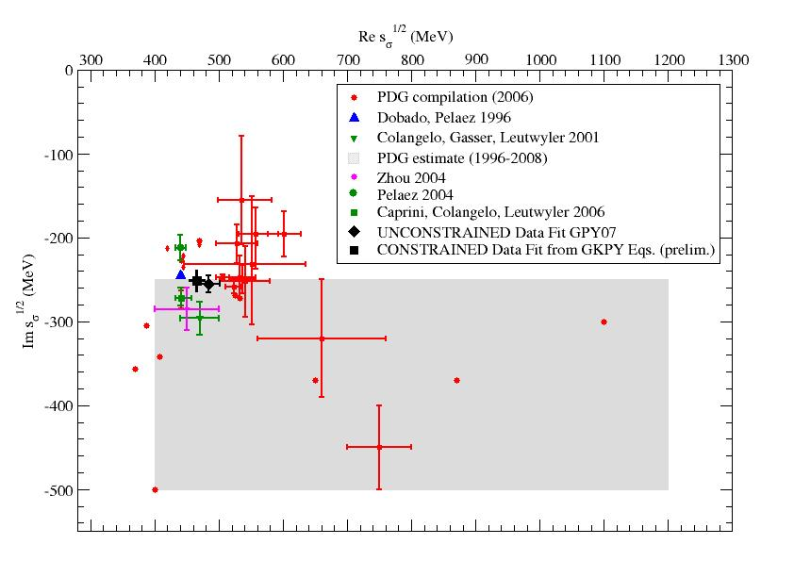
PDG uncertainties ca. 2010
Clear room
for
Improvement

Slide 10
Part of the problem: The theory
Many old an new studies based on crude/simple models,
Strong model dependences
Suspicion: What you put in is what you get out??

Slide 11
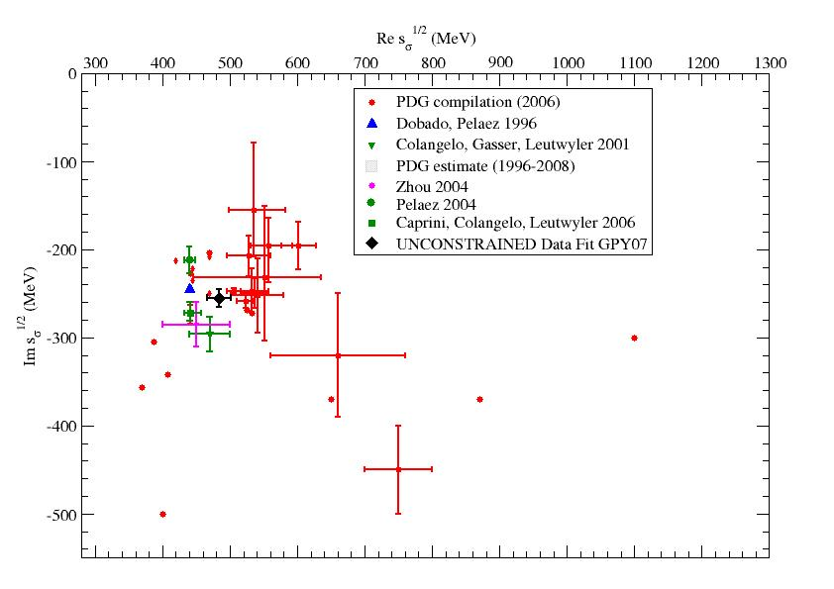
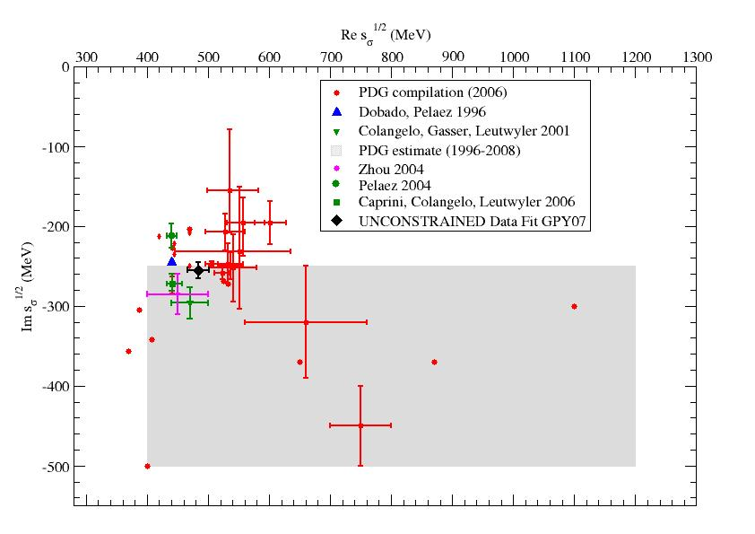
PDG uncertainties ca. 2010
Example: Poles from
same experiment!!

Slide 12
Part of the problem: The theory
Many old an new studies based on crude/simple models,
Strong model dependences
Suspicion: What you put in is what you get out??
Even experimental analysis using
WRONG theoretical tools contribute to confusion
(Breit-Wigners, isobars, K matrix, ….)
Lesson: For poles deep in the complex plane,
the correct analytic properties are essential
Analyticity constraints more powerful in scattering
Dispersive formalisms are the most precise and reliable
AND MODEL INDEPENDENT

Slide 13
The real improvement: Analyticity and Effective Lagrangians
The 60’s and early 70’s: Strong constraints on amplitudes from ANALYTICITY in the form of dispersion relations
But poor input on some parts of the integrals and poor knowledge/understanding of subtraction constants = amplitudes at low energy values
The 80’s and early 90’s: Development of Chiral Perturbation Theory (ChPT).
(Weinberg, Gasser, Leutwyler)
It is the effective low energy theory of QCD. Provides information/understanding on low energy amplitudes
The 90’s and early 2000’s: Combination of Analyticity and ChPT
(Truong, Dobado, Herrero, Donoghe, JRP, Gasser, Leutwyler, Bijnens, Colangelo, Caprini, Zheng, Zhou, Pennington...)

Slide 14
Analyticity and Effective Lagrangians: two approaches
Unitarized ChPT (Truong, Dobado, Herrero, JRP, Oset, Oller, Ruiz Arriola, Nieves, Meissner, …)
Use ChPT amplitudes inside left cut and subtraction constants of dispersion relation.
Relatively simple, although different levels of rigour. Generates all scalars
Crossing (left cut) approximated… so, not good for precision

Slide 15
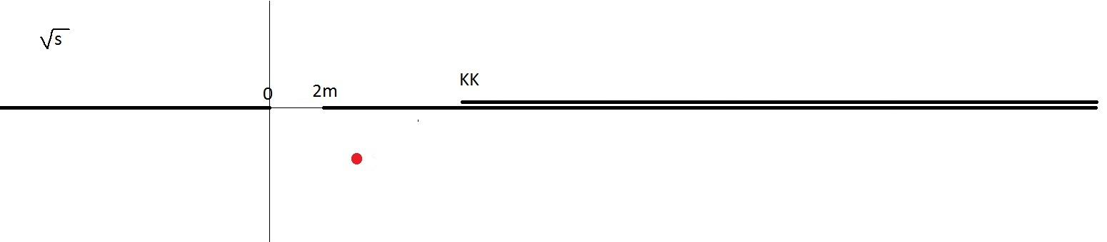
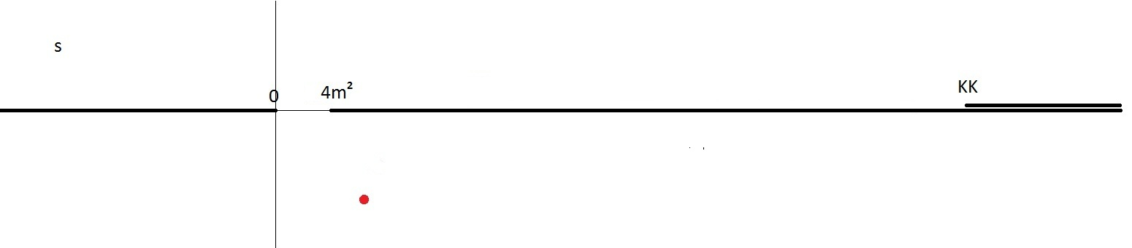
Why so much worries about “the left cut”?
It is wrong to think in terms of analyticity in terms of
Left cut due to
Crossed channels
ρ
σ
Since the partial wave is analytic in s ….
For the sigma,
the left cut
relatively close
and relevant
ρ
σ

Slide 16
Analyticity and Effective Lagrangians: two approaches
Unitarized ChPT 90’s Truong, Dobado, Herrero, JRP, Oset, Oller, Ruiz Arriola, Nieves, Meissner,…
Use ChPT amplitudes inside left cut and subtraction constants of dispersion relation.
Relatively simple, although different levels of rigour. Generates all scalars
Crossing (left cut) approximated… , not good for precision
Roy-like equations. 70’s Roy, Basdevant, Pennington, Petersen…
00’s Ananthanarayan, Caprini, Colangelo, Gasser, Leutwyler, Moussallam, Decotes Genon, Lesniak, Kaminski, JRP…
Left cut implemented with precision . Use data on all waves + high energy .
Optional: ChPT predictions for subtraction constants
The most precise and model independent pole determinations
f₀(600) and κ(800) existence, mass and width
firmly established with precision
For long, well known
for the “scalar community”
Yet to be acknowledged by PDG….
By 2006 very precise Roy Eq.+ChPT pole determination Caprini,Gaser, Leutwyler

Slide 17
PDG uncertainties ca. 2010
Data after 2000, both scattering and production
Dispersive- model independent approaches
Chiral symmetry correct
Yet to be acknowledged by PDG….

Slide 18
Some relevant DISPERSIVE POLE Determinations
(after 2009, also “according” to PDG)
GKPY equations = Roy like with one subtraction
García Martín, Kaminski, JRP, Yndurain PRD83,074004 (2011)
R. Garcia-Martin , R. Kaminski, JRP, J. Ruiz de Elvira, PRL107, 072001(2011).
Includes latest NA48/2 constrained data fit .One subtraction allows use of data only
NO ChPT input but good agreement with previous Roy Eqs.+ChPT results.
Roy equations B. Moussallam, Eur. Phys. J. C71, 1814 (2011).
An S0 Wave determination up to KK threshold with input from previous Roy Eq. works
Analytic K-Matrix model G. Mennesier et al, PLB696, 40 (2010)

Slide 19
The consistency of dispersive approaches, and also with
previous results implementing UNITARITY, ANALTICITY and
chiral symmetry constraints by many other people …
(Ananthanarayan, Caprini, Bugg, Anisovich, Zhou, Ishida Surotsev, Hannah, JRP, Kaminski, Oller, Oset, Dobado,
Tornqvist, Schechter, Fariborz, Saninno, Zoou, Zheng, etc….)
Has led the PDG to neglect those works not fullfilling these constraints
also restricting the sample to those consistent with NA48/2,
Together with the latest results from heavy meson decays
Finally quoting in the 2012 PDG edition…
M=400-550 MeV
Γ=400-700 MeV
More than 5 times reduction in the mass uncertainty
and 40% reduction on the width uncertainty
Accordingly THE NAME of the resonance is changed to…
f₀(500)

Slide 20
DRAMMATIC AND LONG AWAITED CHANGE
ON “sigma” RESONANCE @ PDG!!
The f0(600) or “sigma”
in PDG 1996-2010
M=400-1200 MeV
Γ=500-1000 MeV
Becomes
f0(500) or “sigma”
in PDG 2012
M=400-550 MeV
Γ=400-700 MeV
To my view…
still too
conservative,
but quite an improvement

Slide 21
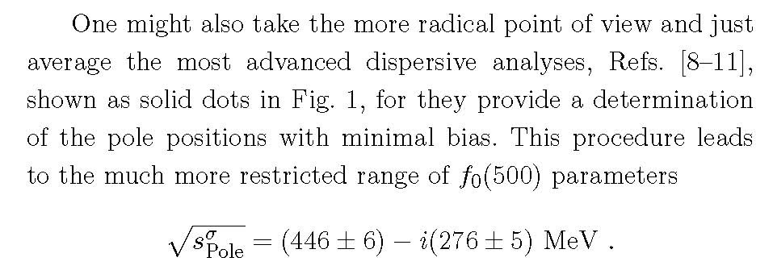
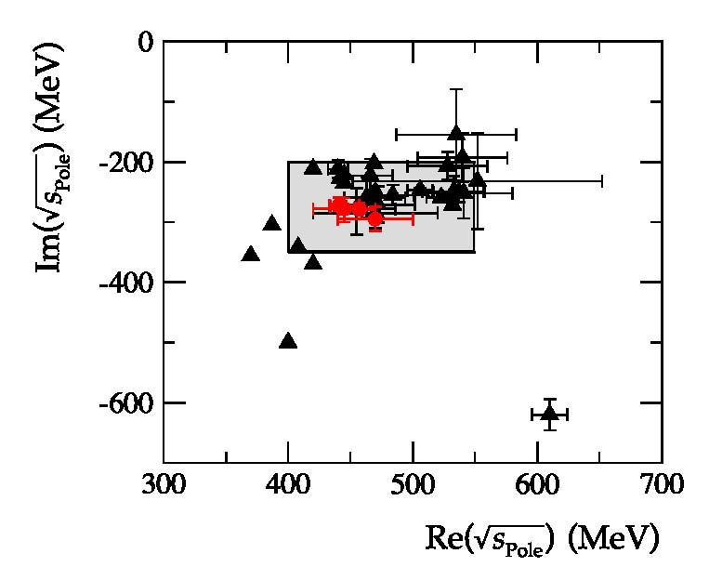
Actually, in
PDG 2012:
“Note on
scalars”
And, at the risk of being annoying….
Now I find somewhat bold to average those results, particularly the uncertainties
8. G. Colangelo, J. Gasser, and H. Leutwyler, NPB603, 125 (2001).
9. I. Caprini, G. Colangelo, and H. Leutwyler, PRL 96, 132001 (2006).
10. R. Garcia-Martin , R. Kaminski, JRP, J. Ruiz de Elvira, PRL107, 072001(2011).
11. B. Moussallam, Eur. Phys. J. C71, 1814 (2011).

Slide 22
Unfortunately, to keep the confusion
the PDG still quotes a “Breit-Wigner mass” and width…
I have no words…

Slide 23
Outline
1) Scalar Mesons: motivation & perspective
2) The σ or f0(500)
3) The f0(980)

Slide 24
DIP vs NO DIP inelasticity scenarios
Longstanding controversy between inelasticity data sets : (Pennington, Bugg, Zou, Achasov….)
Some of them prefer a “dip” structure…
... whereas others do not
GKPY Eqs. disfavors the non-dip solution García Martín, Kaminski, JRP, Yndurain PRD83,074004 (2011)
Garcia-Martin , Kaminski, JRP, Ruiz de Elvira, PRL107, 072001(2011)
Confirmation from Roy Eqs. B. Moussallam, Eur. Phys. J. C71, 1814 (2011)

Slide 25
Some relevant recent DISPERSIVE POLE Determinations of the f0(980)
(after CD2009, also “according” to PDG)
GKPY equations = Roy like with one subtraction
García Martín, Kaminski, JRP, Yndurain PRD83,074004 (2011)
Garcia-Martin , Kaminski, JRP, Ruiz de Elvira, PRL107, 072001(2011)
Roy equations B. Moussallam, Eur. Phys. J. C71, 1814 (2011).
The dip solution favors somewhat higher masses slightly above KK threshold
and reconciles widths from production and scattering

Slide 26
Thus, PDG12 made a small correction for the f0(980) mass
& more conservative uncertainties

Slide 27
Outline
1) Scalar Mesons: motivation & perspective
2) The σ or f0(500)
3) The f0(980)
4) The κ or K(800) and a0(980)
No changes on the a0 mass and width at the PDG for the a0(980)

Slide 28
Comments on the minor additions to the K(800) @PDG12
Still “omittted from the summary table” since, “needs confirmation”
But, all sensible implementations of unitarity, chiral symmetry, describing the data
find a pole between 650 and 770 MeV with a 550 MeV width or larger.
As for the sigma, and the most sounded determination comes from a Roy-Steiner dispersive formalism, consistent with UChPT Decotes Genon et al 2006
Since 2009 two EXPERiMENTAL results are quoted from D decays @ BES2
Surprisingly BES2 gives a pole position of
But AGAIN!!
PDG goes on giving Breit-Wigner parameters!! More confusion!!
Fortunately, the PDG mass and width averages are dominated by the Roy-Steiner result

Slide 29
Summary
For quite some time now the use of analyticity, unitarity, chiral symmetry, etc… to describe scattering and production data has allowed to establish the existence of light the σ and κ
These studies, together with more reliable and precise data, have allowed for PRECISE determinations of light scalar pole parameters
The PDG 2012 edition has FINALLY acknowledged the consistency of theory and experiment and the rigour and precision of the latest results, fixing, to a large extent, the very unsatisfactory compilation of σ results
Unfortunately, some traditional but inadequate parametrizations, long ago discarded by the specialists, are still being used in the PDG for the σ and the κ
I expect a more“cleaning up” in the PDG for other scalar resonances soon

Slide 30
SPARE SLIDES

Slide 31
The light scalar controversy. The theory side... classification
Scalar SU(3) multiplets identification controversial
Too many resonances for many years….
But there is an emerging picture
σ
a₀
A Light scalar nonet:
κ(800)
f₀
Non-strange heavier!!
Inverted hierarchy problem
For quark-antiquark
f₀(600) and f₀(980) are
really octet/singlet mixtures
Singlet
f₀(980)
a₀(980)
+ Another
heavier scalar nonet:
K(1400)
+ glueball
f₀ singlet
f₀
a₀(1475)
f₀
Enough f₀ states have been observed: f₀(1370), f₀(1500), f₀(1700).
The whole picture is complicated by mixture between them (lots of works here)

Slide 32
The light scalar controversy. The theory side... NON-ORDINARY nature
By ORDINARY we mean quark-antiquark, but there are other possibilities
Tetraquarks (Jaffe ’77) .Solves the inverted hierarchy problem
(issues with chiral symmerty and excess of states),
PROBLEM WITH SEMILOCAL DUALITY
Molecules (Achasov, Jülich-Bonn, Oller-Oset) are also NON-ORDINARY,…
May also have problem with semi-local duality
Modified quark-antiquark models with meson interactions
_{Van Beveren, Rupp}
Some people claim/claimed some of these
did/do not exist , like the κ(800) the f₀(1370),
etc…
(Pennington, Minkowski, Ochs, Narison…
σ as glueball supporters in general)
κ

Slide 33
Final Result: Analytic continuation to the complex plane
f0(600)
f0(980)
Roy Eqs. Pole:
Residue:
GKPY Eqs. pole:
Residue:
We also obtain the ρ pole:

Slide 34
On the use of BW and other stuff
Thus, if you insist in using whatever you want to fit your data….
It might be useful to make it public and available for others because you want to parametrize the data somehow so that anybody can use it, compare to it, etc…
Fine… but.
REFRAIN from making Physical or POLE interpretations unless you are sure your parametrizations make sense in the complex plane (analyticity), are unitary, etc…

Slide 35
A dispersive approach to π π scattering: Motivation
The dispersive approach is model independent.
Just analyticity and crossing properties
Determine the amplitude at a given energy even if there were no data precisely at that energy.
Relate different processes
Increase the precision
The actual parametrization of the data is irrelevant once inside integrals.
A precise ππ scattering analysis can help determining the
and f0(980) parameters and is useful for Form
Factors containingseveral pions in the final state

Slide 36
Structure of calculation: Example Roy and GKPY Eqs.
Both are coupled channel equations for the infinite partial waves:
I=isospin 0,1,2 , l =angular momentum 0,1,2,3….
DRIVING
TERMS
(truncation)
Higher waves
and High energy
SUBTRACTION
TERMS
(polynomials)
KERNEL TERMS
known
ROY:
2nd order
More energy suppressed
Very small
Partial wave
on
real axis
GKPY:
1st order
Less energy suppressed
small
“OUT”
“IN (from our data parametrizations)”
Similar
Procedure
for FDRs
=?

Slide 37
UNCERTAINTIES IN Standard ROY EQS. vs GKPY Eqs
Why are GKPY Eqs. relevant?
One subtraction yields better accuracy in √s > 400 MeV region
Roy Eqs.
GKPY Eqs,
smaller uncertainty below ~ 400 MeV
smaller uncertainty above ~400 MeV

Slide 38
S0 wave below 850 MeV
R. Garcia Martin, JR.Pelaez and F.J. Ynduráin PRD74:014001,2006
Conformal expansion, 4 terms are enough. First, Adler zero at m_{π}²/2
Average of πN->ππN data sets with enlarged errors, at 870- 970 MeV,
where they are consistent within 10º to 15º error.
We use data on Kl4
including the NEWEST:
NA48/2 results
Get rid of K → 2π
Isospin corrections from
Gasser to NA48/2
It does NOT HAVE
A BREIT-WIGNER
SHAPE
Tiny uncertainties
due to NA48/2 data

Slide 39
Lesson to learn:
Despite using
Very reasonable parametrizations with
lots of nice properties,
yielding nice looking fits to data…
They are at odds with
FIRST PRINCIPLES
crossing, causality (analyticity)…
And of course, to extrapolate to the complex plane
ANLYTICITY is essential

Slide 40
DIP vs NO DIP inelasticity scenarios
Now we find large differences in
GKPY S0 wave d²
UFD
CFD
992MeV< e <1100MeV
850MeV< e <1050MeV
Dip 1.02
No dip 3.49
Dip 6.15
No dip 23.68
Other waves
worse
and data
on phase
NOT described
Improvement possible?
No dip (enlarged errors) 1.66
But becomes
the “Dip” solution
No dip (forced) 2.06

Slide 41
Comparison with other results:The f₀(600) or σ

Slide 42

Comparison with other results:The f₀(600) or σ
Only second Riemann
sheet reachable
with this approach

Slide 43
Summary
Simple and easy to use parametrizations fitted to ππ scattering DATA
CONSTRAINED by FDR’s+ Roy Eqs+ 3 GKPY Eqs
“Dip scenario” for inelasticity favored
σ and f0(980) poles obtained from DISPERSIVE INTEGRALS
MODEL INDEPENDENT DETERMINATION FROM DATA (and NO ChPT).
GKPY Eqs. pole:
Residue:

Slide 44
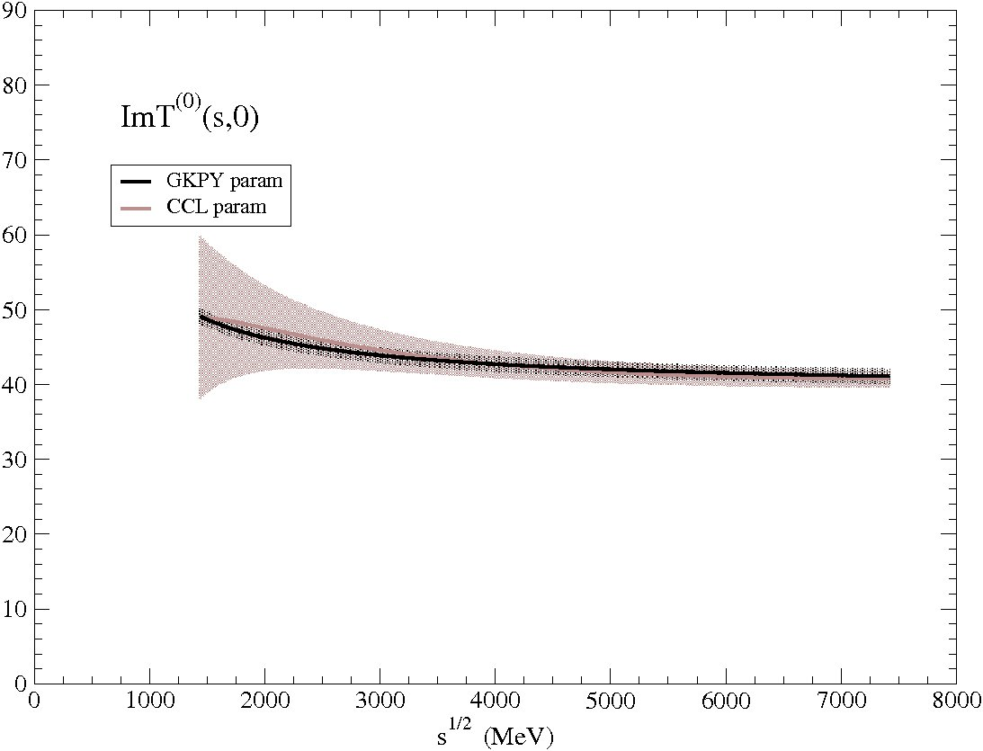
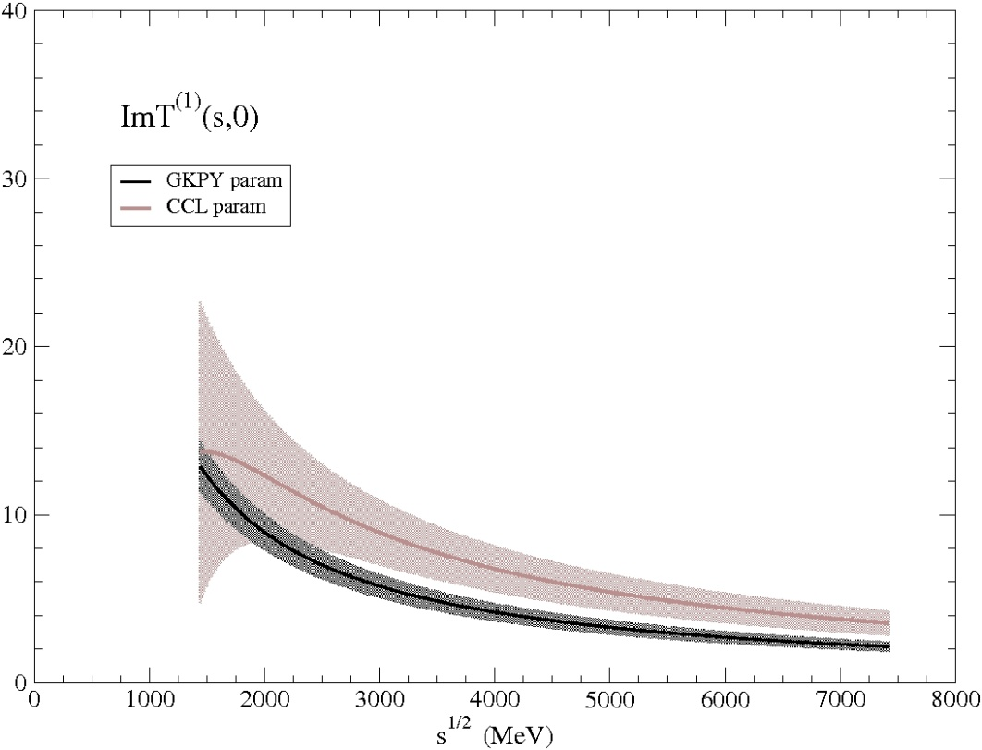
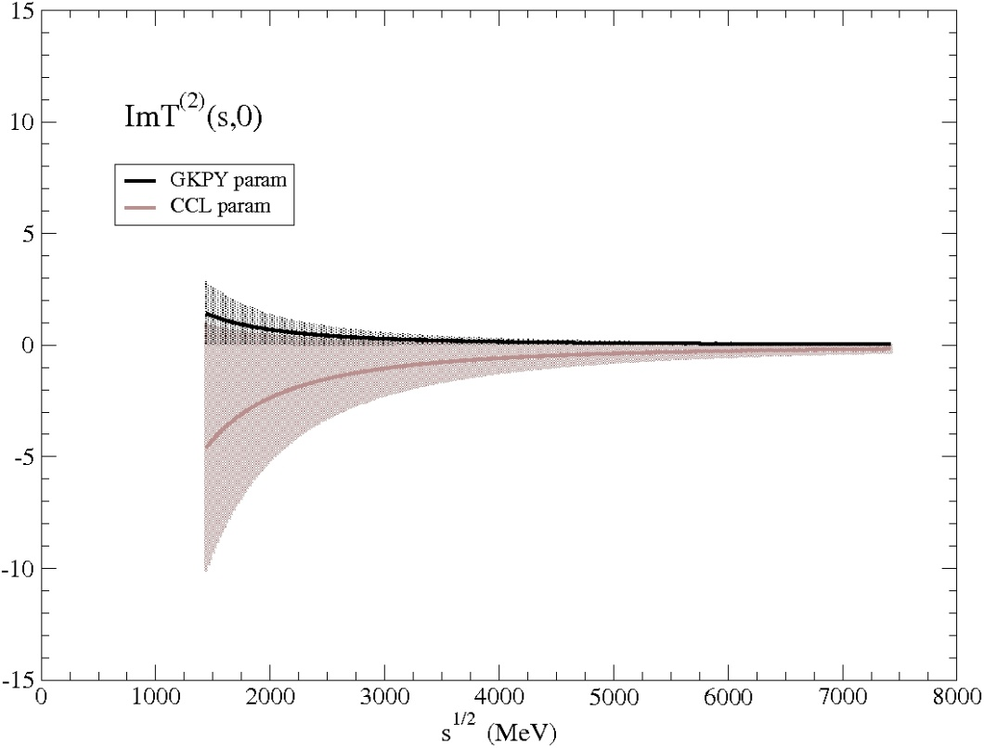
UFD

Slide 45
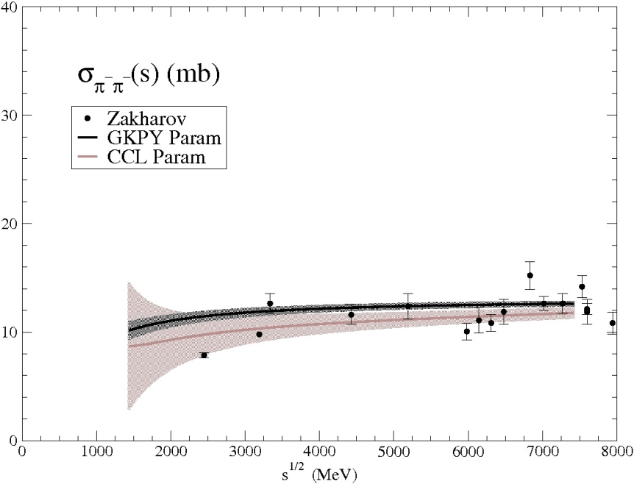
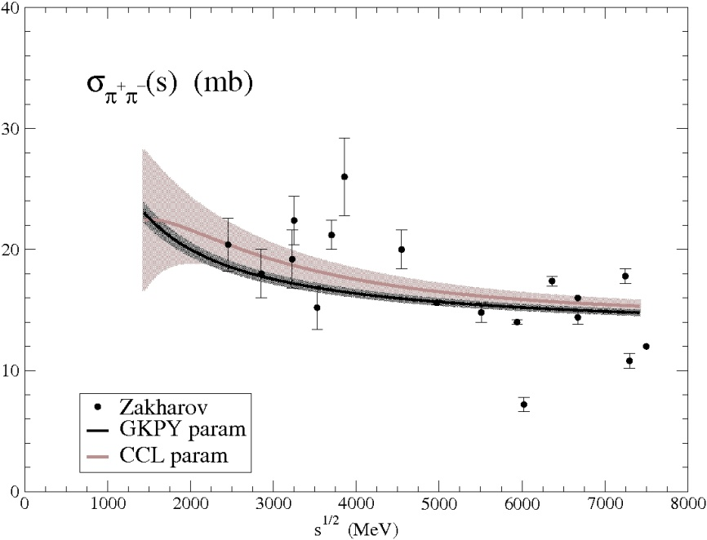
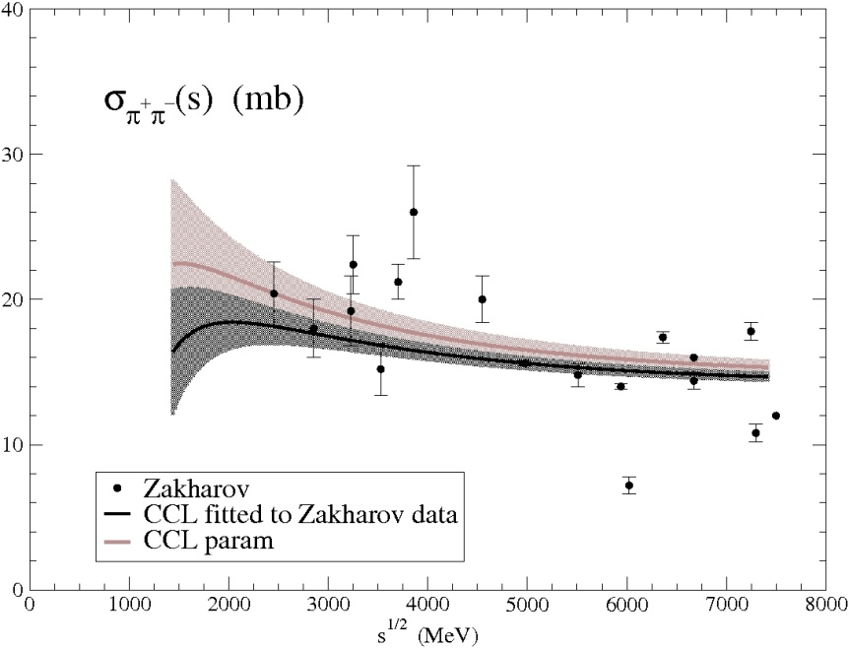
When fitting also Zakharov data

Slide 46
Most confusion
due to using
MODELS
(with questionable
analytic properties)
1973
1972
1987
1979
’95 model by
one of the authors of
PDG review

