Slide 1
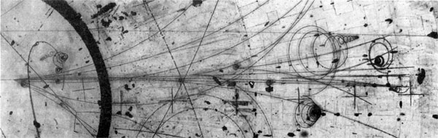
The Outlook for Improved η→π⁰γγ Measurements
D. Mack (TJNAF)
Chiral Dynamics 2012
August 8, 2012

Slide 2
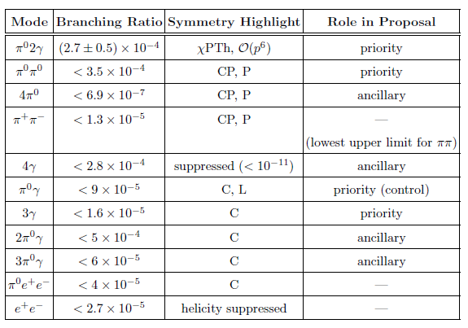
Jlab Eta Factory Physics Program
The niche of the JEF program will be η decays resulting in 3-4 γ’s which traditionally have had high backgrounds due to non-resonant production of
2-3 π⁰’s as well as the large branching ratio decay η→3π⁰.
In addition to searching for new sources of C and CP violation in η→3γ and η→2π⁰ , for the doubly radiative decay η→π⁰2γ we hope to make definitive measurements of Γ and dΓ/dM_{2γ}.

Slide 3
Selection Rule Summary Table: η Decay to π⁰’s and γ’s
Key:
Gamma Column implicitly includes γ*→e⁺e⁻
η→X | 0π | 1π | 2π | 3π | 4π
0γ |  |  | P, CP |  | P, CP
1γ |  | C, CP | C, CP | C, CP | C, CP
2γ
3γ | C | C | C | C | C
4γ
C and P allowed, observed
L = 0
L = 1
L = even or odd (no parity constraint)
.
.
.
.
.
C and P
allowed, upper limits only
C, CP
C violating, CP conserving, etc.
Forbidden by energy and momentum
conservation.
With respect to all-neutral final states, there are many allowed channels (green squares), but the only ones which have been observed are the two large branches (η→2γ, 3π⁰) plus the rare decay under discussion η→π⁰2γ.

Slide 4
Proposal Update
The JEF “boosted η” program will take roughly 5 years to get up and running following PAC approval. (Eg, calorimeter funding, construction, Hall D commissioning, etc.)
Our proposal, PR12-12-003, was submitted to this year’s Program Advisory Committee and deferred. (In total, 6 of 19 proposals were deferred. Formal report still unavailable.) The proposal can be downloaded from
https://cnidlamp.jlab.org/RareEtaDecay/JDocDB/node/10
There are representatives at this conference from COSY, MAMI, KLOE, and BES with much experience measuring η decays.
We are happy to receive constructive criticism and/or expressions of interest from experimentalists and theorists.*
* Contact person LiPing Gan (U North Carolina, Wilmington) ganl@uncw.edu

Slide 5
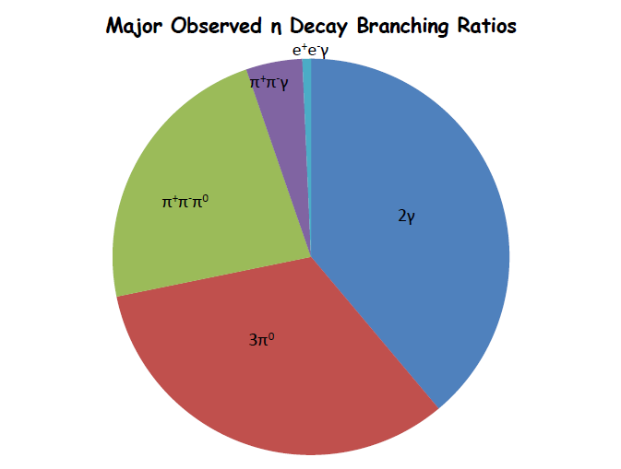
The Most Common η Decay Modes
PDG 2011
The light blue sliver represents BR = 0.7%.
All other η rare decays would be invisible on this pie chart.
All-neutral final states
in yellow.
Final State | Branching Ratio (decreasing order) | Physics Interest
2γ | 0.39 | η, η’, π⁰ mixing
3π⁰ | 0.33 | m_{u} – m_{d}, ππ scattering length
π⁺π⁻π⁰ | 0.23
π⁺π⁻γ | 0.046
Remember:
These two reactions can be a big background for all-neutral decays
η→lotsa photons.

Slide 6
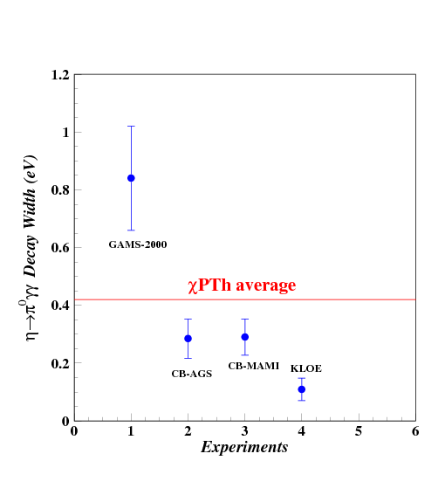
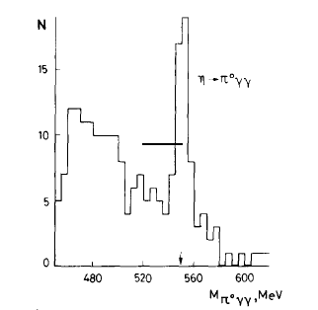
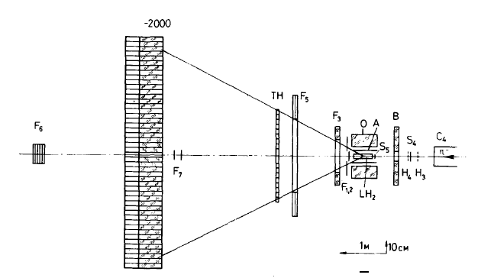
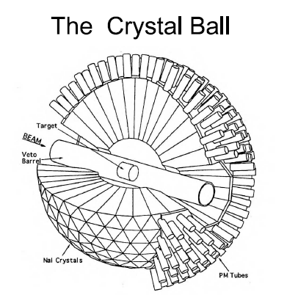
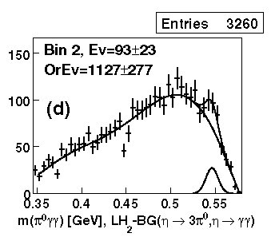
Recent History of η→π⁰γγ Measurements
GAMS Experiment
The η’s were produced with 30 GeV/c π⁻ beam in the π⁻p→η + neutron
Decay γ’s were detected by lead-glass calorimeter
After 1980
High energy η production
Low energy η production
CB –AGS experiment
The η’s were produced with 720 MeV/c π⁻ beam through the π⁻p→ηn
Decay γ’s energy range: 50-500 MeV
NaI
Major Background
π⁻p→ π⁰π⁰ + neutron
η →π⁰π⁰π⁰→6γ

Slide 7

Proposed Experiment in Hall D
FCAL
η→π⁰γ
Simultaneously measure the η→π⁰γγ, η →π⁰π⁰, η→3γ, and
Boosted η’s produced on LH₂ target with 9-11.7 GeV tagged photons: γ+p → η+p
Upgraded Forward Calorimeter with PbWO₄ (FCAL-II) to detect multi-photons from the η decays
Further reduce γp→ π⁰π⁰p and other background by detecting recoil p’s with GlueX detector
7

Slide 8
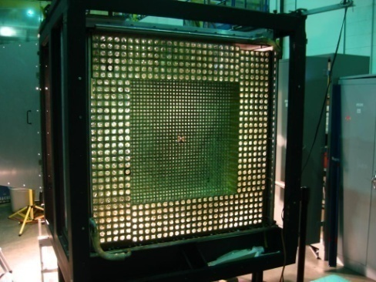
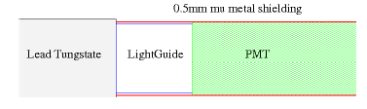
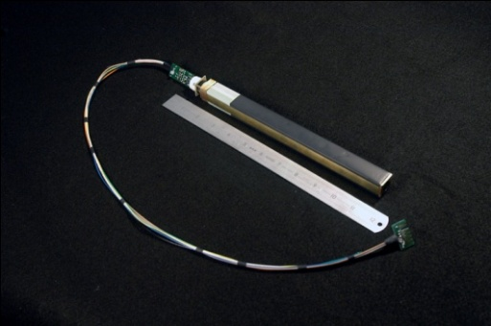
New Equipment: FCAL-II
PrimEx HyCal
118x118 cm² (3445 PWO modules) with a 12x12 cm² central hole.
Similar to the inner part of the PrimEx HyCal with minor modifications to the magnetic shielding.
Energy and angle resolutions will be a factor of two better than current FCAL-I (lead glass).
Also more rad-hard by one order of magnitude.

Slide 9
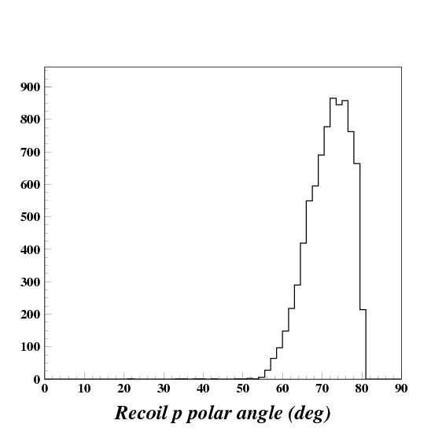
Kinematics and Relative Yield of γ+p→η+p with ~10 GeV Tagged Photons
η’s are mostly produced at 1-5 degrees.
The η’s carry the majority of the beam energy.
Angle θ_{eta} (Deg)
Recoil protons are produced at 60-80 degrees.
A co-planarity cut will help suppress 2π⁰ continuum like
γ+p→π⁰+∆⁺→
2π⁰+p
Recoil θ_{p} vs θ_{eta} (Deg)
The only η’s of interest are exclusively produced thru this 2-body reaction.
Recoil θ_{p} (Deg)

Slide 10
Jlab Hall D η Production Rate
LH2 target length L = 30cm, ρ = 0.0708 g/cm³
The exclusive, forward γ+p→η+p cross section ~70 nb (θ_{η}=1-6º)
Tagged photon beam intensity N_{γ}~ 4x10⁷ Hz (for E_{γ}~9-11.7 GeV)
This is a high enough rate to qualify Jlab Hall D as an η factory.
(KLOE-I
η production rate was about 1 Hz.)
Hence ≈3.1x10⁷ η’s produced per Jlab “year” (100 live days).

Slide 11
Optimizing Distance Between
Tgt Center and Calorimeter Face
Separation too large: we lose signal.
Too close: increase in peaking background from shower merging.
We used the figure of merit:
150x150 cm² PWO Cal.
Signal is η→π⁰γγ
Background is η→3π⁰
Signal window is ±3σ
The 118cmx118cm calorimeter from our reference design is roughly optimized at about 6m separation.
A larger 150cmx150cm calorimeter could not be optimized in the space available in Hall D, but would nevertheless have nearly 50% higher FOM.
118x118 cm² PWO Cal.
Note suppressed zero

Slide 12
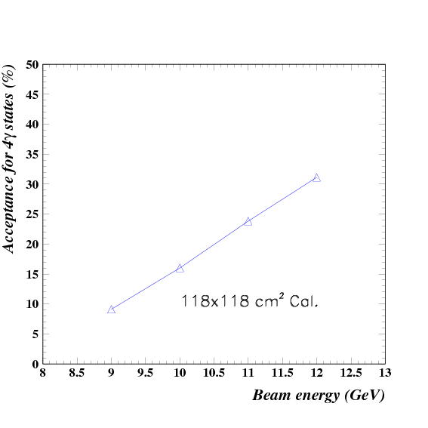
Acceptance for 4γ Final State with Calorimeter at 6m
At 6m separation, the acceptance of the 118cmx118cm calorimeter from our reference design is ~20%.
Photons are predominantly lost around the calorimeter circumference (rather than down the beam hole). The acceptance for a 150cmx150cm calorimeter would be ~40%.
For 4γ final state
~20%

Slide 13
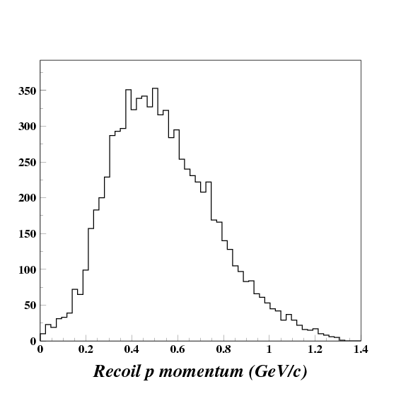
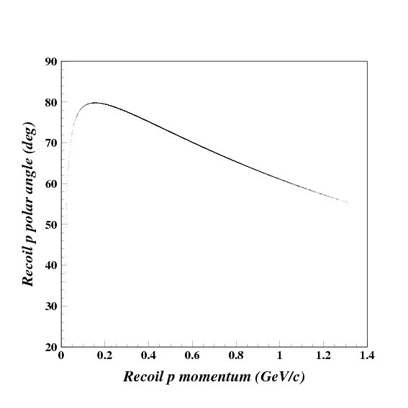
Detection of Recoil Proton with GlueX
Recoil proton kinematics
Polar angle ~55º-80º
Momentum ~200-1200 MeV/c
We assume a 60% efficiency for proton reconstruction.

Slide 14
η→π⁰2γ Detection Rate
  BR(η→π⁰γγ ) ~ 2.7x10⁻⁴
  Average geometrical acceptance ~20% (118x118 cm² FCAL-II)
  Event selection efficiency ~60%
Hence ≈1000 η→π⁰2γ events produced per Jlab “year” (100 live days).

Slide 15
Invariant Mass and Elasticity Resolutions
PWO
σ=3.2 MeV
σ=6.9 MeV
Mγγ
Mγγπ⁰
σ=0.0121
Elasticity
Pb
Glass
σ=15 MeV
σ=6.6 MeV
σ=0.0257
Mγγπ⁰
Mγγ
Elasticity

Slide 16
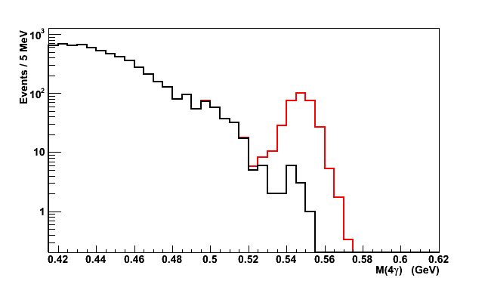
S/B Ratio vs. Calorimeter Types signal: background:
Pb Glass FCAL
@Z= 9m
PWO
S/N=0.5:1
S/B=10:1
PWO provides
major improvements
Granularity
Energy and position resolutions.
PWO
Invariant Mass of 4γ (GeV)
Peaking Bkg
Event selection cuts:
Elasticity
Invariant mass.
Elasticity
Elasticity

Slide 17
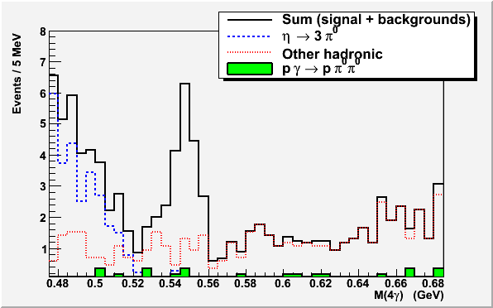
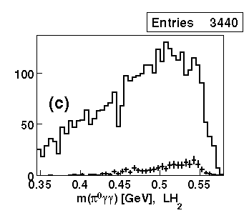
Filter Background with η Energy Boost
Jlab: boosted η production
(E_{γ} = 9-11.9 GeV)
Example: low boost η production
Signal: η→π⁰γγ
η →π⁰π⁰π⁰
Note:
Statistics is normalized to 1
beam day.
Bkg will be further reduced by
requiring only one pair of γ’s
to have the π⁰ invariant mass.
S. Prakhov et al. Phy.Rev.,C78,015206 (2008)

Slide 18
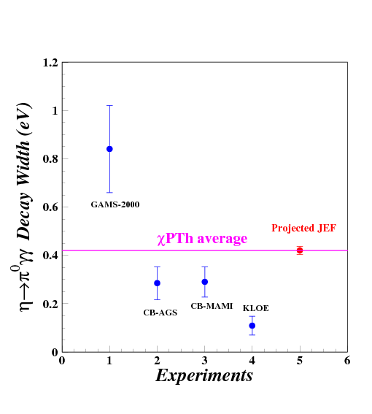
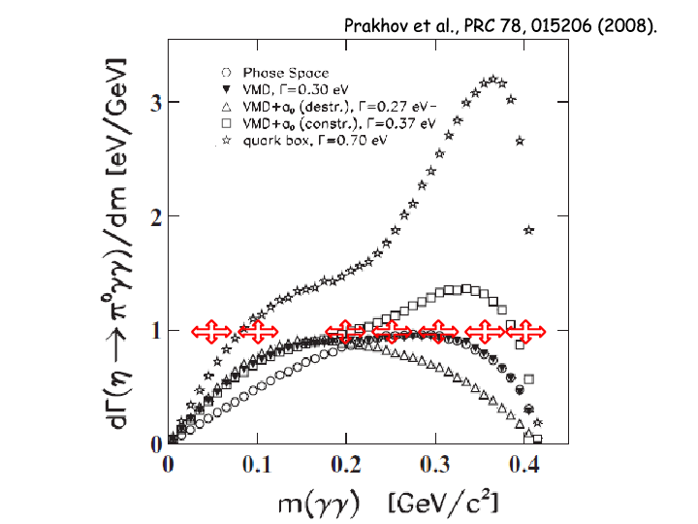
Projected JEF Measurement on η→π⁰2γ

Slide 19
FCAL-II Projected Cost (118x118cm²)
Item | Channels | Cost/Channel | Cost
Crystal | 3445 | $250 | $0.86M
PMT/base | 3445 | $400 | $1.38M
Flash ADC | 3445 | $378 | $1.30M
HV | 3445 | $300 | $1.03M
 |  |  | ---------------
Total |  |  | $4.57M
Possible cost offsets from loans
PrimEx | 1200 | $650 (xtal+pmt/base) | $-0.78M
FCAL-I | 2800 | $378 (Flash ADC) | $-1.06M
Revised Total |  |  | $2.73M-$4.57M
For the 118x118 cm² FCAL-II, the total cost is $2.7M to $4.6M.
This is within the $4M range of an NSF MRI assuming a small equipment loan or foreign funds or Physics Division support for ADCs or HV.

Slide 20
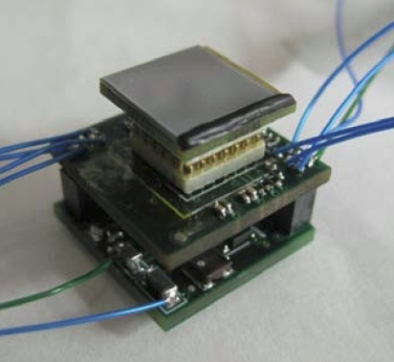
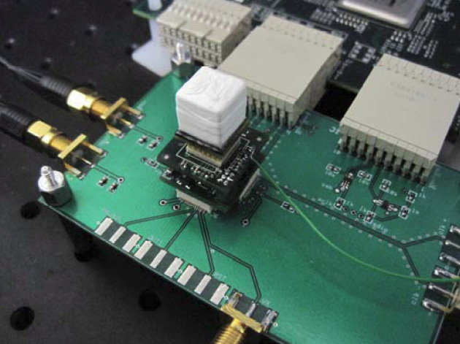
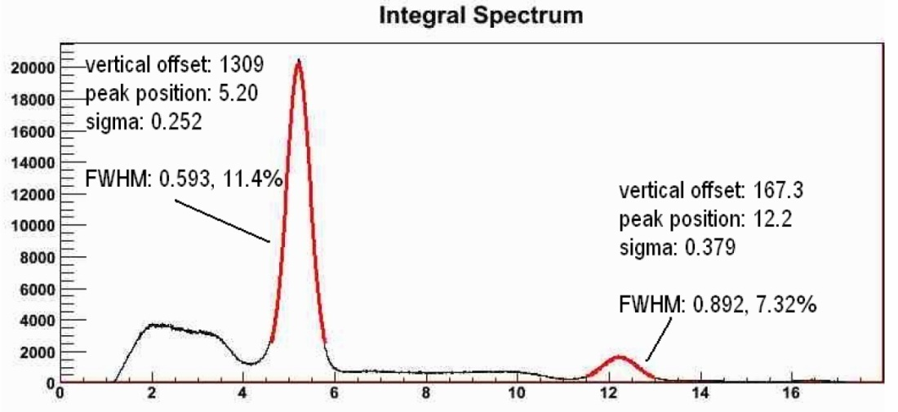
Silicon Photomultiplier (SiPM) with integrated ADC readout
SBIR project between University of Massachusetts and
Radiation Monitoring Devices, Inc. (RMD)
Sensitive area of 2x2 cm² is matched to the PRIMEX lead
tungstate block and HYCAL geometry
250 MSPS 12-bit ADC integrated into the detector
No sensitivity to magnetic fields
Eliminates need for
  HV
  HV and signal cables
  JLab FADC-250 modules or other ADC’s/TDC’s
RMD cost estimate in 2008, $50 to $150 per channel
SiPM
ADC board
Prototype SiPM with integrated 250 MSPS 12-bit ADC readout
Integral pulse spectum with ²²Na source
1 cm³ LYSO crystal mounted on prototype detector, on FPGA readout board

Slide 21
Summary
η rare decays to all-neutral final states suffer from a unique large background from η→3π⁰ →6γ.
Significantly boosting the η’s greatly increases the typical energy loss when a photon is lost out of the acceptance. A missing energy cut thus becomes much more effective at removing the η→3π⁰ background.
Detection of the recoil proton using the GlueX central tracker will allow the expected co-planarity in γ+p→γ+p to be verified, reducing the background from continuum 3-body final states like γ+p→2π⁰ + p.
A new Lead Tungstate calorimeter using Hall D’s ~10 GeV tagged photon facility will permit revolutionary advances in Signal/Background for η→π⁰2γ
and other rare decays of the η meson leading to 3-4 γ’s.

Slide 22
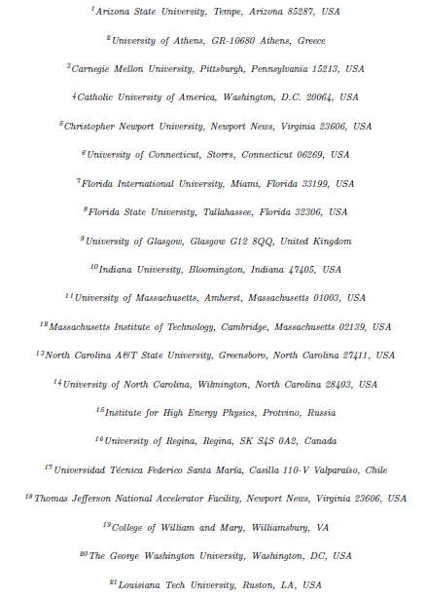
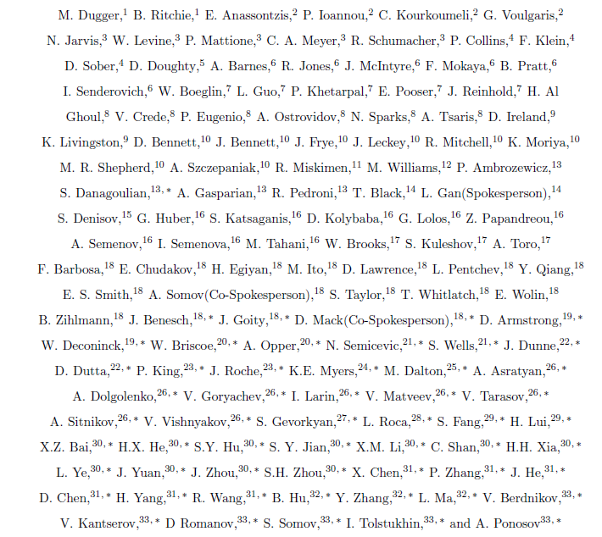
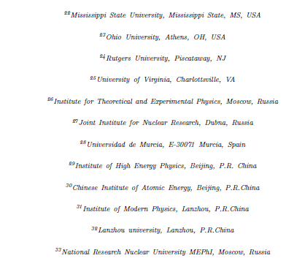
Collaboration
(GlueX Collaboration and Other Participants, 33 institutes)

Slide 23
Extras

Slide 24
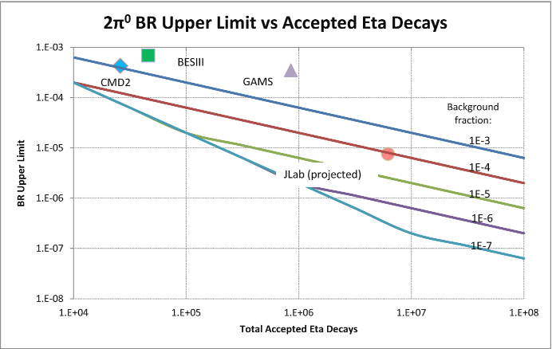
Jlab’s Projected Sensitivity for η→2π⁰
This is a graphical presentation of the relationship between the BR upper limit and two key experimental parameter: N_{η}ε and f_{bkg}.
It allows us to compare experiments and understand how to do better.
Improvement will come from bkg reduction and a larger number of accepted η’s.
(Apparently, modern experiments with large η datasets haven’t even tried.)

Slide 25
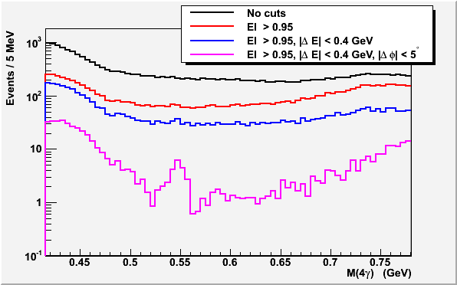
Effect of Cuts on 4γ States
Event Selection
Elasticity is
EL=ΣE_{γ}/ E_{tagged-γ}
Energy conservation
for γ+p → η+p reaction:
ΔE=E(η)+E(p)-E(beam)-M(p)
Co-planarity Δφ= φ(η)- φ(p)
Note:
Statistics is normalized to
1 beam day.
BG will be further reduced
by requiring that only one
pair of γ’s have the π⁰
invariant mass.
Signal: η→π⁰γγ

Slide 26
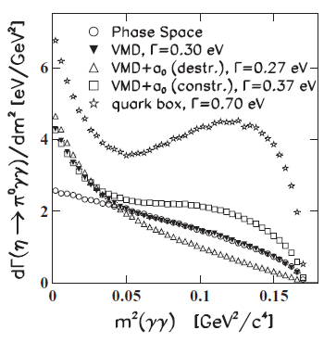
Allowed Rare Decay η→π⁰γγ
A stringent test of the χPTh prediction at Ο(p⁶) level
  Tree level amplitudes (both Ο(p²) and Ο(p⁴)) vanish;
  Ο(p⁴) loop terms involving kaons are suppressed by large mass of kaon
  Ο(p⁴) loop terms involving pions are suppressed by G parity
  The first sizable contribution comes at Ο(p⁶) level
A long history of large discrepancies exists between experimental results and theoretical predictions.
Current experimental value in PDG is: BR(η→π⁰γγ )=(2.7±0.5)x10⁻⁴
Prakhov et al., Phys. Rev. C78, 015206

Slide 27
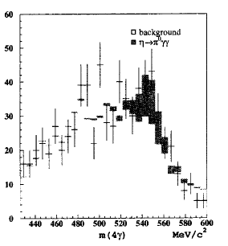
Advantages of JLab
High energy tagged photon beam to reduce the background from η→ 3π⁰
  Lower relative threshold for γ-ray detection
  Improved missing energy resolution
Recoil proton detection to reduce non-coplanar backgrounds like non-resonant γp→π⁰π⁰p
High resolution, high granularity PbWO₄ Calorimeter
  improved invariant mass, energy and position resolutions
  fewer overlapping showers, thus reducing background from η→ 3π⁰
  Fast decay time (~20ns) and Flash ADCs → reduced pile-up
High statistics to provide a precision measurement of Dalitz plot
High energy η-production
Low energy η-production
GAMS
CB
KLOE

Slide 28
Detectable η Decays to 4γ States
Accepted η decays/”year” = Produced x Acceptance x Efficiency
= 3.1x10⁷ x 20% x 60%
= 3.7x10⁶

Slide 29
Jlab Niche Summary
Produce a competitive number of η’s (10⁷ – 10⁸) in one year with acceptance for decay products of 1/3 or higher.
(It’s hard to do better than that without running into dead-time and pile-up issues. For every η produced, a “million” other particles hit the detector.)
2. Achieve backgrounds up to 2 orders of magnitude lower than previous experiments for neutral channels due to
  i. Fine grained, high resolution calorimeter
  ii. Beam of boosted, exclusively produced η’s
  (Our biggest improvement in FOM comes from reducing background.)
Under these circumstances, the JLab Eta Factory in a 1 year run could lower existing BR’s for many rare η decays to all-neutral final states by 1-1.5 orders of magnitude, a very noteworthy achievement.

Slide 30
Jlab’s Niche: η Rare Decays to All-Neutral Final States
KLOE has produced fairly large η datasets and done a nice job extracting physics from charged final states for common decay branches.
Mainz and WASA-at-COSY have made precise measurements of all-neutral final states for the common decay branches.
A poorly exploited but exciting niche wrt η decays is rare decays to all-neutral final states because it requires features no previous η decay experiment has had:
1. boosted etas to suppress the background from η→3π⁰→6γ. (more later)
Hall D’s tagged photon facility and 30cm LH2 target, which are under construction, can provide the boosted η’s.
2. superb calorimetry
Such as a large PbWO₄ calorimeter.

Slide 31
Beam Time Request
Run type | Beam Time (days)
LH₂ Production | 100
Empty target and target out | 7
Tagger efficiency, TAC runs | 3
FCAL-II commissioning, Calibration | 12
Luminosity optimization | 14
Total | 136
We will collect about one order of magnitude more η→π⁰γγ events than current existing results

Slide 32
Selection Rules for η→Nπ+Mγ
(for N,M ≥1 not covered in previous slides)
η: I^{G} (J^{PC}) = 0⁺ (0⁻⁺) π⁰: I^{G} (J^{PC}) = 1⁻ (0⁻⁺) γ: I (J^{PC}) = 0,1 (1⁻⁻)
M_{η} = 547.9 MeV/c² M_{π0} = 135.0 MeV/c² M_{γ} = 0 MeV/c²
Momentum/Energy N = 1,2,3,4; M = 1,…,∞; N+M ≥ 2 allowed
G parity not meaningful with photons
Parity: P_{η} = P_{Nπ+Mγ}
-1 = (-1)^{N}(-1)^{M} (-1)^{L}
(The final state can usually select a value of L that conserves parity.
The case of a single γ is unique since only L=1 is allowed.)
No constraints from parity.
C parity: C_{η} = C_{Nπ+Mγ}
+1 = (+1)^{N}(-1)^{M} (note: only the number of photons matters)
  hence M = even. Possible decays are η→Nπ⁰2γ, Nπ⁰4γ, etc.
What is observed? The η decays to π⁰2γ about 0.03% of the time. C parity blocks the otherwise parity-allowed decays like π⁰γ, π⁰3γ, etc.
Note that the η decays to π⁺π⁻γ with a 4.6% branching ratio. C is evaded by π± !
v2

Slide 33
Interesting All-Neutral Final States
Mode | Branching Ratio (PDG) | Physics Highlight | Role in Proposal
π⁰ 2γ | ( 2.7 ± 0.5 ) × 10 ⁻ ⁴ | χPTh, Ο(p⁶) | priority
2π⁰ | <3.5 × 10 ⁻⁴ | CP, P | priority
3γ | <1.6 × 10 ⁻ ⁵ | C | priority
π⁰ γ | <9 × 10 ⁻ ⁵ | C, L, gauge inv. | (control)
4γ | <2.8 × 10 ⁻⁴ | Suppressed (<10⁻¹¹) | ancillary
π⁰ π⁰ γ | <5 × 10 ⁻ ⁴ | C | ancillary
π⁰ π⁰ π⁰ γ | <6 × 10 ⁻ ⁵ | C | ancillary
4π⁰ | <6.9 × 10 ⁻ ⁷ | CP, P | ancillary

Slide 34
Other Unobserved η Decay Modes
PDG 2011
Final State | Branching Ratio (upper limit) | Physics Interest
2π⁰2γ | < 1•10⁻³
4γ | < 3•10⁻⁴ | Low SM branching ratio
e⁺e⁻ | < 3•10⁻⁵ | Helicity suppressed SM process which could be enhanced by s- or t-channel exchange of exotic particles
2e⁺e⁻ | < 7•10⁻⁵
e⁺e⁻μ⁺μ⁻ | < 2•10⁻⁴
2μ⁺2μ⁻ | < 4•10⁻⁴
μ⁺μ⁻π⁺π⁻ | < 4•10⁻⁴
π⁺π⁻2γ | < 2•10⁻³
π⁺π⁻π⁰γ | < 5•10⁻⁴
π⁰μ⁺μ⁻γ | < 3•10⁻⁶

Slide 35
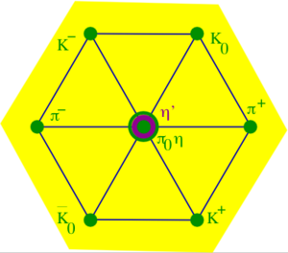
Why Are η Meson Decays Unique and Interesting?
The most massive member of the pseudoscalar meson octet (547.9 MeV/c²)
Significant strange quark content (but no net strangeness)
Since the η, π⁰, and γ are states of good C, decays of the η to all-neutral final states permit interesting C and CP tests.
(u*ubar + d*dbar - s*sbar)/√3
Given the mass of the η, one would naively expect it to quickly decay to multiple pions and have a decay width O(100) MeV. But due to inhibitions by chiral symmetry and selection rules, the η decay width is only Γ_{η} = 1.3 KeV. (The ρ meson width by contrast is Γ_{ρ} = 149 MeV.)
Because the isospin conserving strong interaction does not participate in η decays, potential exotic phenomena in the isospin violating strong interaction could be enhanced by 5 orders of magnitude in an η decay compared to a ρ decay for example.
η decays provide a unique, flavor-conserving laboratory to search for new sources of C, P, and CP violation between the strong and weak scales.

Slide 36
Observed Rare η Decay Modes
PDG 2011
Final State | Branching Ratio (decreasing order) | Physics Interest
e⁺e⁻γ (light blue sliver!) | 7.0•10⁻³ | η electromagnetic form factor F(q²,0)
μ⁺μ⁻γ | 3.1•10⁻⁴ | η electromagnetic form factor F(q²,0)
π⁰2γ | 2.7•10⁻⁴ | O(p⁶) matrix elements
π⁺π⁻e⁺e⁻ | 2.7•10⁻⁴
μ⁺μ⁻ | 5.8•10⁻⁶
All-neutral final state.
Except for π⁰2γ, these reactions can be thought of as higher order QED processes, O(α)- or O(α²)-suppressed versions of a common decay. For example, η→2γ becomes
η→γ + γ_{v} → γ + e⁺e⁻
Where the decay spectrum dΓ/dM_{γ} provides information on the EM structure of the η.
(Note these virtual photons have a real mass, unlike the virtual photons in electron scattering. )

Slide 37
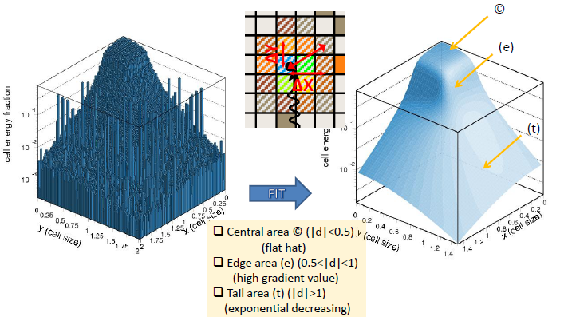
PWO Transverse Shower Profile
Experimental electron scan data (E_{e}~4 GeV)
extracted shower profile function

Slide 38
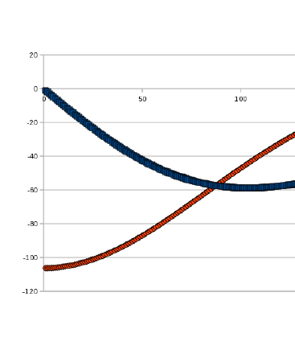
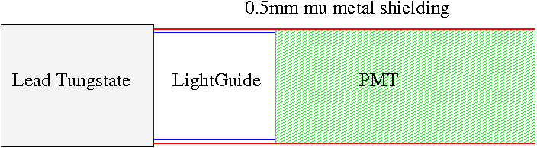
Magnetic Shielding of FCAL-II PMTs
The transverse shielding factor of a cylinder
of material with permeability μ is
SF_{T} = H_{out}/H_{in} = ¾ (t/r) μ
where t is the thickness, and r is the radius.
(The longitudinal shielding factor is 10x smaller.) The field is not high enough to saturate mu metal, so a single layer is sufficient. Assuming 0.5mm of co-netic (μ = 50,000) we estimate:
B Field
(G)
B_{X}
SF_{T} | B_{T}^{max} | Shielded Field = B_{T}^{max}/SF_{T}
2000 | 55 G | 0.03 G (negligible)
B_{Z}
Radial Distance from Solenoid Z axis (cm)
SF_{L} | B_{L}^{max} | Shielded Field = B_{L}^{max}/SF_{L}
200 | 105 G | 0.5 G (acceptable)
For R_{calorimeter} = 0 to 83cm:
B_{x} = 0-55 Gauss
B_{z} = 60-105 Gauss
B field must be mitigated. The small diameter of our PMTs helps a lot (18.6mm or 0.75”).
Note the new lightguide.

Slide 39
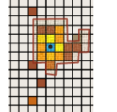
Island algorithm for the PWO calorimeter by I. Larin
Island algorithm:
Find maximum energy deposition cell
Declare all simply connected area around as initial “raw” cluster
Try to split “raw” cluster into many hits based on the shower profile function

Slide 40
Probability of two-cluster separation vs. distance between hits
Study done by using PrimEx-II snake scan data
First cluster: “permanent” with energy 5 GeV
Second cluster: “moving” with energy 1-5 GeV
Artificially split events are counted as
missing
Reconstruction efficiency (100%)
PWO
Pb glass
Reconstruction efficiency (100%)
Separation distance (cm)
Separation distance (cm)

Slide 41
Can we use existing FCAL located at 10 m?
Z=6 m
PWO
σ=6.7 MeV
Pb glass
σ=14.5 MeV
Invariant Mass of 4γ (GeV)
Z=6 m
Pb glass
Invariant Mass of 4γ (GeV)
σ=16.2 MeV
Invariant Mass of 4γ (GeV)

Slide 42
Detection of recoil p by GlueX

Slide 43
Comparison of different crystals
(From R. Y. Zhu)

