Slide 1
MEM analysis of the QCD sum rule and
its Application to the Nucleon spectrum
K. Ohtani, P.Gubler and M. Oka, Eur. Phys. J. A 47, 114 (2011),
K. Ohtani, P.Gubler and M. Oka, in preparation
Tokyo Institute of Technology Keisuke Ohtani
Collaborators : Philipp Gubler, Makoto Oka

Slide 2
Outline
Introduction
Nucleon QCD sum rules
Parity projected sum rule
Conclusion

Slide 3
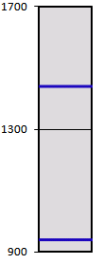
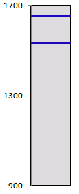
Introduction
Positive parity
Negative parity
N(1650)
N(1535)
The mass difference between nucleon ground state
and N(1535) is about 600 MeV.
N(1440)
At finite temperature and density, these two
states will be degenerate due to the chiral
symmetry restoration.
It is predicted that Chiral symmetry breaking
cause these difference.
p,n
To investigate these properties from QCD, non perturbative
method is needed.
As a first step, we use QCD sum rules and examine the mass of
the nucleon states in the vacuum.

Slide 4
Nucleon QCD sum rules
: interpolating field, which consists of quark operators and
has the same quantum number as the hadron of interest.
where、
In the following, we fix the value of α to 1.
In the physical energy region such as , the information on
hadron properties is contained in the spectral function.
Typical behavior of the spectral functions:

Slide 5
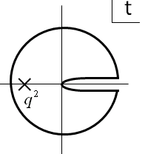
Nucleon QCD sum rules
can be calculated in the deep Eucledian region ( )
by the operator product expansion (OPE) :
Using the dispersion relation and the proper transformation,
we can get the following equations.
Borel sum rule:
Gaussian sum rule:

Slide 6
Nucleon QCD sum rules
Traditional method :
The form of the spectral function is assumed to be of the
“Pole + continuum” form
To improve
Maximum entropy method (MEM)
MEM is a statistical approach based on Bayes’ theorem.
The result strongly depends on the “Pole + continuum” ansatz.
The advantage :
The assumption ‘Pole + continuum ` is not necessary.
Most probable spectral function is obtained.

Slide 7
Nucleon QCD sum rules
Using Bayes’ theorem,
G: OPE data
H : prior knowledge on the spectral function
Likelihood function :
Prior probability :
: default model
The most probable spectral function can be obtained
by maximizing .

Slide 8
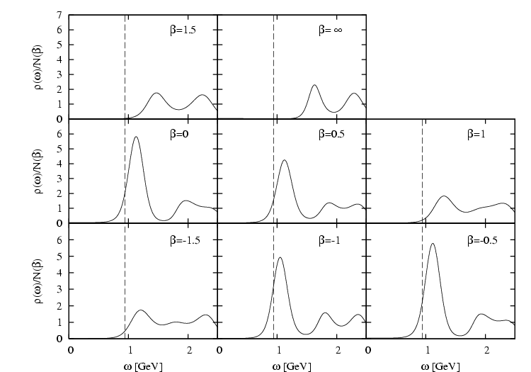
Nucleon QCD sum rules
Interpolating field :
Eur. Phys. J. A 47, 114 (2011)
We succeed in applying the MEM analyses to the nucleon QCD sum rules.
The spectral functions corresponding to the different interpolating field
have distinct behavior.

Slide 9
Nucleon QCD sum rules
The problem of the analyses
The spectral functions contain the information of the positive and
negative parity states.
In these analyses, we ignore the α_{ｓ} corrections.
We can not determine the peak around 1.6 GeV corresponds to
either positive or negative parity state.
Parity projected sum rule
1st order α_{ｓ} correction of perturbative term is about 90 % of the
leading term. Therefore the validity of the analysis is suspicious.
Phase - rotated kernel

Slide 10
Parity projected sum rule
As for the time ordered correlator:
Both of and contain the contribution of the
positive and negative parity states.
We consider the forward correlator.
D. Jido, N. Kodama and M. Oka, Phys. Rev. D 54, 4532
After the contributions of positive and negative parity states
are separated, the analysis can be carried out.

Slide 11
Parity projected sum rule
As for the parity projected QCD sum rules, we use following equation.
Here,
Chiral even terms
Chiral odd terms
The difference between positive and negative parity states is
caused by the chiral odd terms.

Slide 12
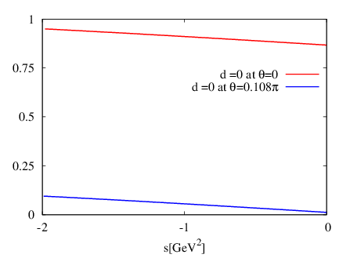
Parity projected sum rule
The phase rotated QCD sum rule is proposed by Ioffe and Zyabluk.
In this sum rule, q² is replaced by q²e^{iθ}
To apply this approach to the parity projected sum rules, we use this
phase – rotated kernel :
Ratio
As for the Phase - rotated kernel, 1st order α_{ｓ} correction is about 10 %
of the leading term.

Slide 13
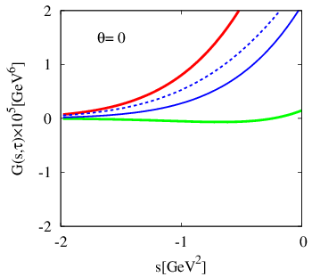
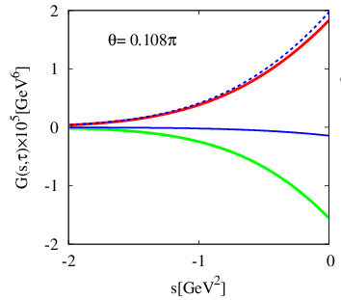
Parity projected sum rule

Slide 14
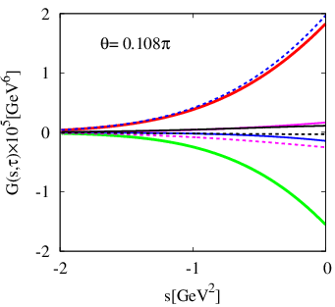
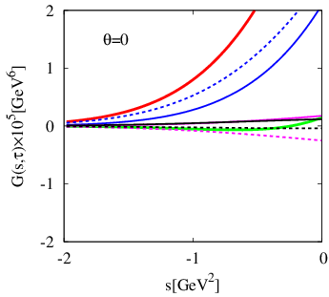
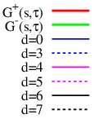
Parity projected sum rule
The feature of phase – rotated Gaussian sum rule
The chiral condensate term is dominant.
The perturbative term has not large contribution.

Slide 15
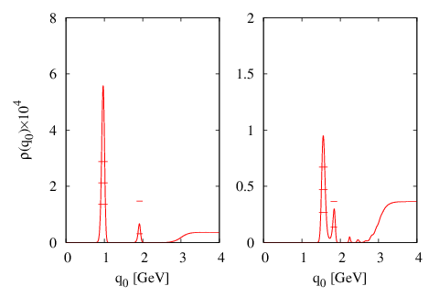
Parity projected sum rule
Interpolating field :
Positive parity
Negative parity
970MeV
1560MeV
In both positive and negative parity, the peaks are found.
In the negative parity analysis, the peak correspond to the N(1535) or (and) N(1650).

Slide 16
Conclusion
We analyze the nucleon spectral function by using QCD sum
rules with MEM
We construct the parity projected sum rule using phase - rotated
Gaussian kernel with α_{s} correction.
It is found that, in this sum rule, chiral condensate term is
dominant and continuum contributions is reduced.
The information of not only the ground state but also the
negative parity excited state is extracted
Future plan
We will apply the same approach to the nucleon QCD sum rule
at finite density.

Slide 19
