Slide 1

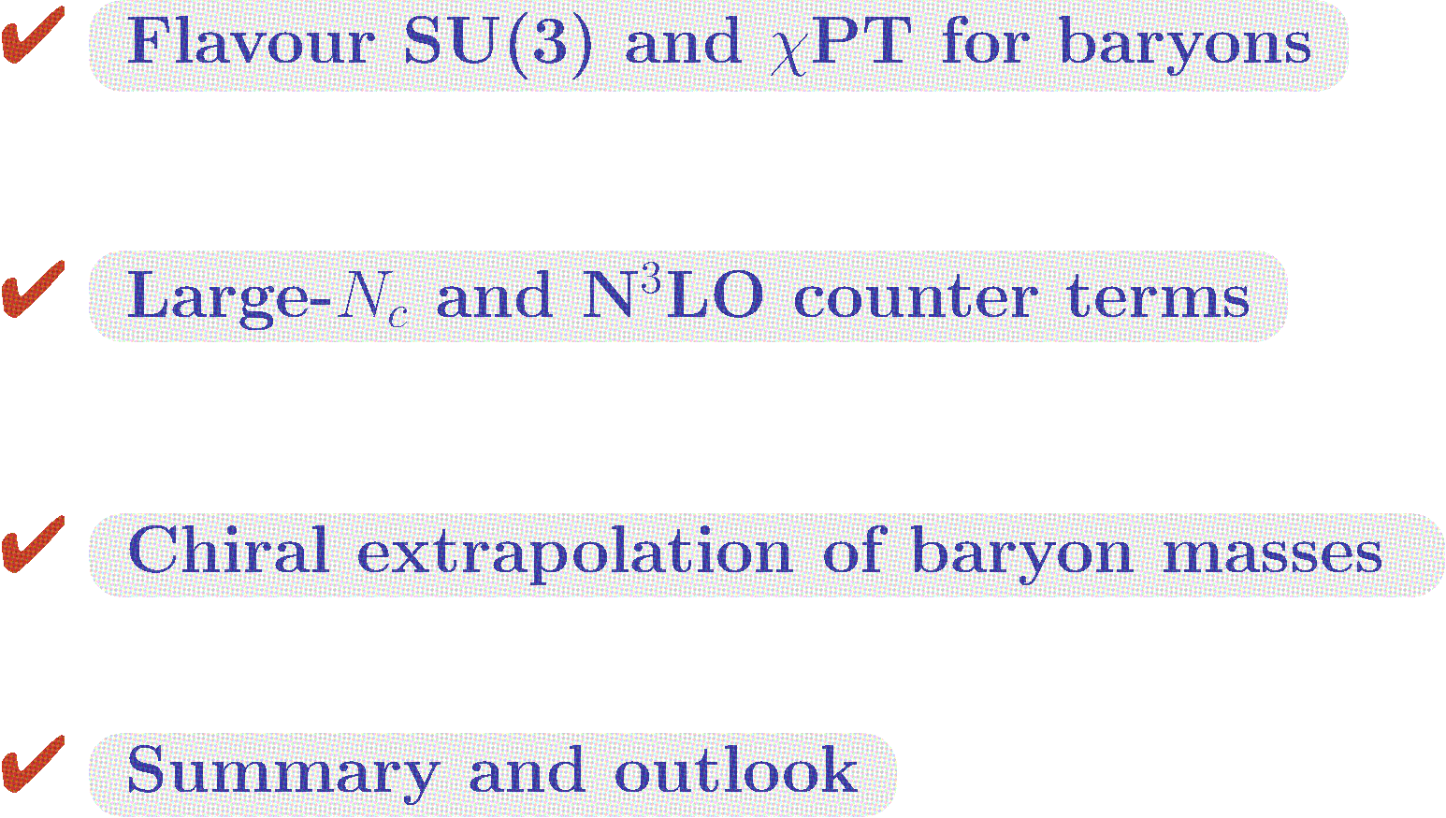
TexPoint fonts used in EMF.
Read the TexPoint manual before you delete this box.: A

Slide 2


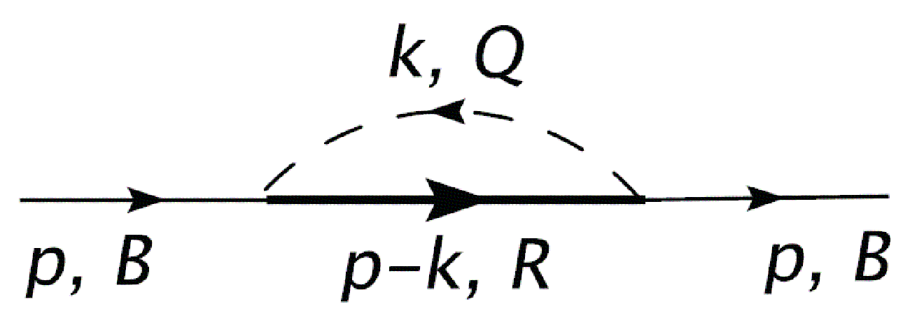
NP A778 (2006), NP A789 (2007)

Slide 3
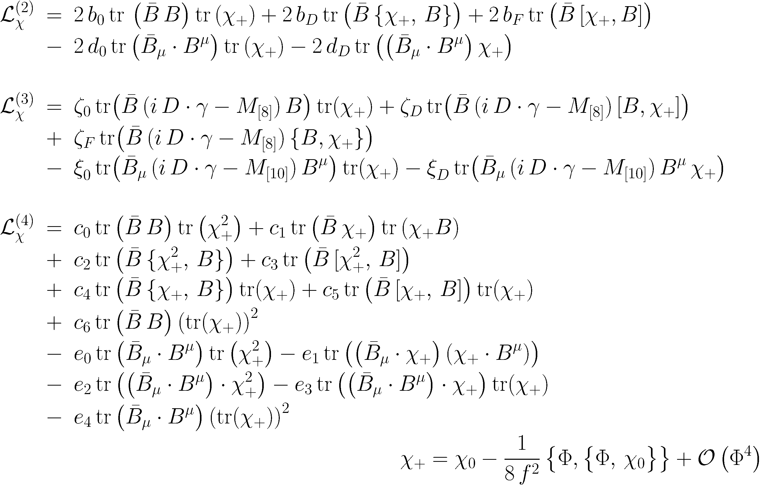
PR D85 (2012)

Slide 4




Slide 5
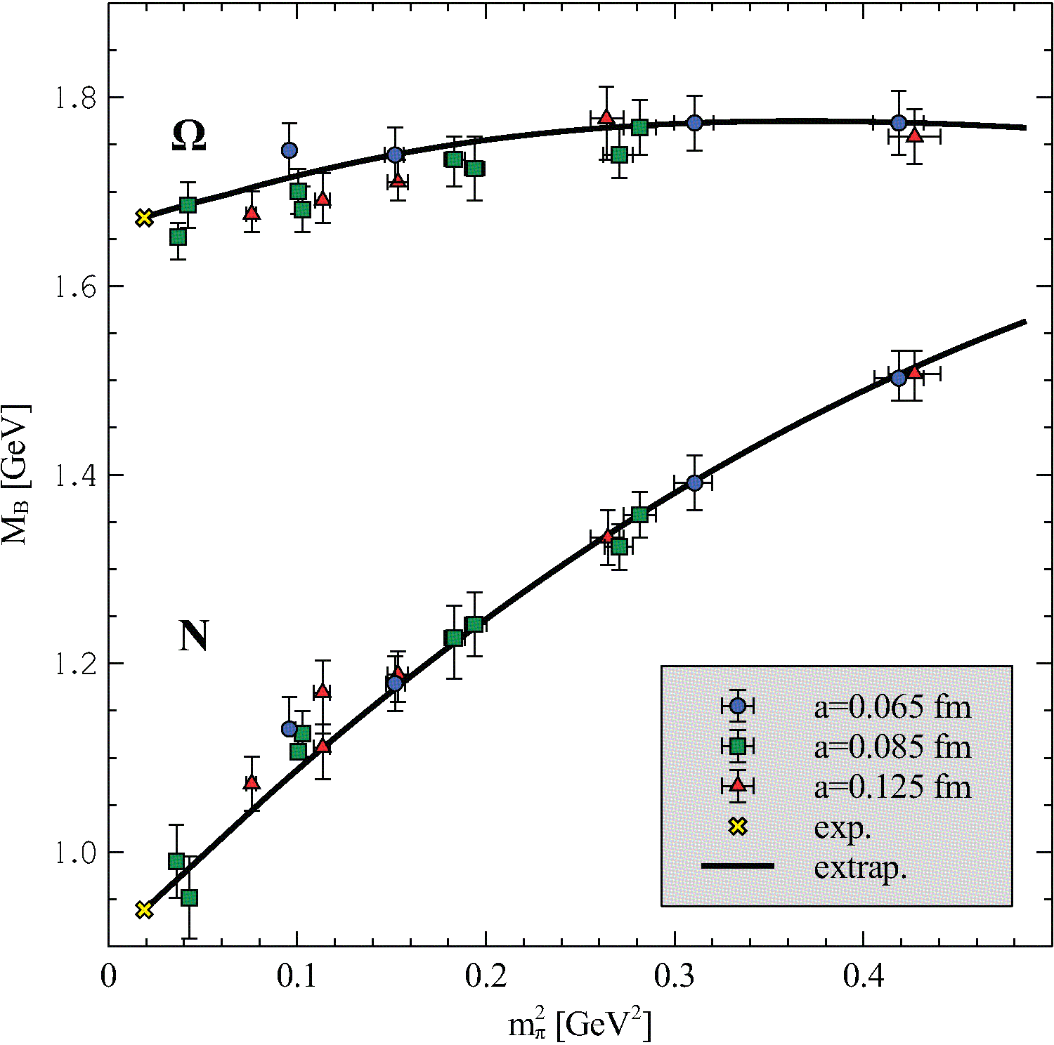
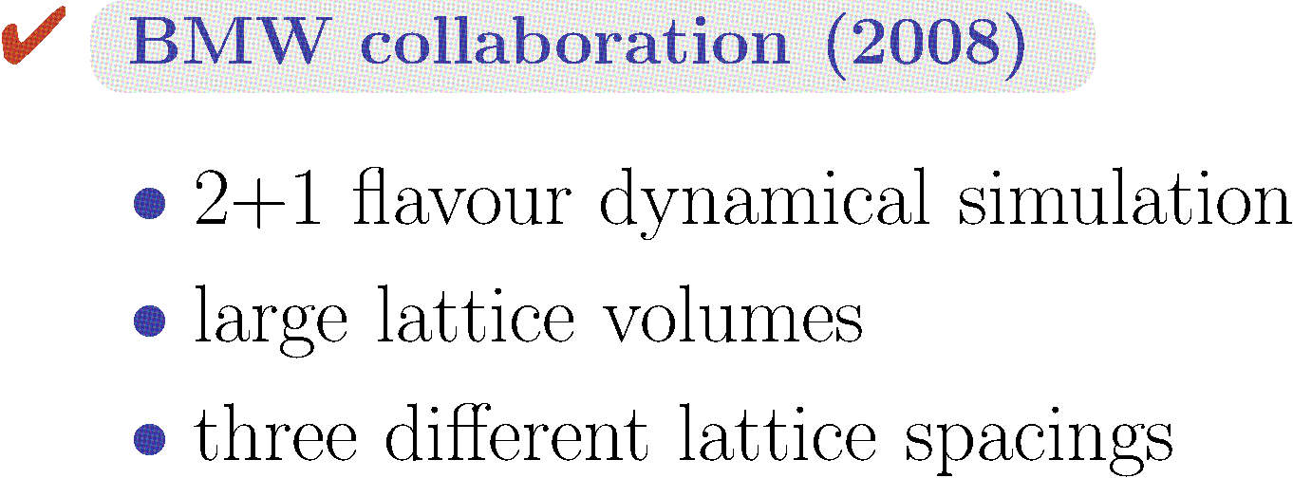


PR D85 (2012)

Slide 6
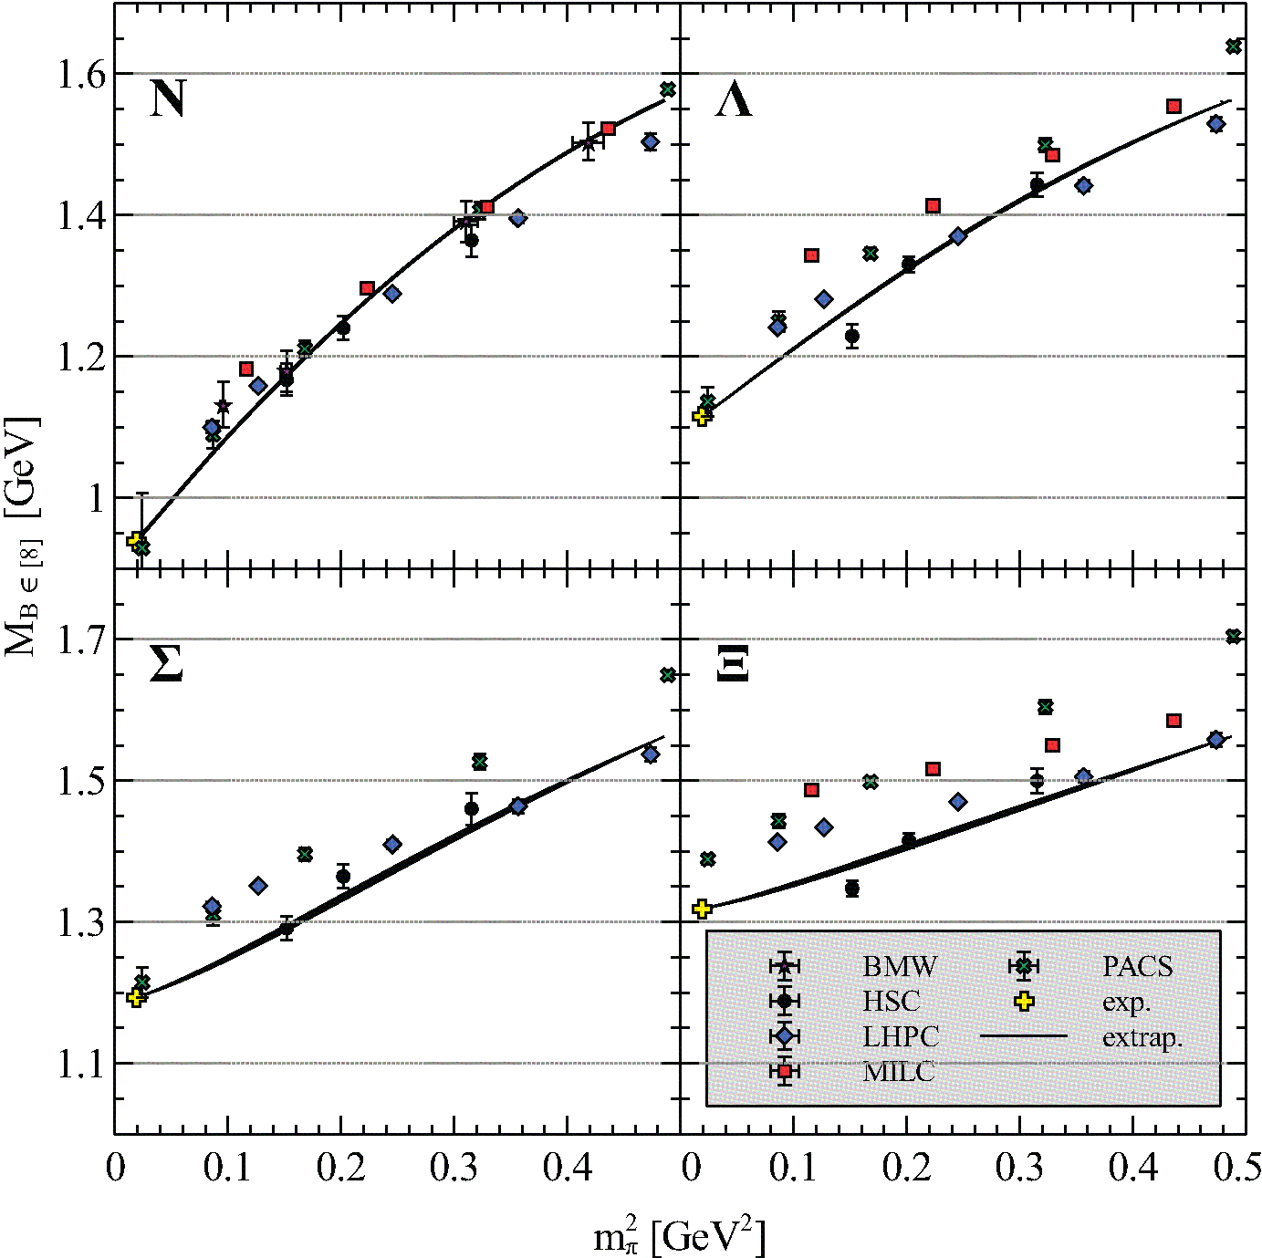

PR D85 (2012)

Slide 7
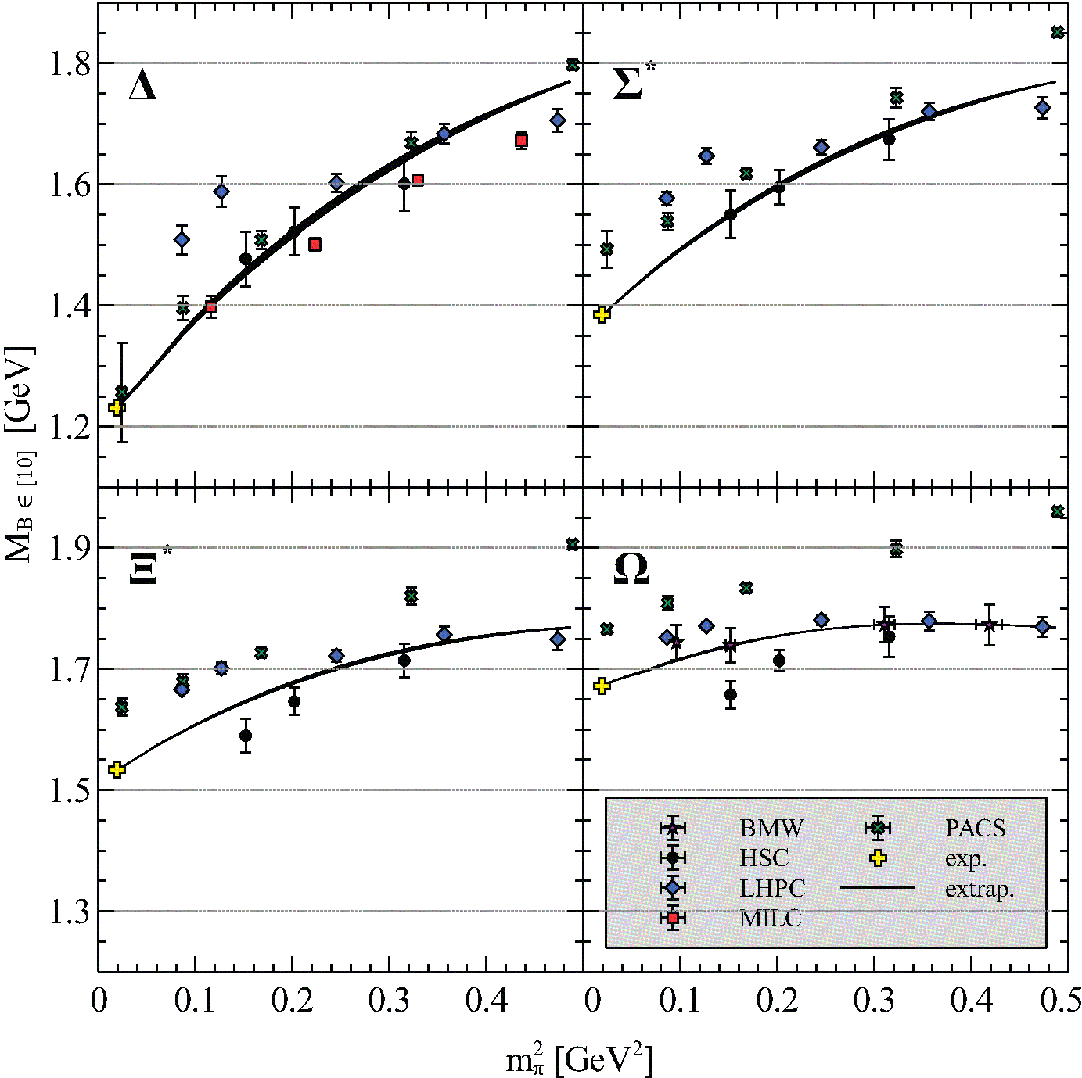
PR D85 (2012)

Slide 8
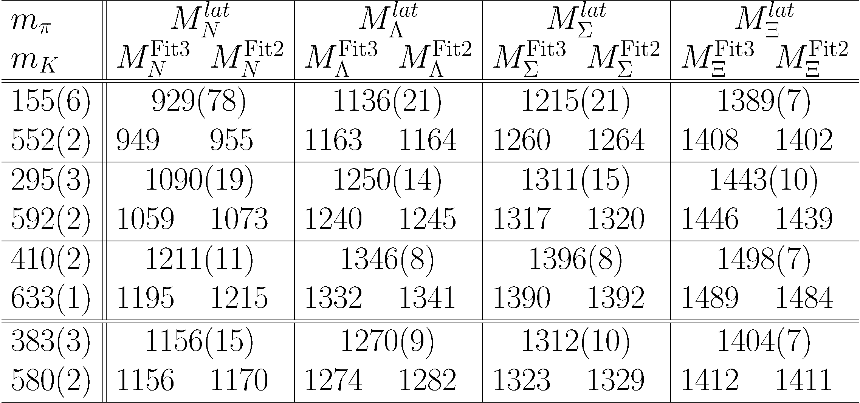
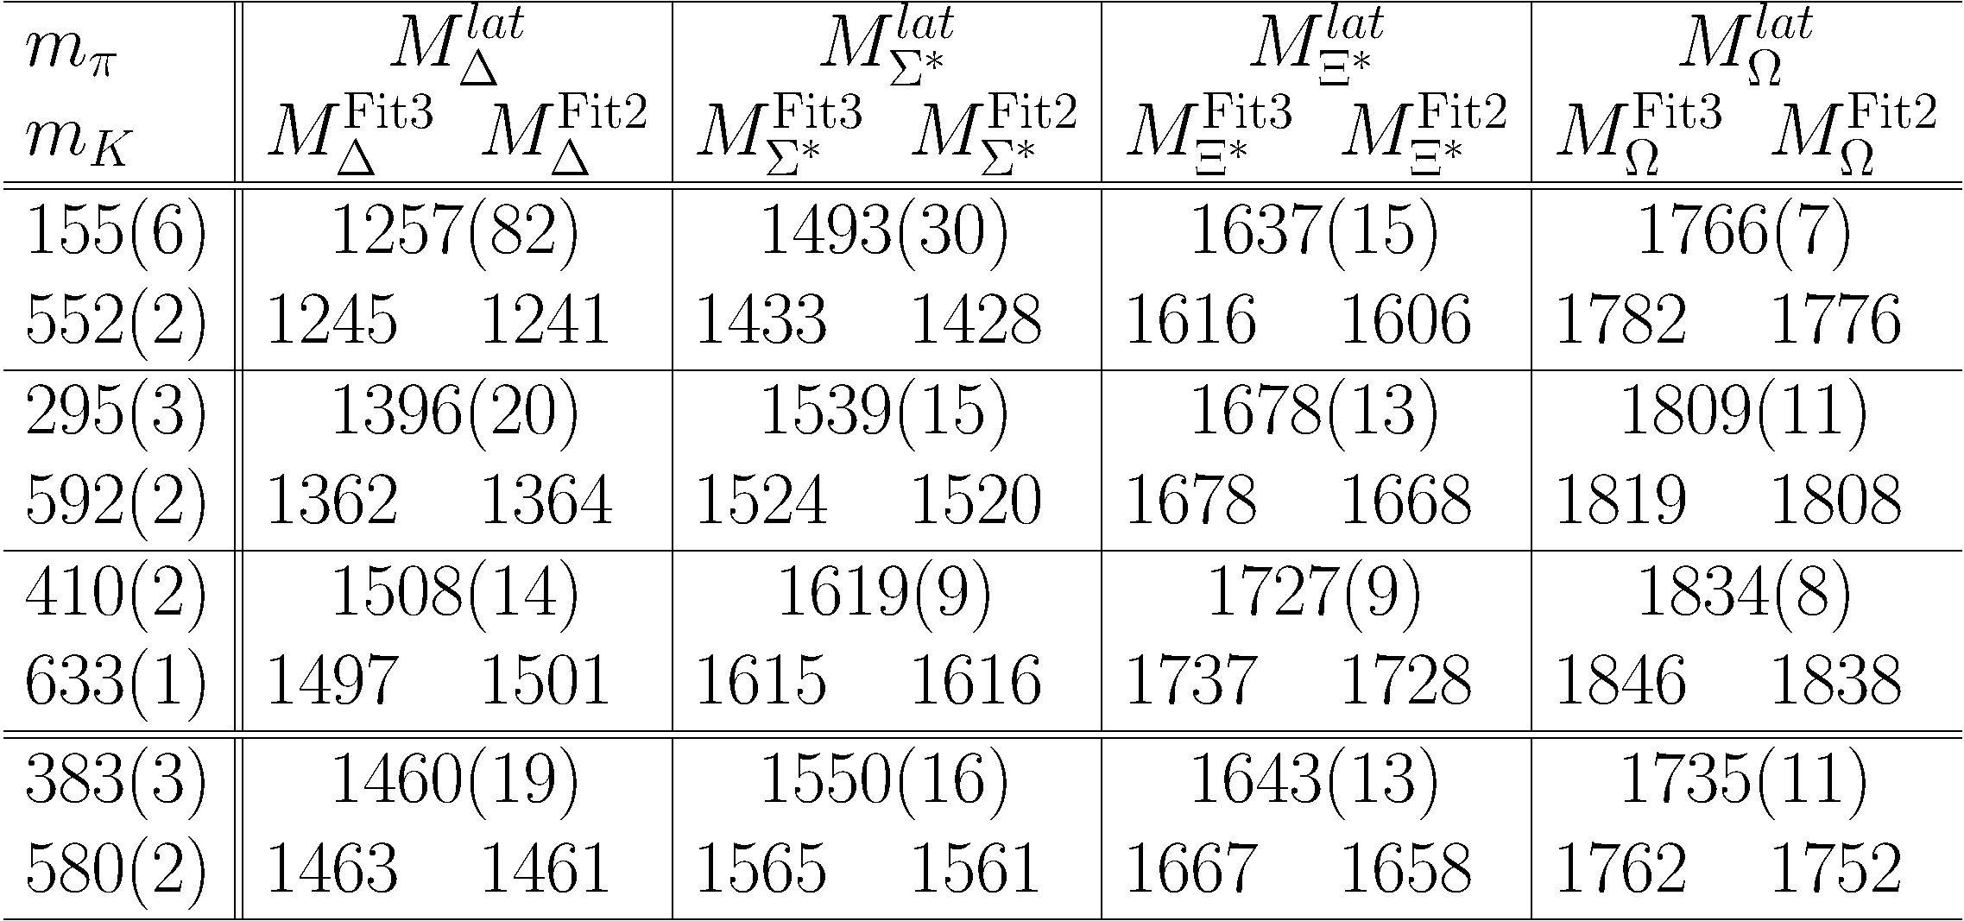

arXiv:1202.3556

Slide 9
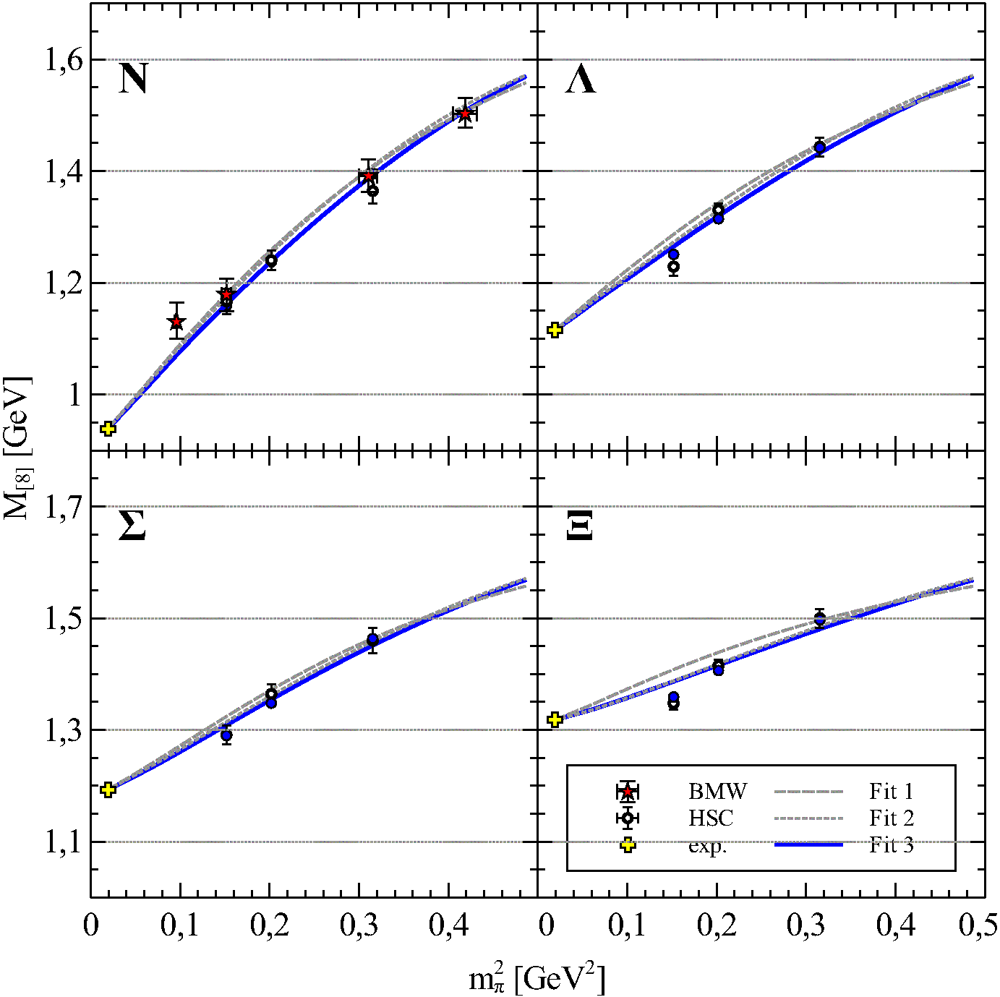
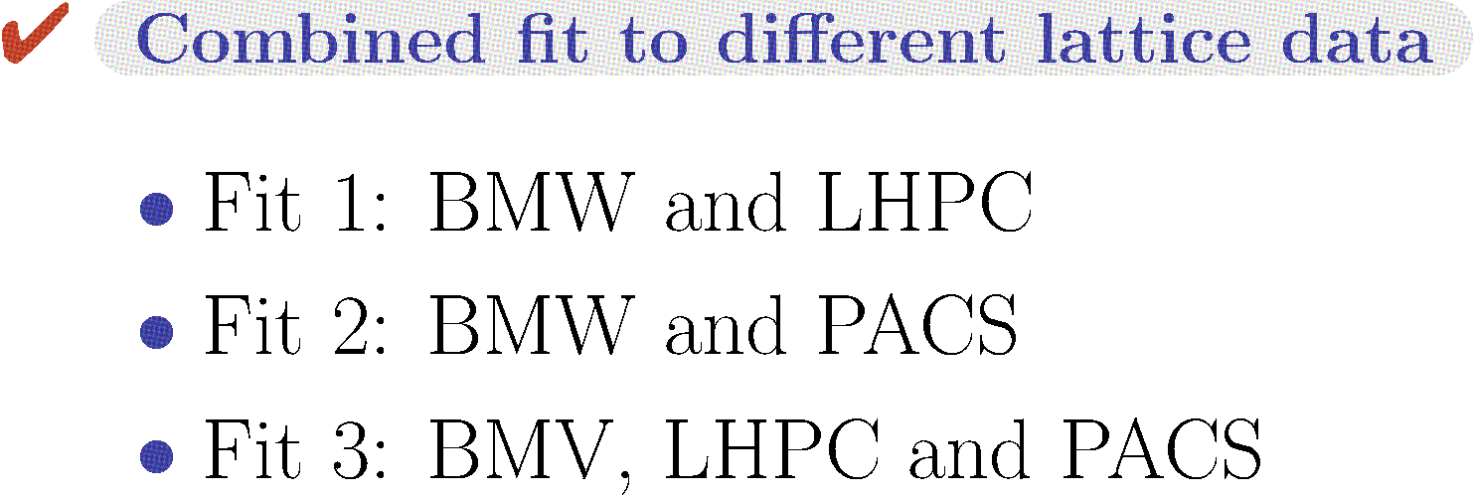
arXiv:1202.3556

Slide 10
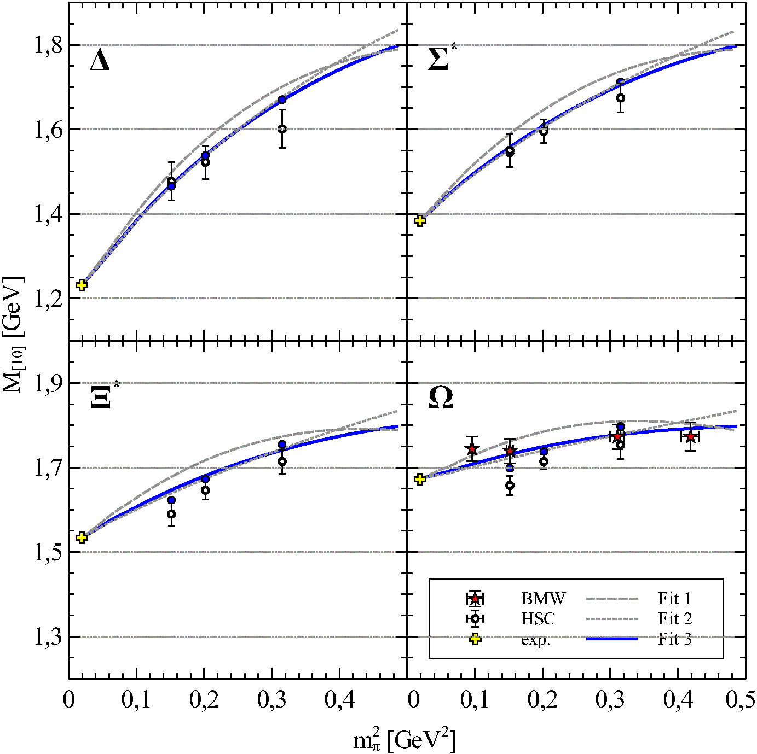
arXiv:1202.3556

Slide 11
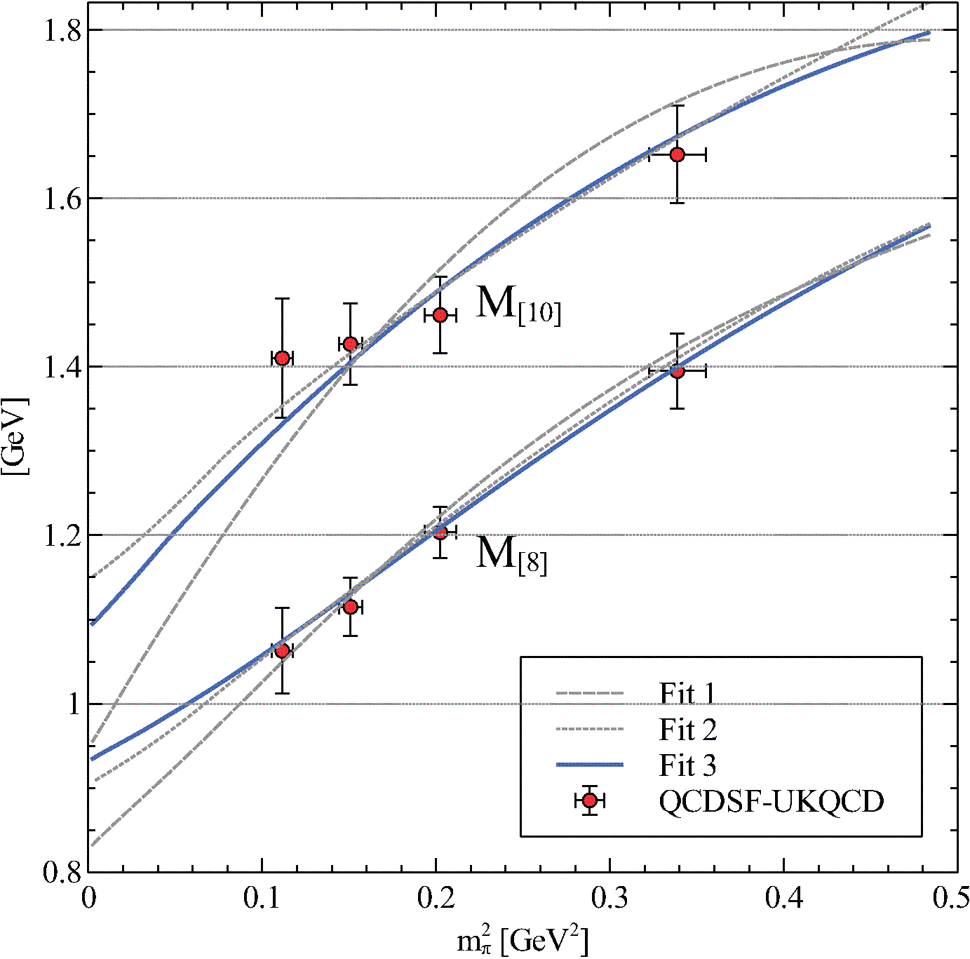

arXiv:1202.3556

Slide 12



arXiv:1202.3556

Slide 13
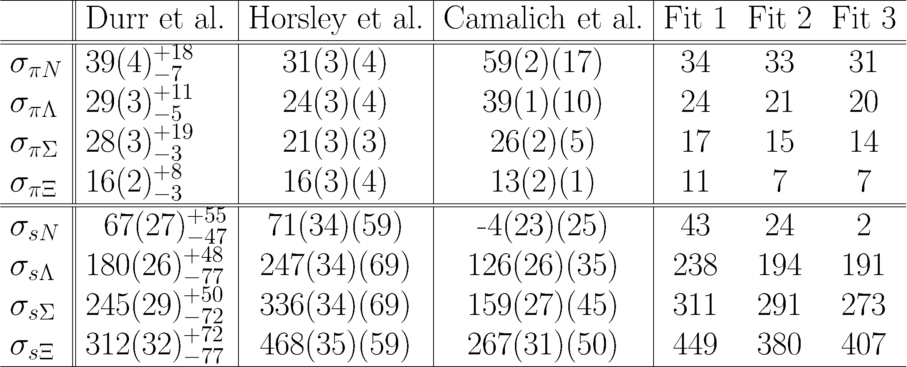
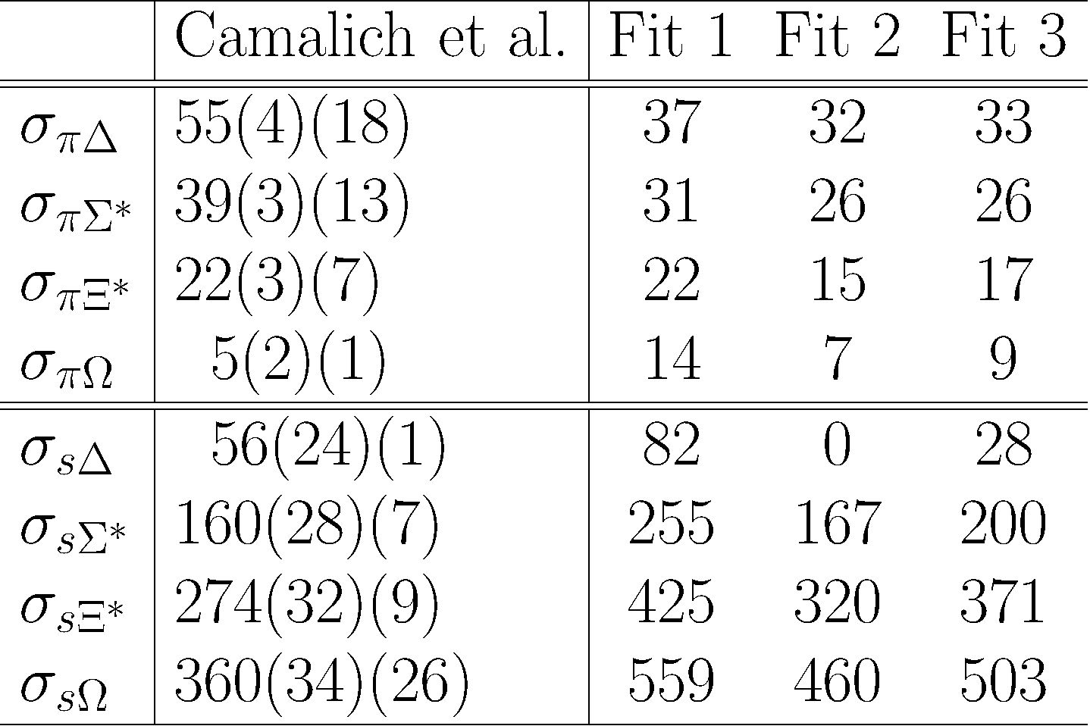


arXiv:1202.3556

Slide 14




