Slide 1
Studies of Nuclei at TUNL/HIGS:
From Hadron Structure to Exploding Stars

Slide 2
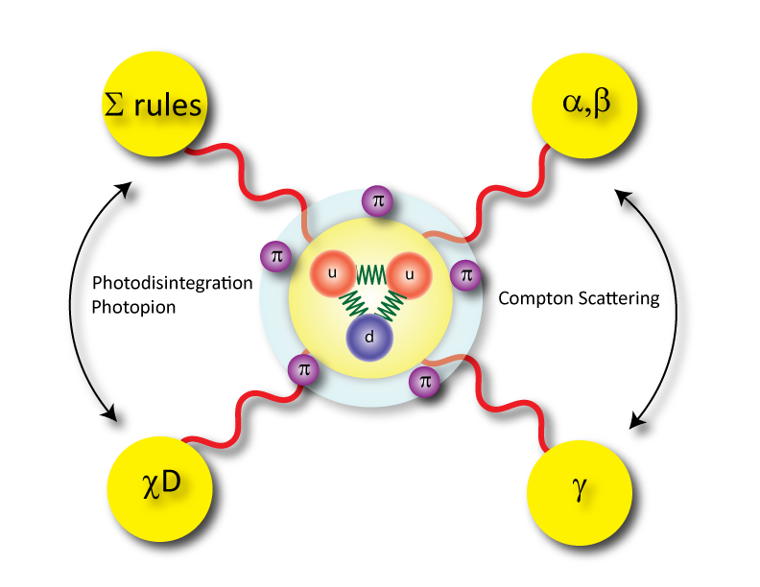
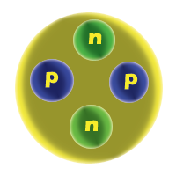
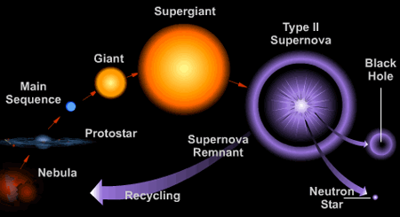
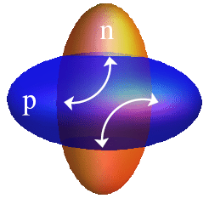
TUNL/HIGS Across Distance Scales
Physics of Hadrons to Physics of Nuclei

Slide 3
Outline Studies of Hadron Structure at TUNL
Recent Results from:
⁶Li Compton Scattering and Isoscalar polarizabilites
³He Gerasimov-Drell-Hearn (GDH) Sum Rule Measurements
Upcoming Experiments:
Deuteron GDH Measurement Between 4 and 16 MeV
α_{P}, β_{P}, α_{N}, and β_{N} (Static EM Polarizabilities) Measurements
γ_{P} (Spin Polarizabilities) Measurements

Slide 4
Outline Few-Body Systems & Nuclear Astrophysics
Studies of Light Nuclei:
⁴He(γ,n) and ⁴He(γ,p) Results
n-n interactions via neutron-deuteron breakup
Nuclear Astrophysics
Direct Observation of a New 2⁺ State in ¹²C and Recent Effective Field Theory Lattice Calculations
Nuclear Matter
The nature of Pygmy Dipole Resonance (PDR)
Iso-Vector Giant Quadrupole Resonance Studies With Nuclear Compton Scattering

Slide 5
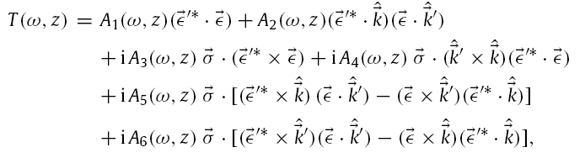
Compton Scattering, the Foundations
The T-matrix for the Compton scattering of incoming photon of energy ω with a spin (σ) ½ target is described by six structure functions
ε = photon polarization, k is the momentum

Slide 6

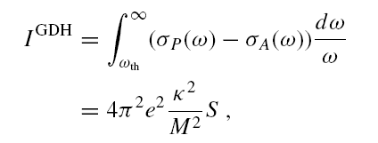
Compton Scattering, the Foundations
For forward scattering, the low-energy theorems (LETs) describe
Gerasimov-Drell-Hearn (GDH) Sum Rule

Slide 7
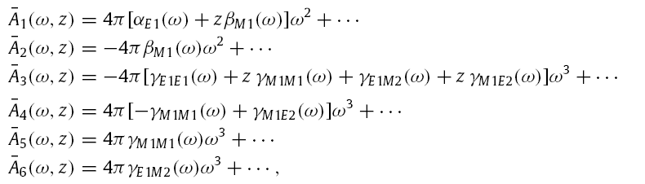

Compton Scattering, the Foundations
Electric and Magnetic Polarizabilities (order of ω²)
Spin Polarizabilities (order of ω³)

Slide 8
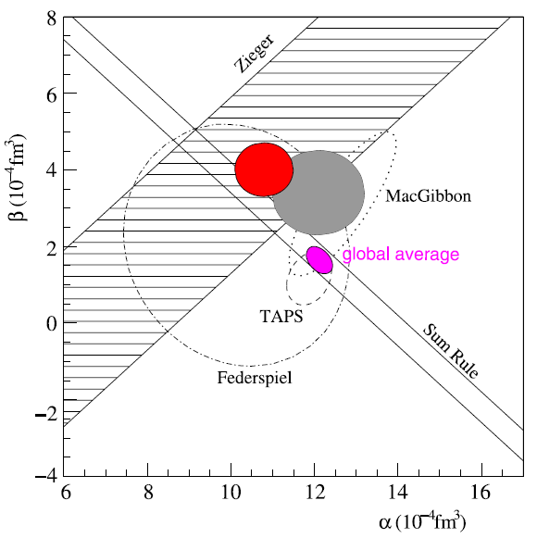
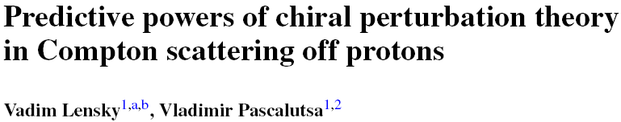

The electromagnetic polarizabilities for the proton

Slide 9
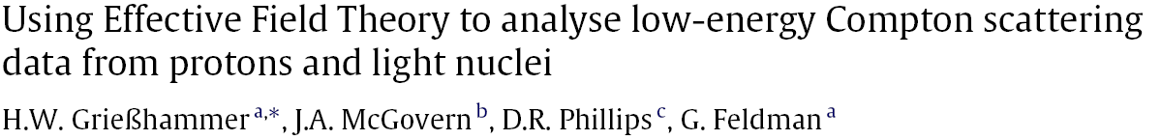
The electromagnetic polarizabilities for the proton
Details: See talk by H. W. Grißhammer at the Hadron Structure Working group on Monday 7th at 15:45

Slide 10
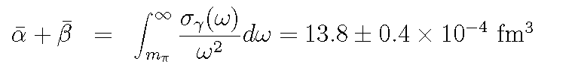
The electromagnetic polarizabilities for the proton
Baldin Sum Rule
Effective Field Theory Analysis
α_{E1} = 10.7 ± 0.3 (stat) ± 0.2 (Baldin) ± 0.8 (theory)
β_{E1} = 3.1 ∓ 0.3 (stat) ± 0.2 (Baldin) ± 0.8 (theory)
BχPT with Δ Prediction
α = 10.7 ± 0.7
β = 4.0 ± 0.7
Significantly different
PDG Accepted Value
α = 12.7 ± 0.6
β = 1.9 ± 0.5

Slide 11
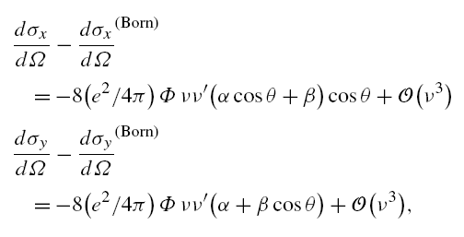
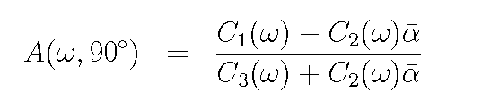
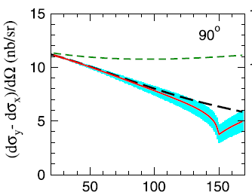
HIGS: Linearly polarized gamma ray measurement
An active unpolarized scintillating target
4 HINDA detectors
two setups of 2 each in perpendicular and parallel planes at 90º
A 300 hour experiment measuring the asymmetry will yield an electric polarizability measurement at ~ 5% level
E_{γ}

Slide 12
Deuteron Compton Scattering – Active Target
Adjust α_{N} & β_{N} in a χEFT to fit theoretical cross sections with experimental data
Extract α_{n} & β_{n} using the better known values of α_{p} & β_{p}
Energy (MeV) | Angle | Cross Section (nb/sr) | Rate (counts/hour) | Time (hours) | Counts | %Err (stat)
65 | 45 | 16.5 | 15.9 | 300 | 4782 | 1.5%
65 | 80 | 12.4 | 11.9 | 300 | 3579 | 1.7%
65 | 115 | 13.7 | 13.3 | 300 | 3982 | 1.6%
65 | 150 | 17.8 | 17.2 | 300 | 5158 | 1.4%
Details: See talk by H. W. Weller at the Few-Body Working group on Tuesday 7th at 16:55

Slide 13

Nucleon Compton Scattering
The Measurement
Nucleon
You do not want to start the game like this !

Slide 14
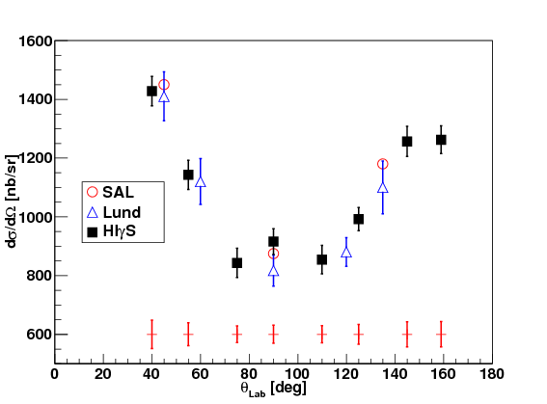
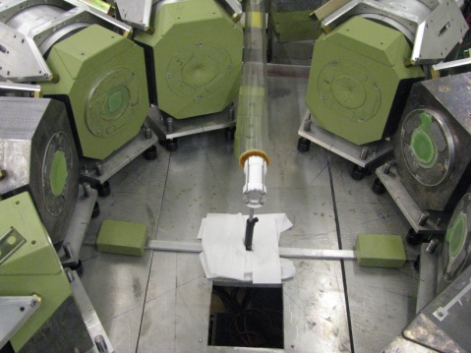
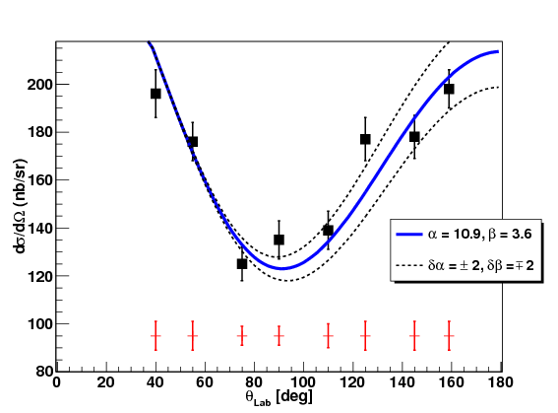
HIGS Results on ¹⁶O and ⁶Li Compton Scattering
¹⁶O
⁶Li
Phenomenological Model
Giant Resonances
Quasi-Deuteron
Modified Thompson
Details: See talk by L. S. Myers at the Few-Body Working group on Tuesday 7th at 17:20

Slide 15
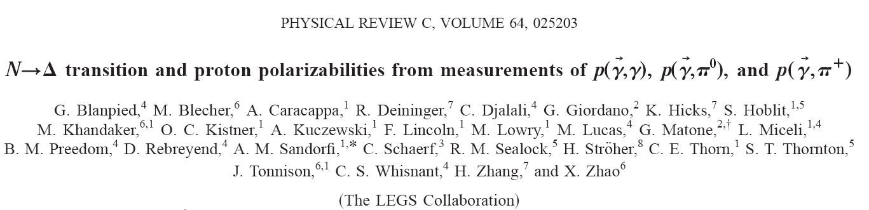
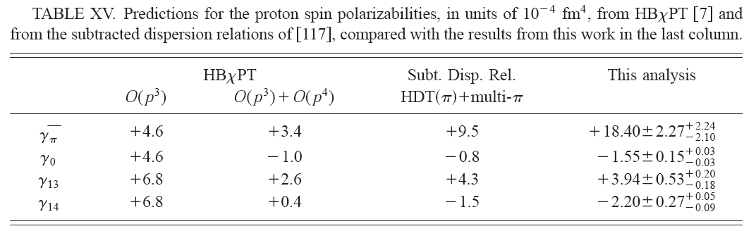
Spin Polarizabilities of the Proton
Focus of many theoretical efforts but sparse experimental data
γ₀, γ_{π} have been measured directly measured

Slide 16
Spin Polarizabilities of the Proton
 | O(p³) | O(p⁴) | O(p⁴) | LC3 | LC4 | SSE | BGLMN | HDPV | KS | DPV | Experiment
γ_{E1E1} | -5.7 | -1.4 | -1.8 | -3.2 | -2.8 | -5.7 | -3.4 | -4.3 | -5.0 | -4.3 | No data
γ_{M1M1} | -1.1 | 3.3 | 2.9 | -1.4 | -3.1 | 3.1 | 2.7 | 2.9 | 3.4 | 2.9 | No data
γ_{E1M2} | 1.1 | 0.2 | .7 | .7 | .8 | .98 | 0.3 | -0.01 | -1.8 | 0 | No data
γ_{M1E2} | 1.1 | 1.8 | 1.8 | .7 | .3 | .98 | 1.9 | 2.1 | 1.1 | 2.1 | No data
γ₀ | 4.6 | -3.9 | -3.6 | 3.1 | 4.8 | .64 | -1.5 | -.7 | 2.3 | -.7 | -1.01 ±0.08 ±0.10
γ_{π} | 4.6 | 6.3 | 5.8 | 1.8 | -.8 | 8.8 | 7.7 | 9.3 | 11.3 | 9.3 | 8.0± 1.8
The pion-pole contribution has been subtracted from the experimental value for γ_{π}
Calculations labeled O(p^{n}) are ChPT
LC3 and LC4 are O(p³) and O(p⁴) Lorentz invariant ChPT calculations
SSE is small scale expansion
Other calculations are dispersion theory
Lattice QCD calculation by Detmold is in progress

Slide 17
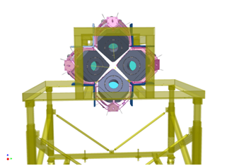
Spin Polarizabilities of the Proton: HIGS
Details: On Mainz results and HIGS plans: Rory Miskimen, Hadron Structure Working Group, Monday 6th, at 15:20
- photon helicity
Assuming HINDA left-right acceptance matching at the level of 10%, the resulting error in Σ_{2x} is at the level of 0.001

Slide 18
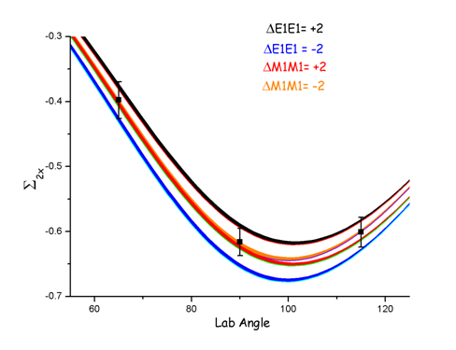
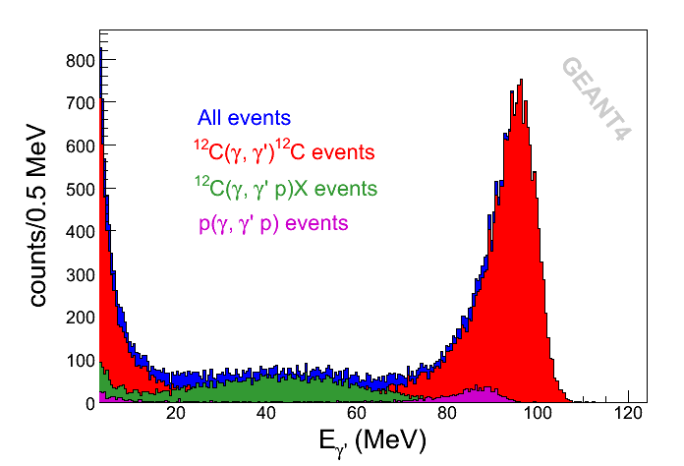
Spin Polarizabilities of the Proton: HIGS
Energy | Full Inten. | Bunches | Coll. Dia. | ΔE | Intensity on target | Polarization | Beam time on target
100 | ≥1×10⁸ | ≥2 | 12 mm | 3% | 5×10⁶ | 100% circular | 800 hours
Angle | Effective Spin Polarizability | Error in effective SP | Error in γ_{Ε1Ε1}+γ_{Μ1Μ1} | Error in γ_{E1E1}
65° |  | 2.2×10⁻⁴ fm⁴ | 2.3×10⁻⁴ fm⁴
90° |  | 1.4×10⁻⁴ fm⁴ | 1.4×10⁻⁴ fm⁴ | ≈1.0×10⁻⁴ fm⁴
115° |  | 2.1×10⁻⁴ fm⁴ | 2.1×10⁻⁴ fm⁴

Slide 19
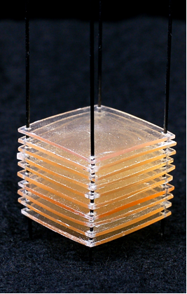
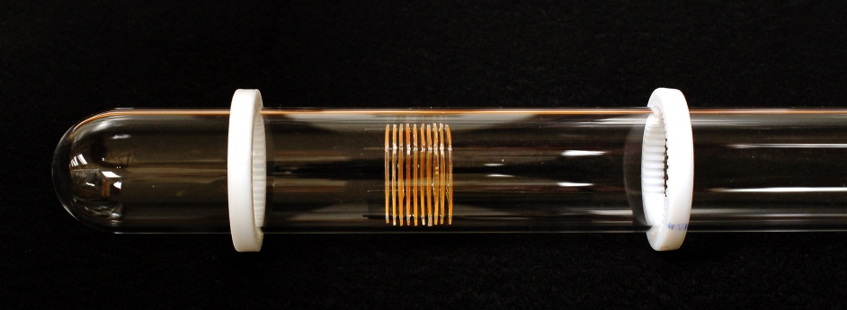
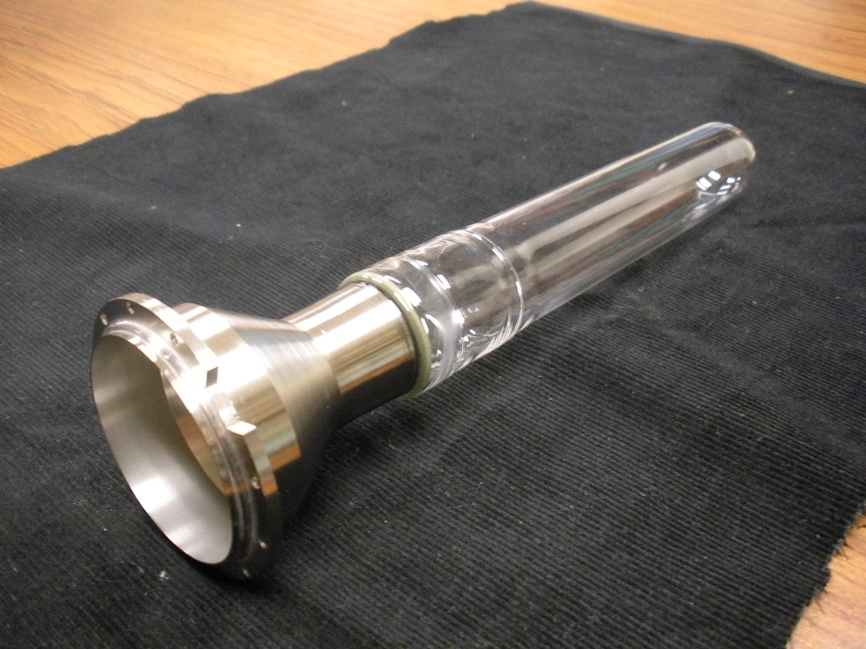
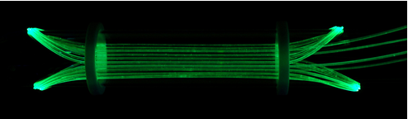
HIGS: Transverse Polarized Scintillating Target
Prototype scintillator target
Quartz mixing chamber
Wave shifting fibers wound onto quartz mixing chamber
Low temperature APD development

Slide 20
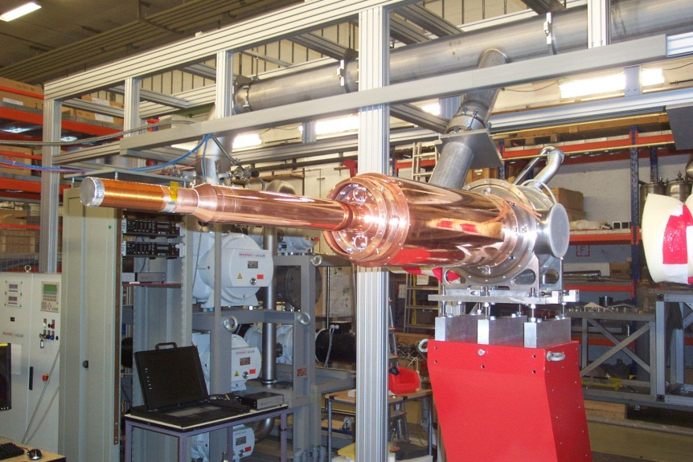
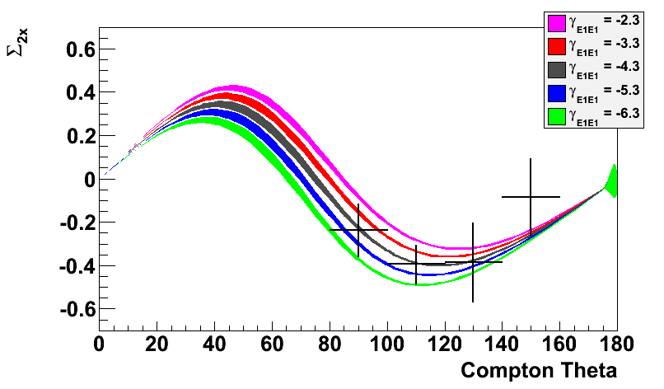
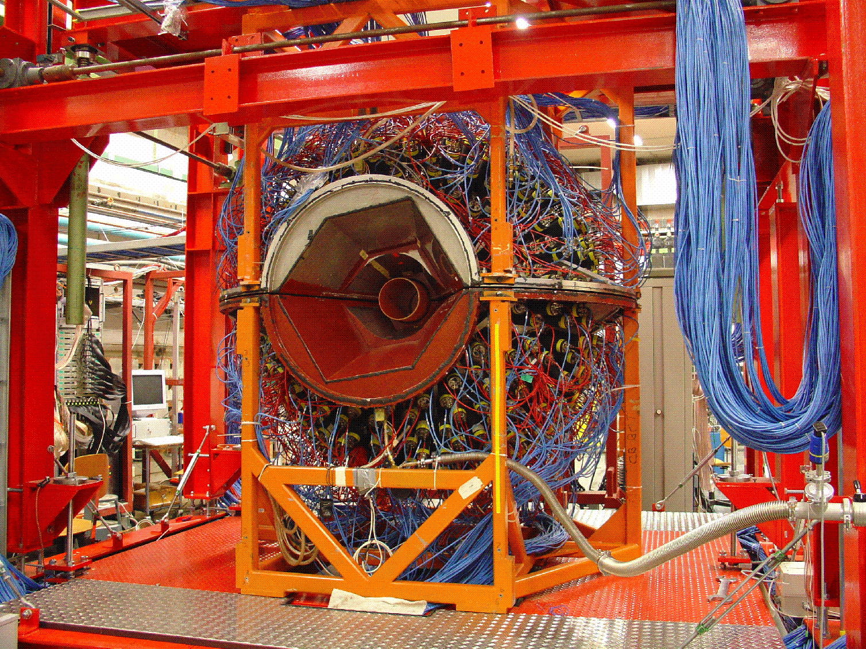
Measuring the spin polarizabilities of the proton in double-polarized Compton scattering at Mainz: PRELIMINARY results from P. Martel (Ph.D. UMass)
Transverse target asymmetry Σ_{2x} and sensitivity to γ_{E1E1}
Frozen spin target
PRELIMINARY
Crystal Ball

Slide 21
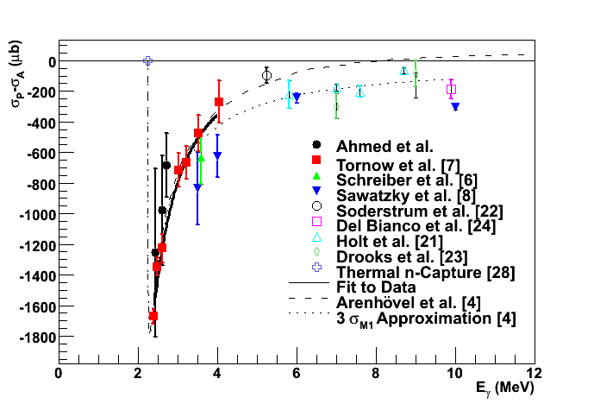
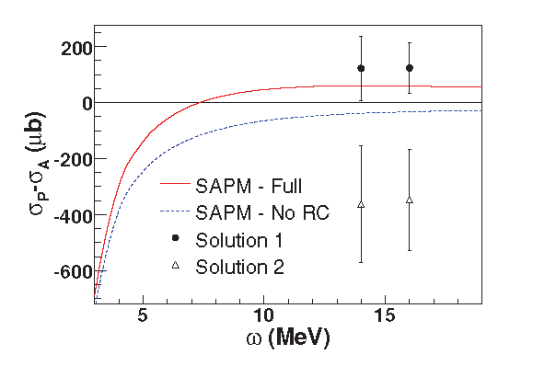
Few-Body Studies at HIGS: The Spin Structure
HIGS is mounting the GDH experiment on the deuteron starting September 2012 (next month)
The process will start with the on-site installation of the HIGS Frozen Spin Target (HIFROST) which is being tested at Uva
The majority of data taking will be complete by summer of 2013 between 4 and 16 MeV
Phys. Rev. C78, 034003 (2008)
Phys. Rev. C77, 044005 (2008)

Slide 22
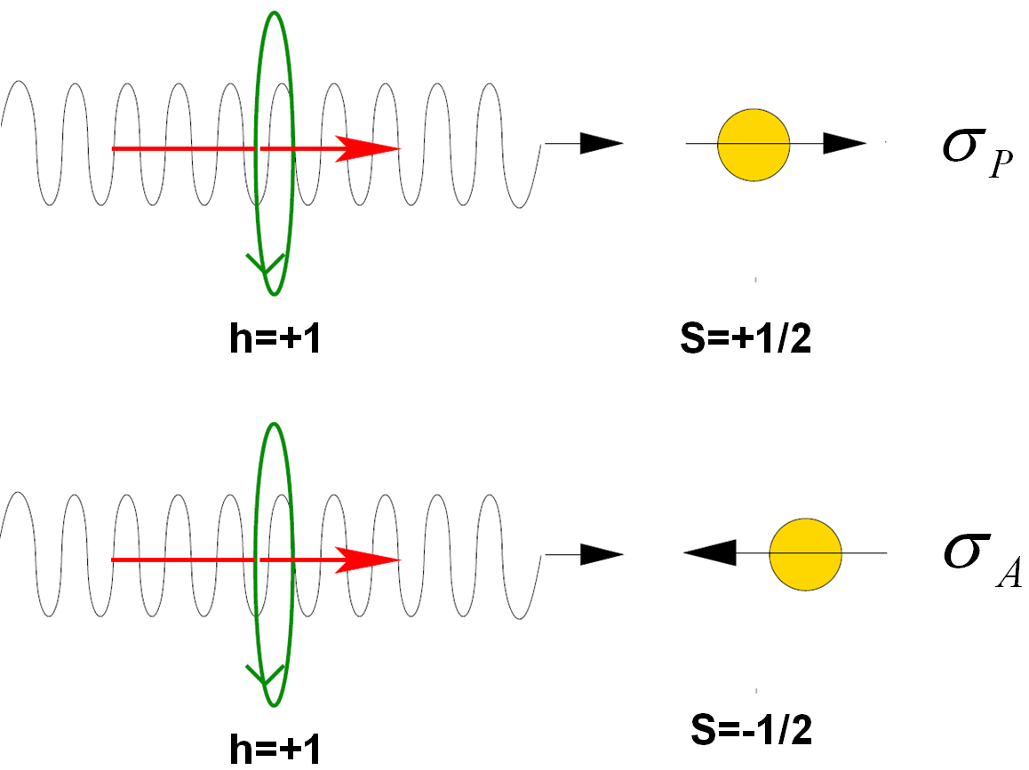
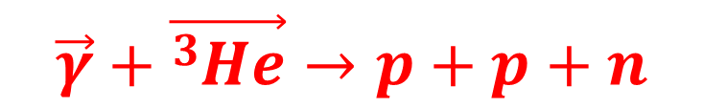
Three-body photodisintegration of ³He with double polarizations at 12.8 and 14.7 MeV at HIGS/TUNL facility (Haiyan Gao)
$$\vec{γ}+\vec{{}_{}^{3}{He}}→p+p+n$$
We detect neutrons!
Two Primary Goals:
Test state-of-the-art three-body calculations made by Deltuva [1] and Skibinski [2], and future EFT calculations.
Important step towards investigating the GDH sum rule for ³He below pion production threshold :
[1] A. Deltuva et al., Phys. Rev. C 71, 054005 (2005); Phys. Rev. C 72, 054004
(2005) and Nucl. Phys. A 790, 344c (2007).
[2] R. Skibinski et al., Phys. Rev. C 67, 054001 (2003); R. Skibinski et al. Phys.
Rev. C 72, 044002 (2005); R.Skibinski. Private communications.

Slide 23
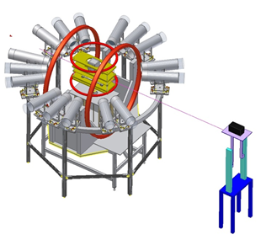
Three-body photodisintegration of ³He with double polarizations at 12.8 and 14.7 MeV at HIGS/TUNL facility: Setup
~100% circularly polarized γ-beam at 12.8 and 14.7 MeV
Emitted neutrons detected with 8 neutron detectors pairs at 30º, 45º, 75º,90º,105º,135º,150º and165º positioned 1m from the ³He target
High pressure hybrid ³He target (~7amgs) polarized longitudinally using Spin Exchange Optical Pumping

Slide 24
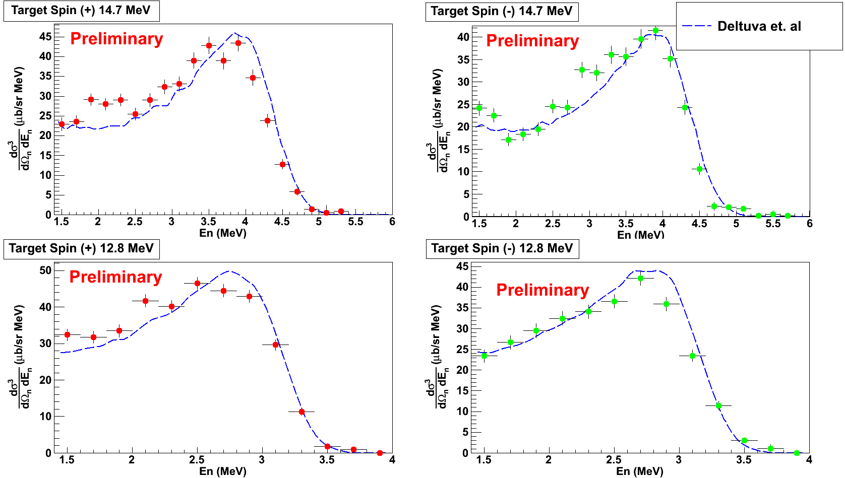

Preliminary results on spin dependent double differential cross sections
(${θ_{n}^{}}_{}^{lab}={90}^{o}$)

Slide 25
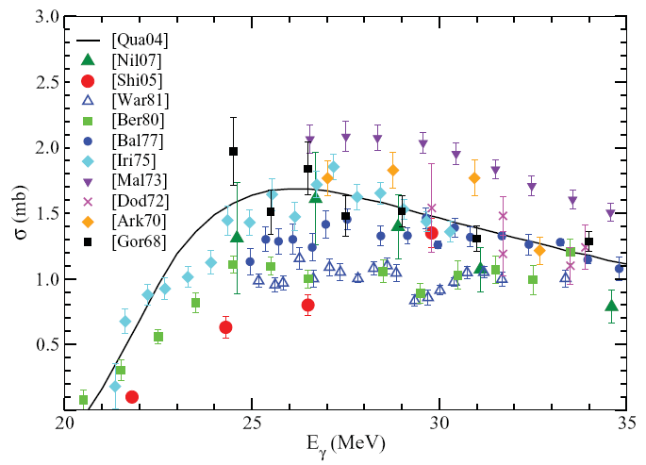
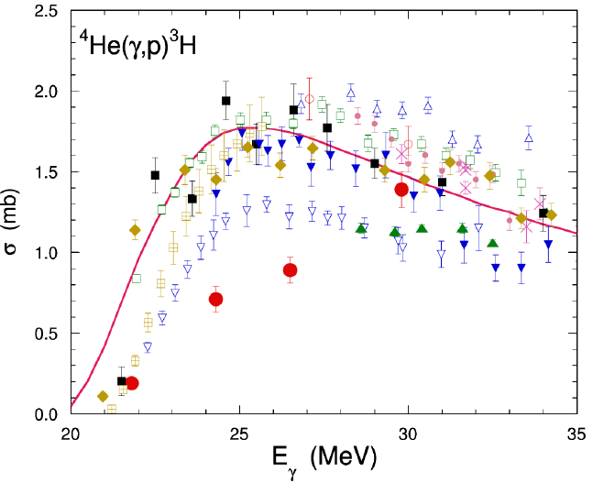
The Few-Body System: ⁴He Inconsistencies !
World Data on
⁴He(γ,n)³He
⁴He(γ,p)³H
References: Raut et al., PRL, 108, 042502 (2012), and Tornow et al., PR C85, 061001R (2012)

Slide 26
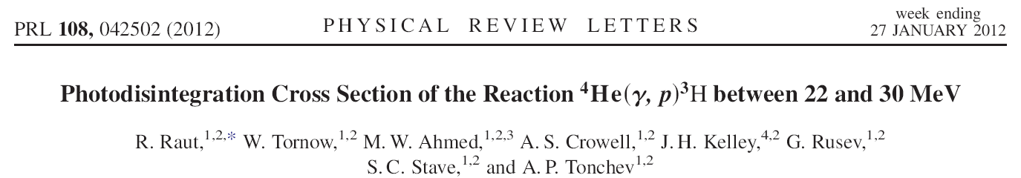
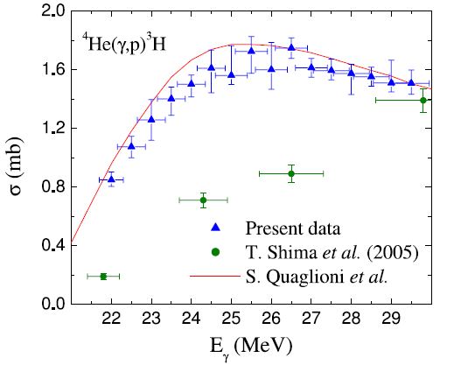
The Few-Body System: ⁴He Results from HIGS

Slide 27
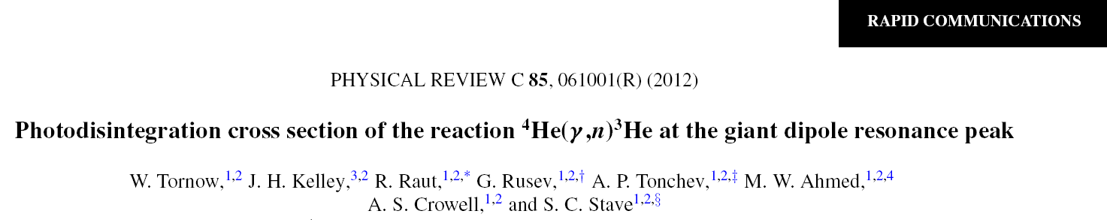
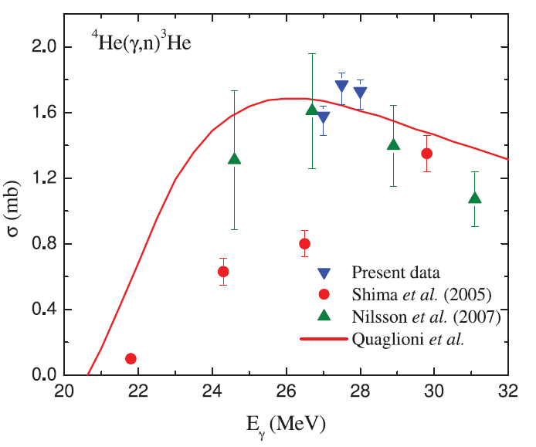
The Few-Body System: ⁴He Results from HIGS

Slide 28
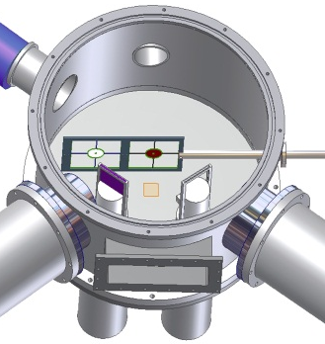
n-d Breakup Experiments at TUNL and a_{nn}
Cross-section Measurements:
nn FSI to determine ¹S₀ nn scattering length
two star configurations (space and co-planar)
nn FSI
n₂
n₁
Both experiments use the same technique:
thin CD2 foil target
detection of proton in coincidence with one neutron
normalization using concurrent nd elastic scattering
p
star
neutron
detectors
CD2 foil
neutron
beam
ΔE scintillator
charged-particle
ΔE-E telescopes

Slide 29
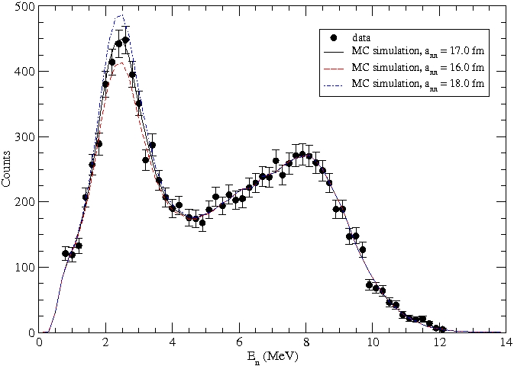
Summary and Results from TUNL: a_{nn}
nn FSI Measurement
Space-star Cross-section
nn FSI
np QFS
New TUNL data
CD Bonn
NN potential
a_{nn} = -17.3 ± 0.6 fm
Simulation with CD Bonn NN potential
Compared to:
avg. of π⁻d capture measurements
a_{nn} = -18.6 ± 0.4 fm
other nd breakup measuements
a_{nn} = -18.7 ± 0.7 fm, D.E. Gonzalez Trotter et al.,
Phys. Rev. Lett. 83, 3788 (1999)
a_{nn} = -16.2 ± 0.4 fm, V. Huhn et al., Phys. Rev. C
63, 014003-1 (2000)
M. Stephan et al., Phys. Rev. C39, 2133 (1989).
J. Strate et al., Nucl. Phys. A501, 51 (1989);
K. Gebhardt et al., Nucl. Phys. A561, 232 (1993).
H. Setze et al., Phys. Rev. C71, 034006 (2005);
A. Crowell, Ph.D. thesis, Duke University (2001);
R. Macri, Ph.D. thesis, Duke University (2004).
Z. Zhou et al., Nucl. Phys. 684, 545C (2001).
Details will be given by Calvin Howell in his talk in the Few-Body Physics working group session on Wednesday

Slide 30
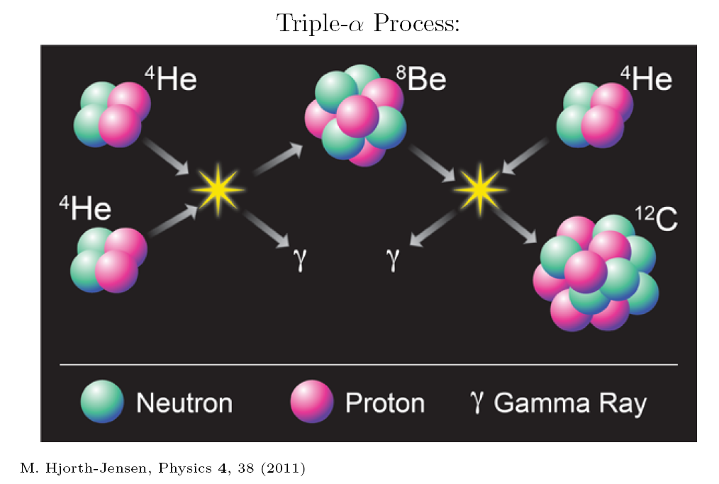
Nuclear Astrophysics: The 2₂⁺ State in ¹² C
What is the structure of the Hoyle State?

Slide 31
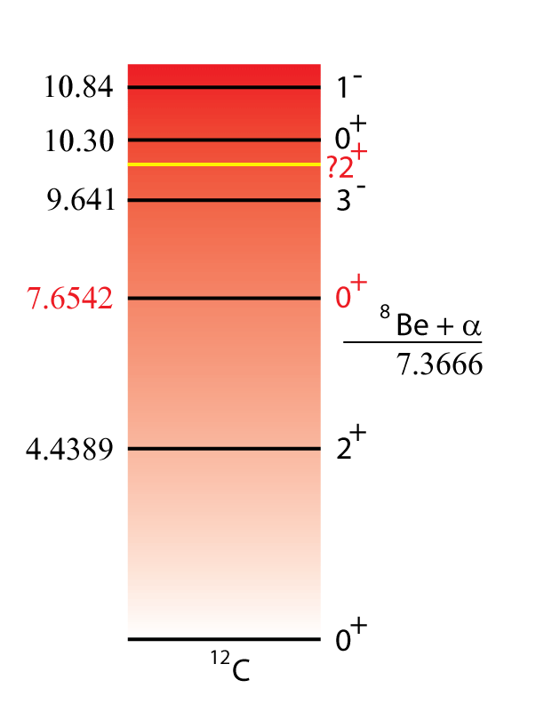
Nuclear Astrophysics & EFT Lattice Calculations
A 2₂⁺ state in ¹²C was predicted by Morinaga (Phys. Rev. 101, 1956) as the first rotational state of the “ground” state 7.654 MeV (Hoyle State)
Recently, Epelbaum, Krebs, Lee, Meißner (Phys. Rev. Lett. 106, 192501, 2011) have performed Ab Initio Chiral Effective Field Theory Lattice calculations for the Hoyle State and its structure and rotations.

Slide 32
Nuclear Astrophysics Impact of the 2₂⁺ State
Quiescent helium burning occurs at a temperature of 10⁸–10⁹K, and is completely governed by the Hoyle state;
However, during type II supernovae, γ-ray bursts and other astrophysical phenomena, the temperature rises well above 10⁹ K, and higher energy states in ¹²C can have a significant effect on the triple-α reaction rate;
Preliminary calculations suggest a dependence of high mass number (>140) abundances on the triple alpha reaction rate based on the parameters of the 2₂⁺ state.

Slide 33
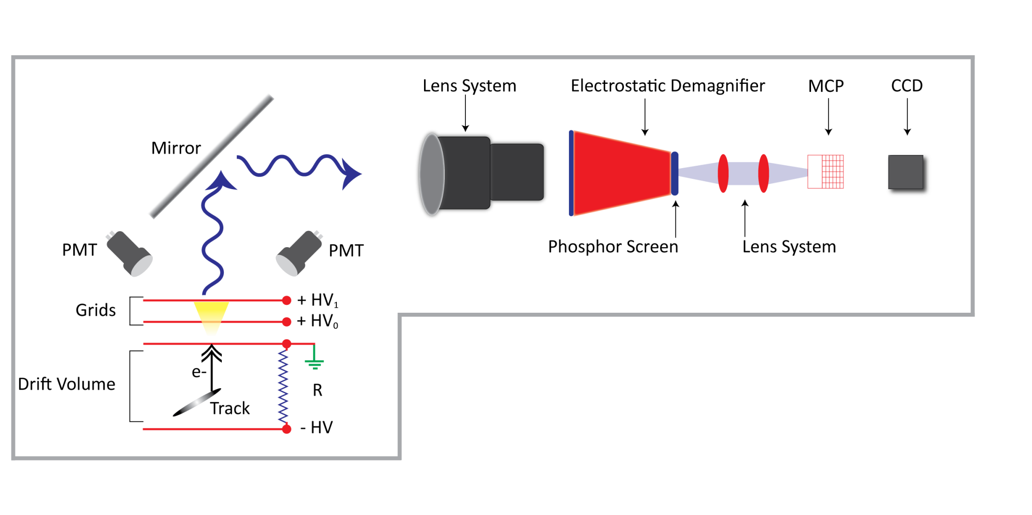
Evidence of a New 2₂⁺ State in ¹²C
Studies using Optical Time Projection Chamber
Details: Talk by W. Zimmerman, Few-Body Physics Working Group,
Monday 6th, 15:15

Slide 34
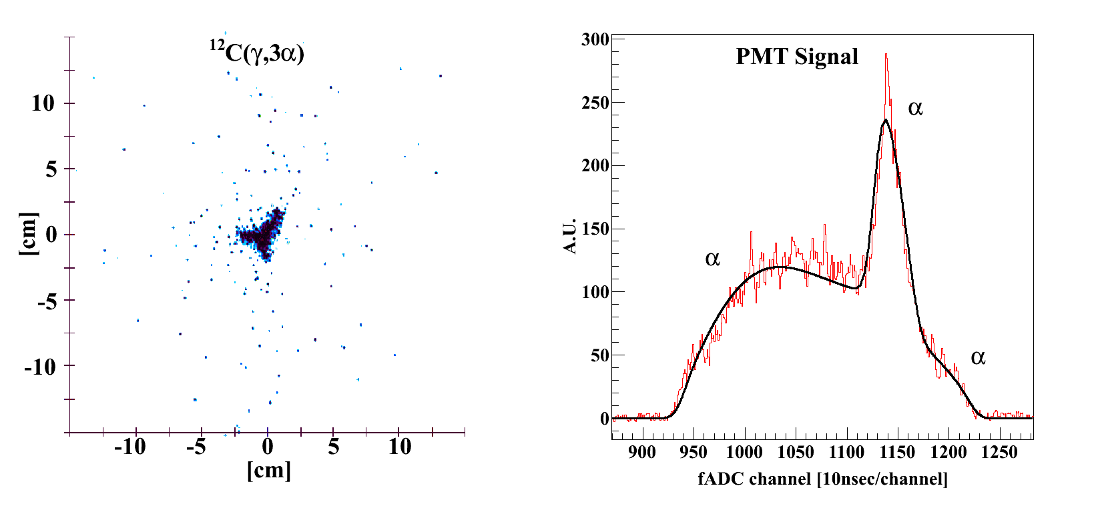
Evidence of a New 2₂⁺ State in ¹²C

Slide 35
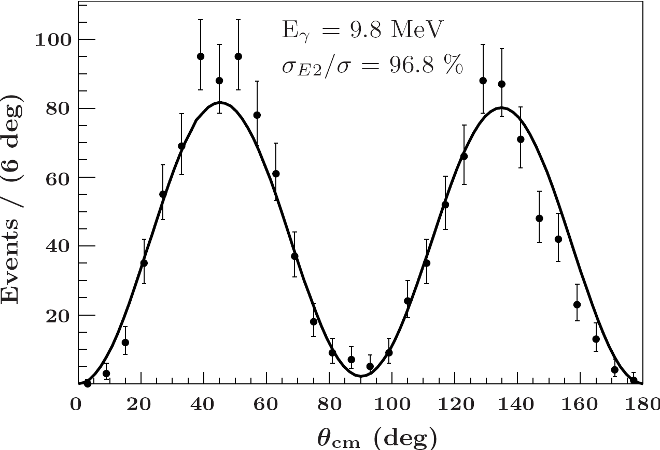
Measured Angular Distribution of ¹²C Events

Slide 36
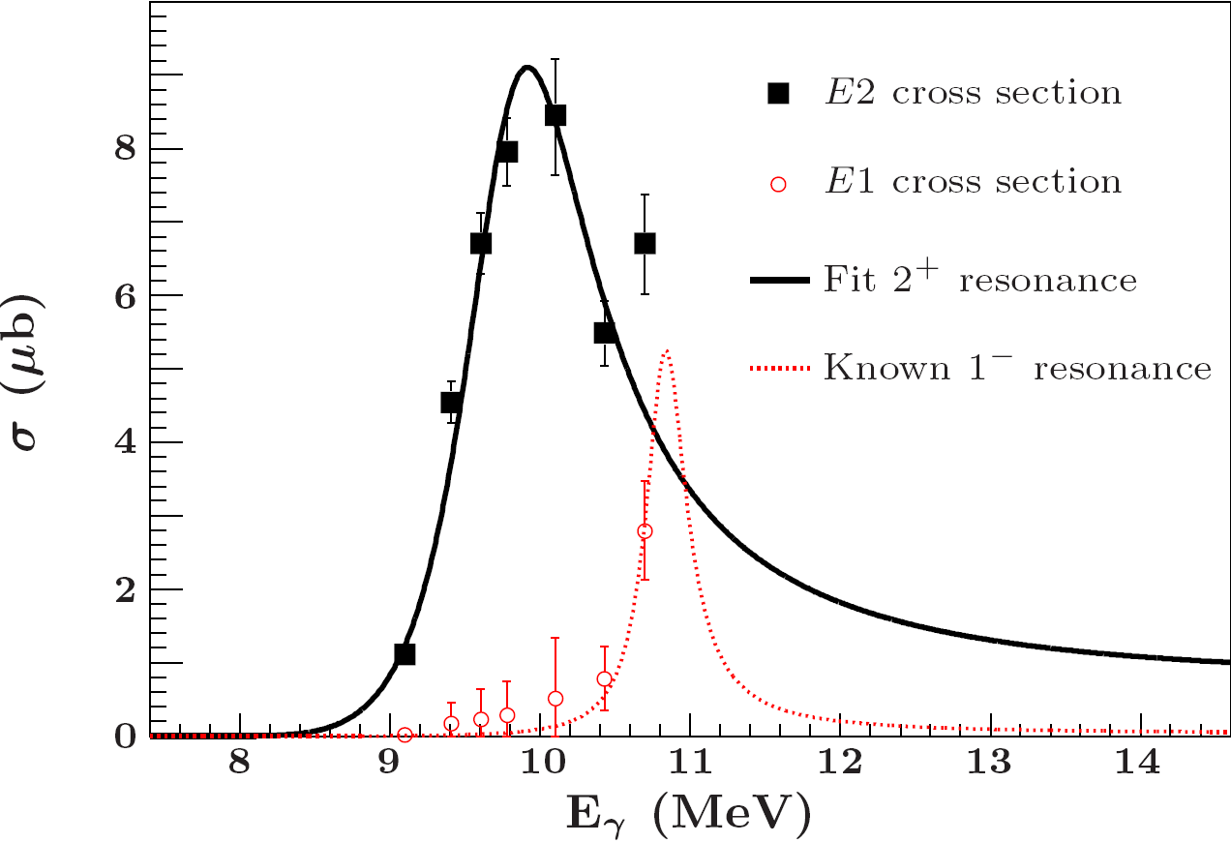
Evidence of a New 2₂⁺ State in ¹²C : Cross Section

Slide 37
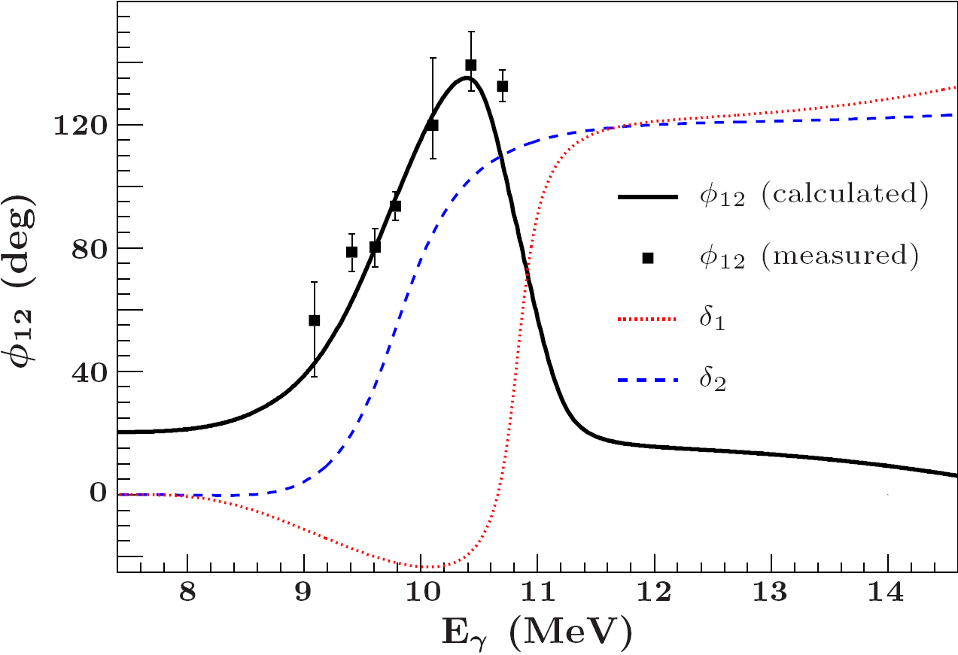
Evidence of a New 2₂⁺ State in ¹²C: Phase

Slide 38

Evidence of a New 2₂⁺ State in ¹²C: Reaction Rate

Slide 39

Evidence of a New 2₂⁺ State in ¹²C: Results
Experiment:
Comparing the Experimental Results and the lattice EFT Calculation
 | E(2₂⁺ - 0₂⁺) | B(E2: E(2₂⁺ →0₁⁺)
Experiment | 2.37 ± 0.11 | 0.73 ± 0.13
Theory | 2.0 ± 1 to 2 | 2 ± 1
Details: Talk by D. Lee, Few-Body Physics Working Group,
Monday 6th, 14:50

Slide 40
Evidence of a New 2₂⁺ State in ¹²C: Conclusions
A 2₂⁺ State in ¹²C has been directly observed
The structure of Hoyle State is believed to be similar to the ground state based upon observation of similar B(E2) values calculated for the 2₁⁺ → 0₁⁺ and 2₂⁺ → 0₂⁺ (Caution: the experiment did not measure the B(E2: 2₂⁺ → 0₂⁺ )
The ¹²C ground state is predicted to be a compact triangle cluster of 3 alpha particles, whereas the Hoyle state is predicted to be a combination of an obtuse triangle and a compact triangle configuration.

Slide 41

The Giant in the Room ¹²C(α,γ)¹⁶O
R-matrix fits to three data sets
For similar χ², factor of 18 different S-factors
M. Assuncao et al., Phys Rev. C 73, 055801 (2006),
J. W. Hammer et al., Physics, A 752 514c-521c (2005)

Slide 42


The Giant in the Room ¹²C(α,γ)¹⁶O : Previous Data
Consequence !
Can not constrain the phase. The fit to obtain the S-factors has only 2-parameters and the phase is fixed by elastic scattering
M. Assuncao et al., Phys Rev. C 73, 055801 (2006),
J. W. Hammer et al., Physics, A 752 514c-521c (2005)

Slide 43

The Giant in the Room ¹²C(α,γ)¹⁶O : HIGS Initial Data
We now have data from gamma ray energies of 9.1 to 10.7 MeV

Slide 44

Nuclear Matter and the Symmetry Energy
Pygmy Dipole Resonance (PDR)
Iso-Vector Giant Quadrupole Resonance (IVGQR)

Slide 45
Nuclear Matter: An example of Symmetry Energy
In the oscillation of neutrons against protons, the symmetry energy acts as its restoring force which gives rise to a dipole response
In neutron rich nuclei the neutron skin is responsible for this response (the Pygmy Dipole Resonance PDR)
The neutron skin is weakly correlated with the low-energy dipole strength (total photoabsorption cross section is dominated by GDR strength) but strongly correlated with the dipole polarizability
Study of such systems at nuclear densities is relevant to objects such as neutron stars

Slide 46



Study of Pygmy Dipole Resonance at HIGS

Slide 47


Study of Pygmy Dipole Resonance at HIGS

Slide 48



Nuclear Matter: IVGQR
Flips sign forward and backward angles
²⁰⁹Bi Compton Scattering
Details: See talk by H. W. Weller at the Few-Body Working group on Tuesday 7th at 16:55

Slide 49


Nuclear Matter: IVGQR
A novel technique which leads to unprecedented precision in the extracted parameters of the resonance

Slide 50

Road Map to the Future

Slide 51

Upcoming and Future Experiments at HIGS
Compton Scattering on 6Li at 80 MeV
Compton Scattering on proton at 80 MeV for EM pol
Compton Scattering on proton at 100 MeV for Spin pol
GDH Sum Rule for the Deuteron from 4 to 16 MeV
IVGQR Measurements on various nuclei
Further studies of PDR on ¹⁴⁰Ce, and ¹²⁴Sn
¹²C(γ,α)⁸Be
¹⁶O(γ,α)¹²C with the OTPC
¹⁶O(γ,α)¹²C with the Bubble Chamber
See the review article for the photopion program plans:

Slide 52
For further details on the experiments & theory
Please attend the presentations by:
Proton EM and Spin Polarizabilities – H. W. Weller, Few-Body, Tuesday 16:55
6Li Compton Scattering– L. S. Myers, Few-Body, Tuesday 17:20
Low-Energy Compton Scattering– H. W. Grißhammer, Hadron Structure, Monday 15:45
Proton Spin Polarizability– R. Miskimen, Hadron Structure, Monday 15:20
a_{nn}– C. R. Howell, Few-Body, Wednesday 14:00
¹²C 2₂⁺– B. Zimmerman, Few-Body, Monday 15:15
Lattice EFT Calculations for light nuclei– D. Lee, Few-Body, Monday 14:50

Slide 53


Basic Nuclear Physics Research at TUNL is supported by
DOE Grant # DE-FG02-97ER41033

