Slide 1

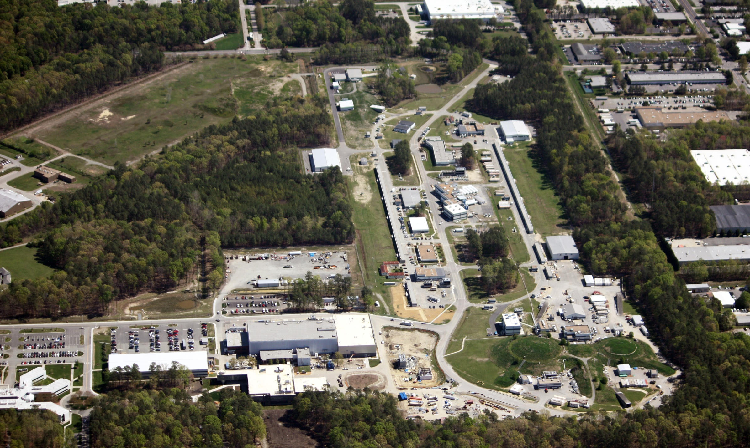
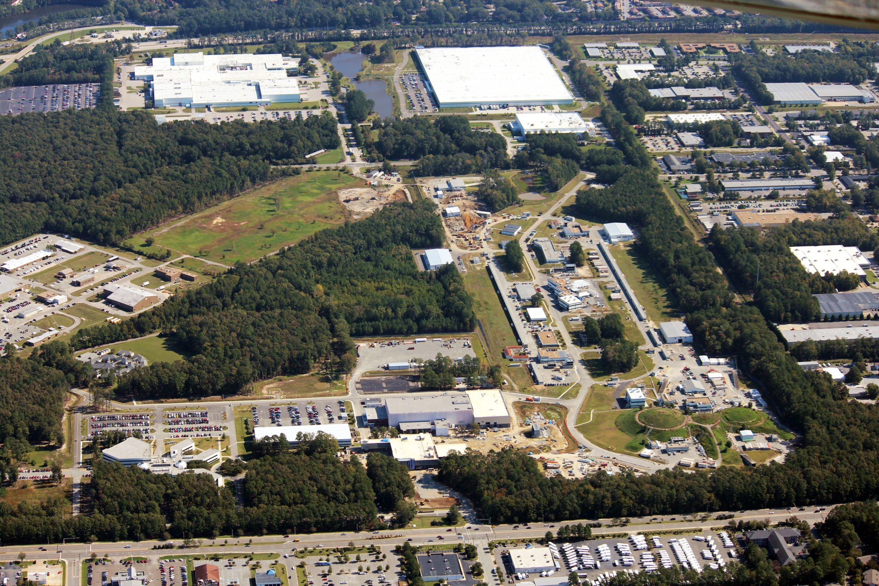
Jefferson Laboratory
Science Overview
R. D. McKeown
Chiral Dynamics 2012
Jefferson Lab

Slide 2
Outline
JLab context in Nuclear Physics
12 GeV Physics Program
phenomenology
techniques (theory+exp)
standard model tests
MEIC
Outlook
Discovery
Potential
New
Notes:
Like to give an overview of Jefferson Lab.
I can’t get going without saying something of the current status of the lab.
The dominant part of the talk will concern our 12 GeV Upgrade Project, the physics and the project status.
However, the technology which enables our nuclear physics and its enhancement also provides opportunities in the future
Photon Science
Accelerator Driven Systems
Nuclear Physics
Conclude

Slide 3
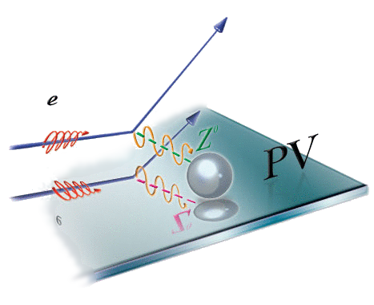
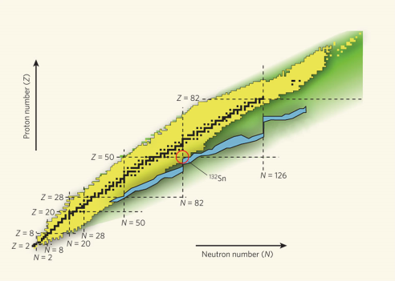
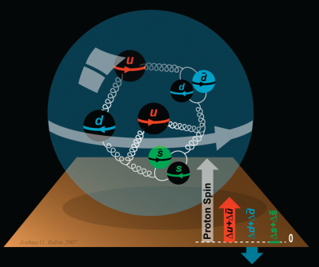
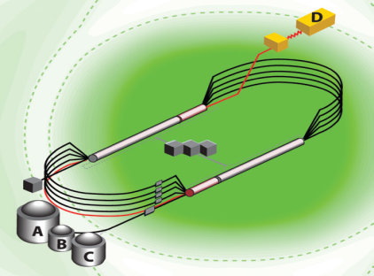

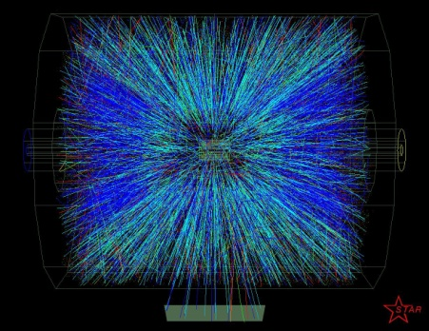
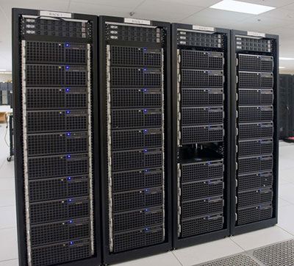
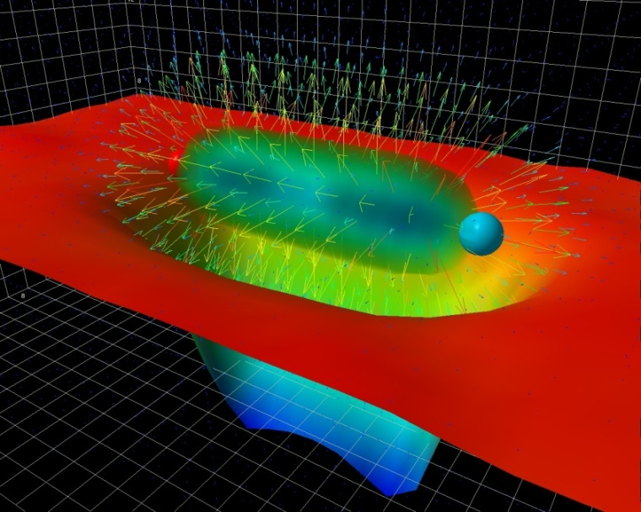
A Laboratory for Nuclear Science
Nuclear Structure
Structure of Hadrons
Fundamental
Forces & Symmetries
Accelerator S&T
Medical Imaging
Quark Confinement
Hadrons from Quarks
Theory and Computation

Slide 4
JLab: 21st Century Science Questions
What is the role of gluonic excitations in the spectroscopy of light mesons? Can these excitations elucidate the origin of quark confinement?
Where is the missing spin in the nucleon? Is there a significant contribution from valence quark orbital angular momentum?
Can we reveal a novel landscape of nucleon substructure through measurements of new multidimensional distribution functions?
What is the relation between short-range N-N correlations and the partonic structure of nuclei?
Can we discover evidence for physics beyond the standard model of particle physics?

Slide 5
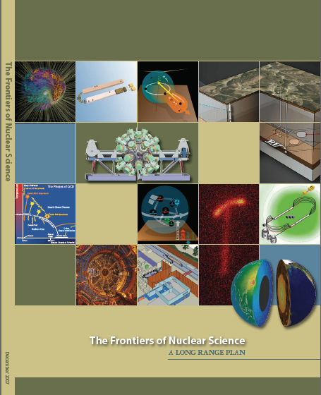
12 GeV Upgrade Project
Upgrade is designed to build on existing facility: vast majority of accelerator and experimental equipment have continued use
New Hall
Upgrade arc magnets
and supplies
Add 5 cryomodules
20 cryomodules
CHL upgrade
Maintain capability to deliver lower pass beam energies: 2.2, 4.4, 6.6….
Add arc
20 cryomodules
The completion of the 12 GeV Upgrade of CEBAF was ranked the highest priority in the 2007 NSAC Long Range Plan.
Add 5 cryomodules
Scope of the project includes:
Doubling the accelerator beam energy
New experimental Hall and beamline
Upgrades to existing Experimental Halls
Enhanced capabilities
in existing Halls

Slide 6
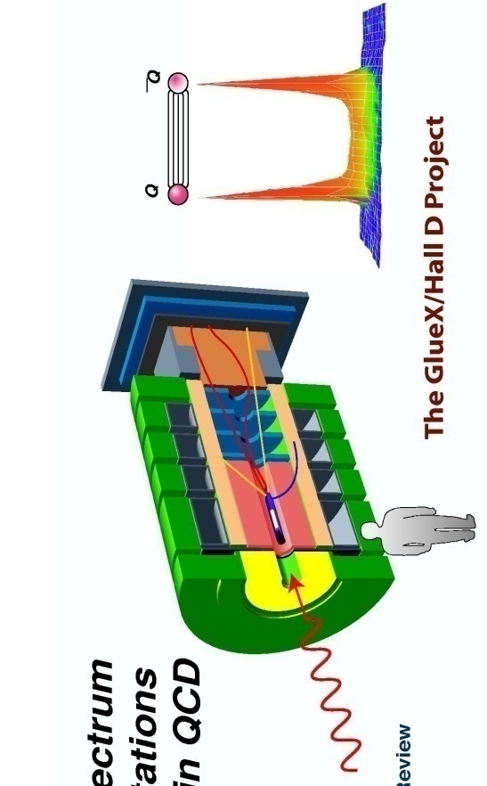
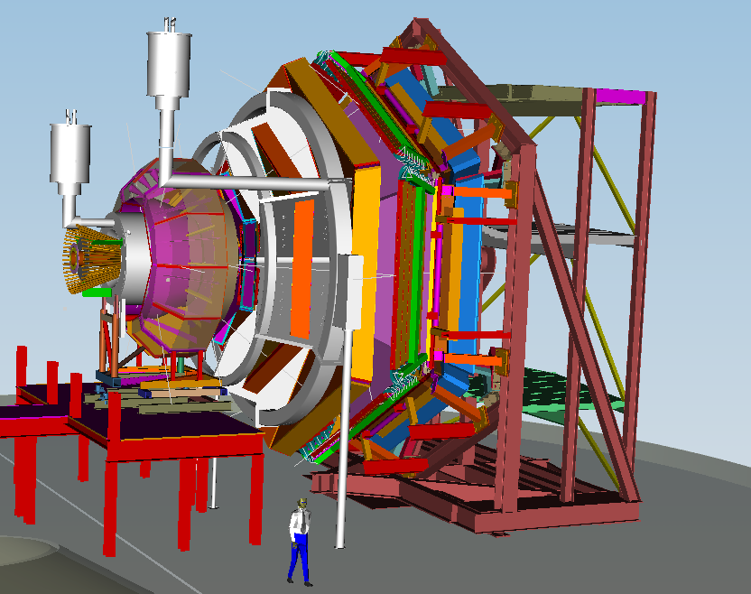
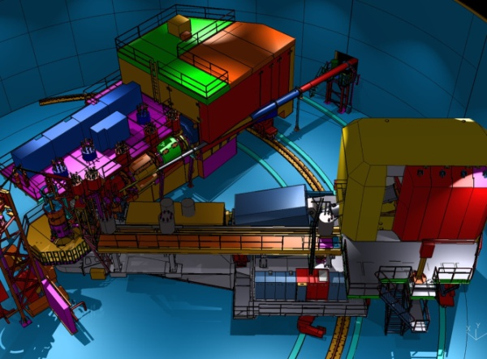
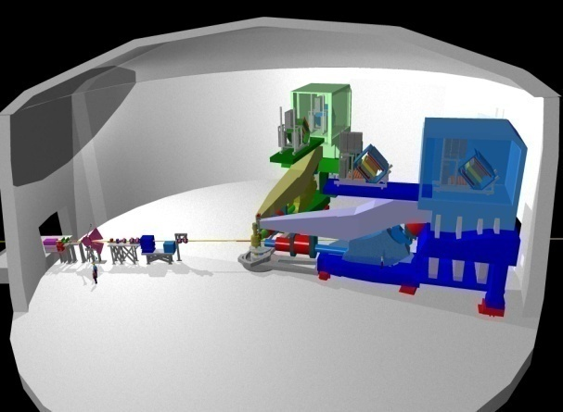
12 GeV Scientific Capabilities
Hall D – exploring origin of confinement by studying exotic mesons
Hall B – understanding nucleon structure via generalized parton distributions
Hall C – precision determination of valence quark properties in nucleons and nuclei
Hall A –form factors, future new experiments (e.g., SoLID and MOLLER)
Notes:
6
Note BSM not included in project

Slide 7
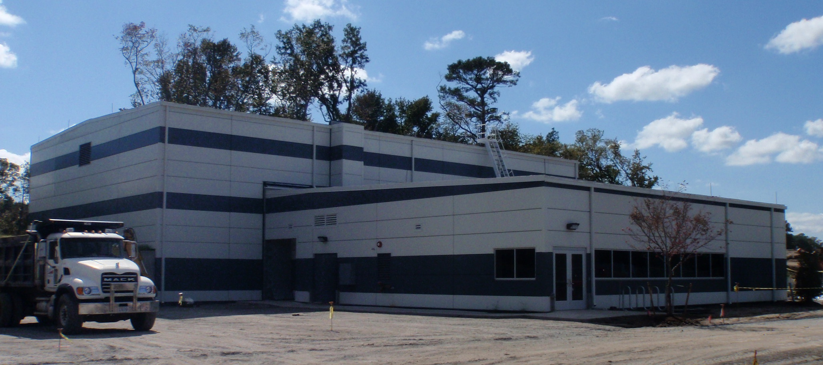
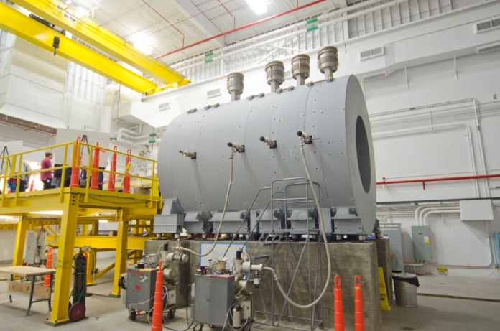
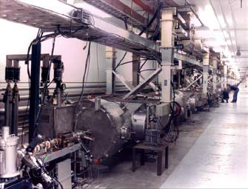
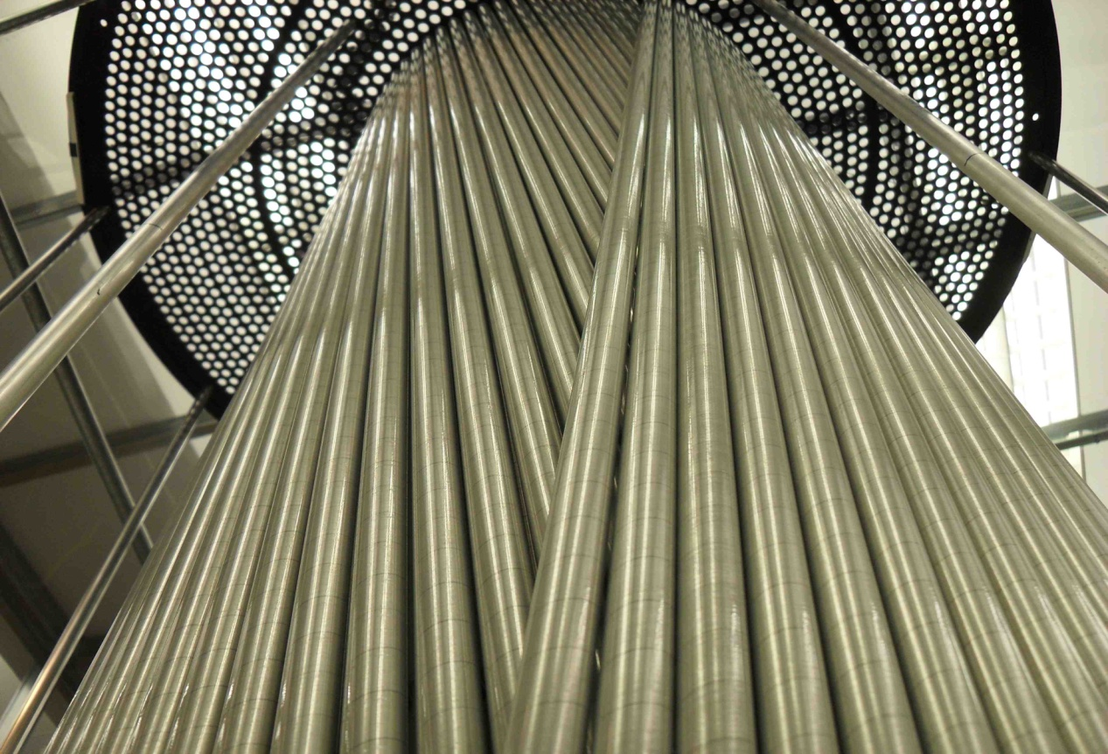
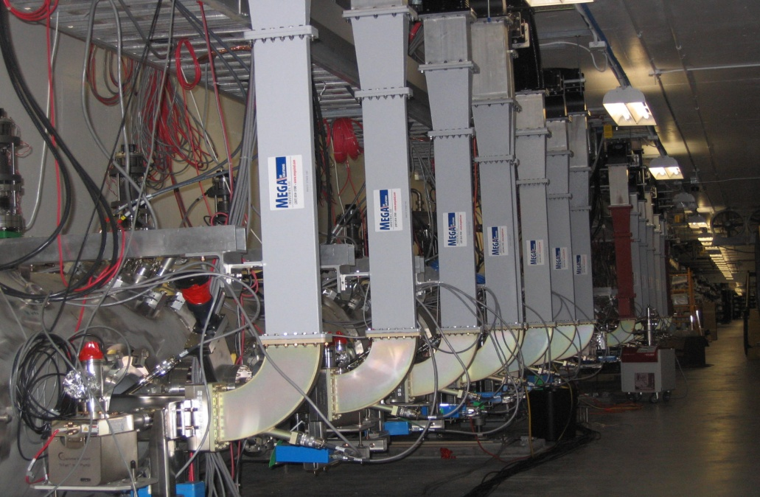
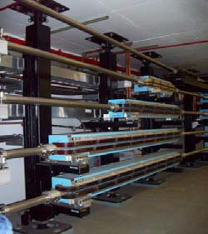
12 GeV Project Status
Hall D & Counting House
Hall D Interior
12 GeV Cryomodules
Cryomodule Waveguides
Arc Magnets
Hall D Drift Chamber
Performance Index: schedule 96%; cost 96%
Project Construction 58% complete
Civil 94% complete

Slide 8
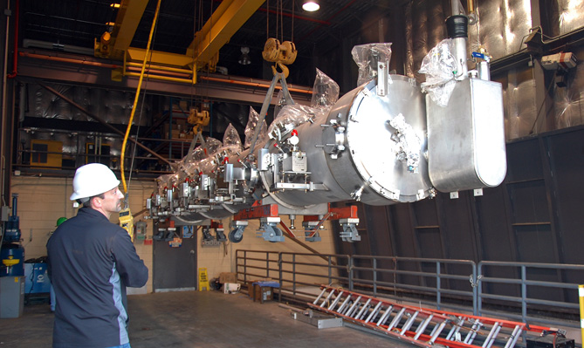
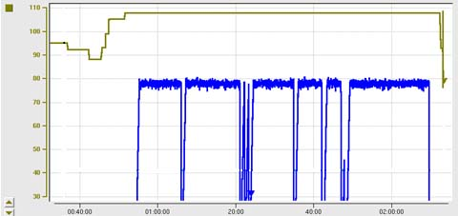
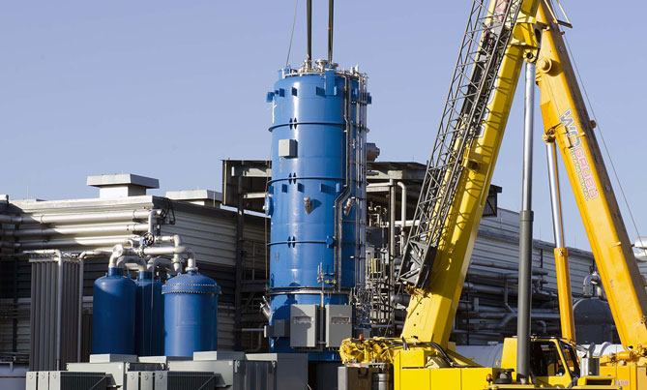
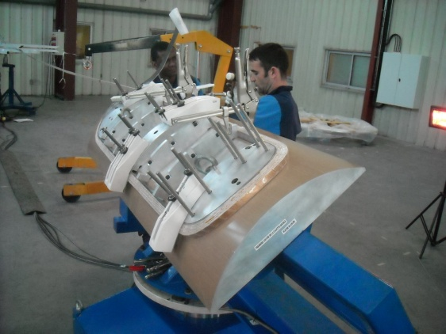
12 GeV Upgrade – Recent Progress
High gradient cryomodule performance
demonstrated in tunnel
◻ Met research beam spec. of 108 MeV @ 465 μA
Central Helium Liquefier-2 equipment in place
Hall D – equipment installation in progress
Superconducting magnets under construction
All major detector systems under construction
Third C100 Cryomodule
transferred to tunnel
C100 Cryomodule Energy Gain – May 18th
108 MeV
– 200
98 MeV
CHL-2
installation
– 150
ENERGY GAIN (MeV)
Beam Current/pass (μA)
– 100
– 50
TIME (in 20 minute increments)
Hall C Dipole
Magnet Coil

Slide 9
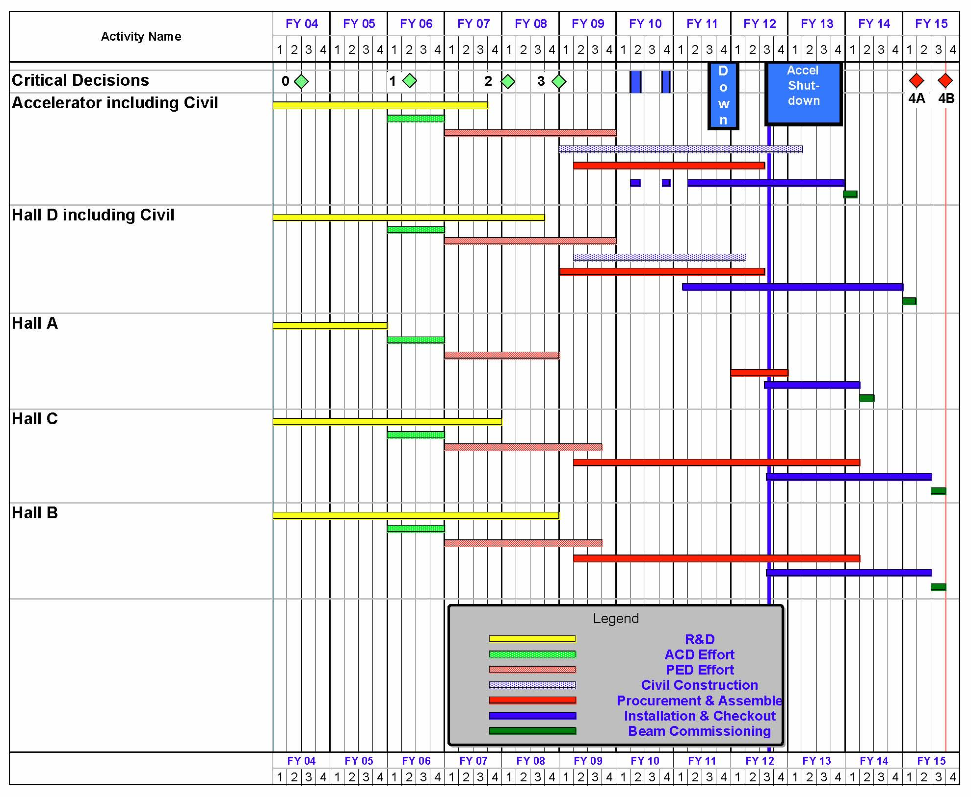
12 GeV Upgrade Project Schedule
FY12: reduction of $16M
FY13: Pres Request – no restoration
CD-4B may be at Risk
    12 16-month installation
    May 2012 - May Sept 2013
    Hall A commissioning start Oct 2013 Feb 2014
    Hall D commissioning start
    April 2014 Oct 2014
    Halls B & C commissioning start Oct 2014 Apr 2015
    Project Completion June 2015
Project to be re-baselined
November, 2012

Slide 10
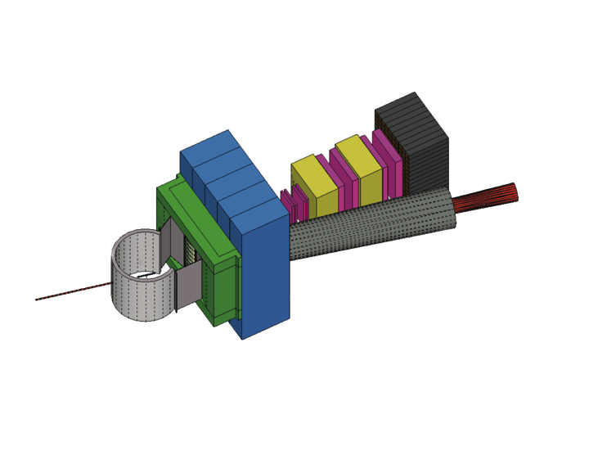
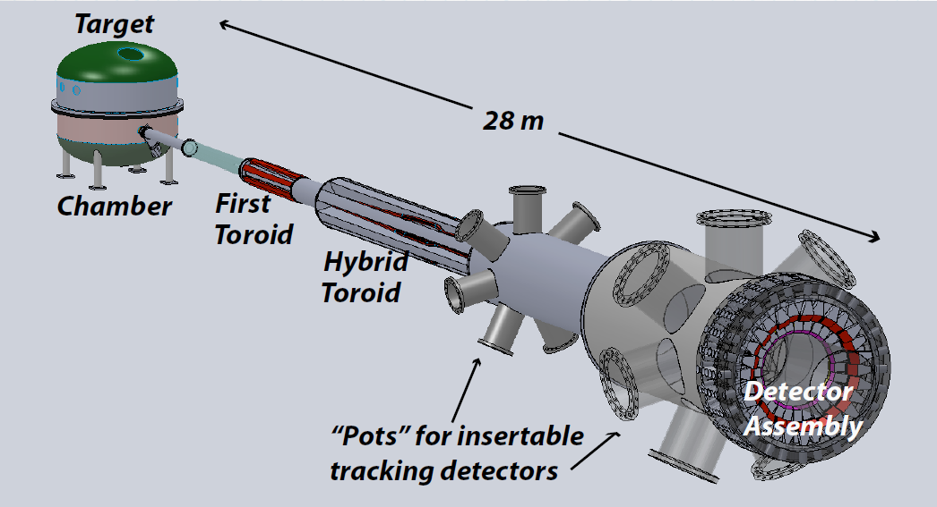
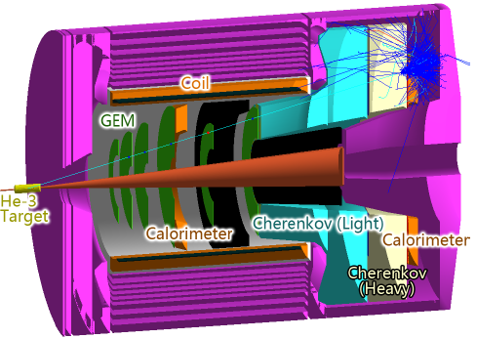
Beyond 12 GeV Upgrade
Super BigBite Spectrometer
(Approved for FY13-15 construction)
MOLLER experiment
(MIE – FY14-18?)
SoLID
Chinese collaboration
CLEO Solenoid?

Slide 11
12 GeV Science Program
The physical origins of quark confinement (GlueX, meson and baryon spectroscopy)
The spin and flavor structure of the proton and neutron (PDF’s, GPD’s, TMD’s…)
The quark structure of nuclei
Probe potential new physics through high precision tests of the Standard Model
Defining the Science Program:
  Eight Reviews: Program Advisory Committees (PAC) - 2006 through 2011
  Results: 52 experiments approved; 15 conditionally approved
  White paper for NSAC subcommittee
Experiments for 4 Halls approved for
more than seven years of operation beginning in FY15.

Slide 12
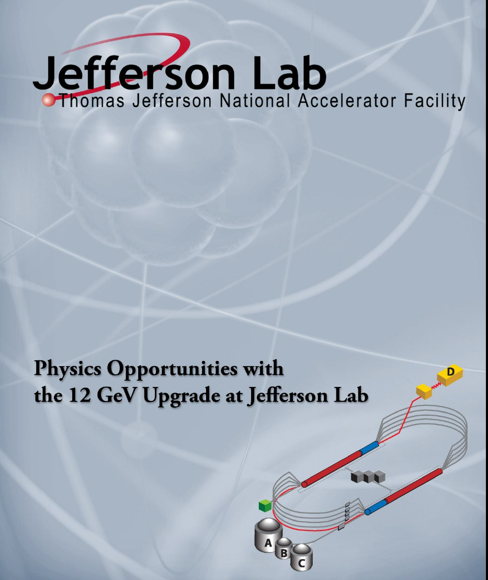
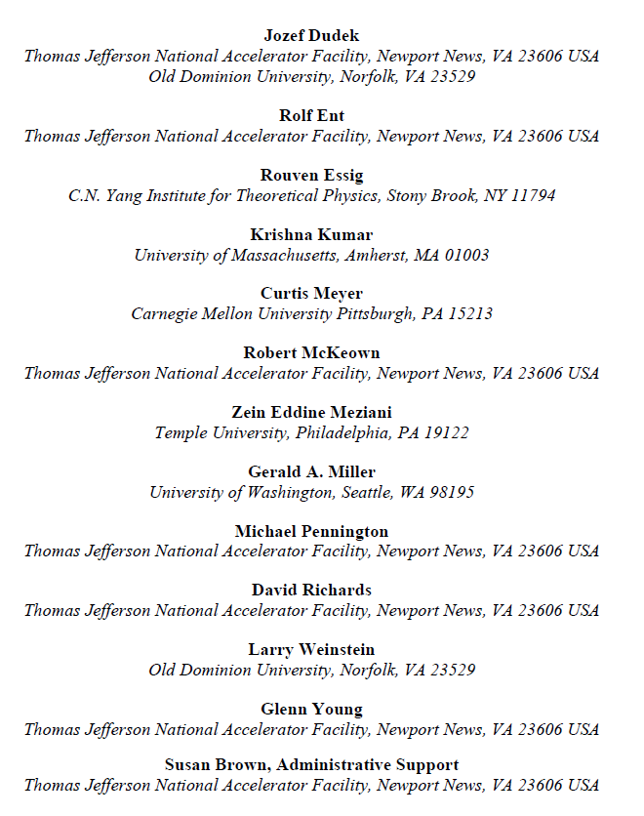
White Paper

Slide 13
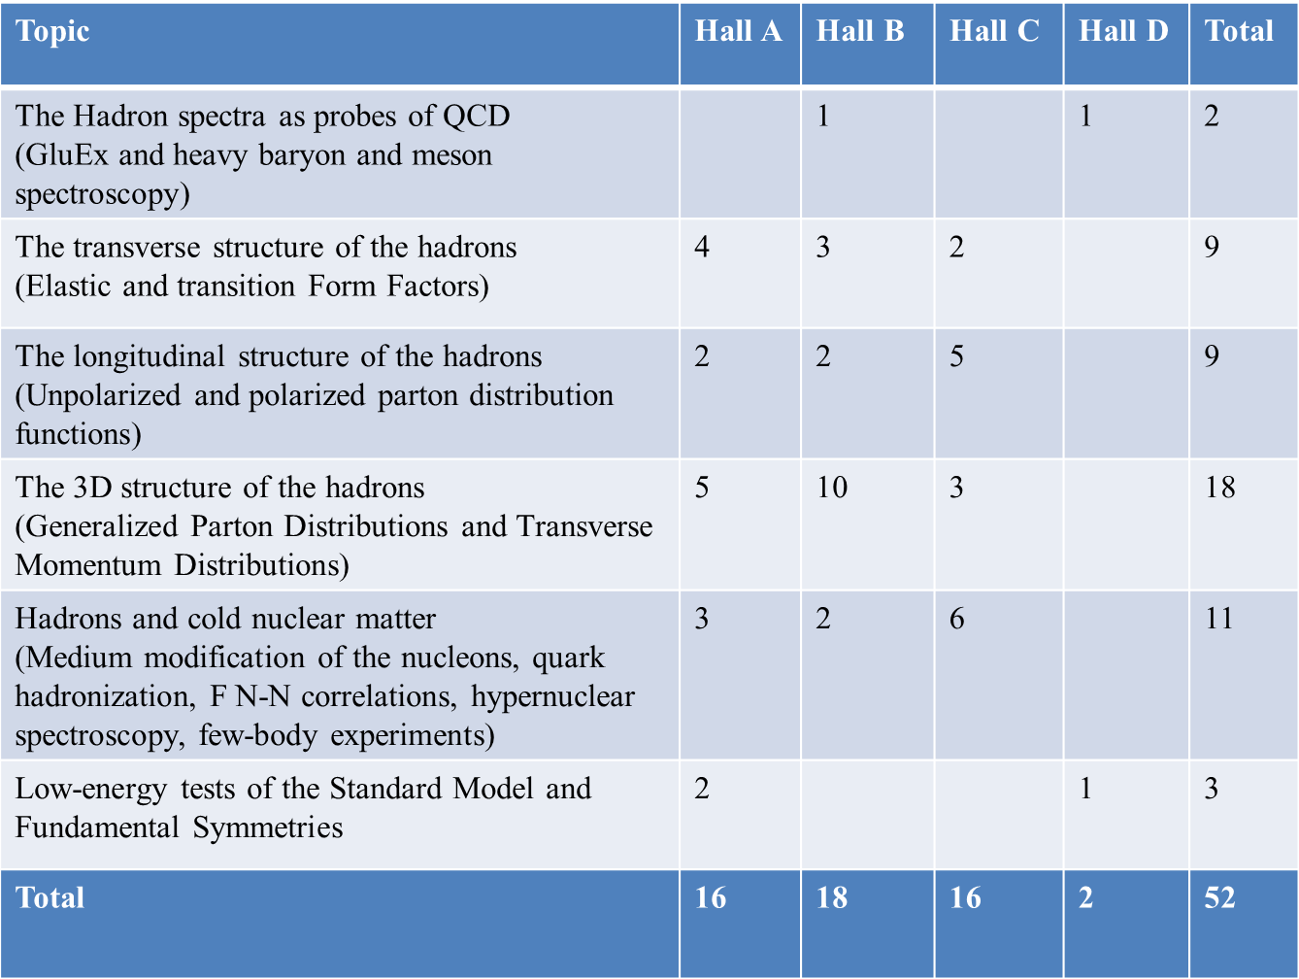
12 GeV Approved Experiments by Physics Topics
E12-11-105 has not been counted with the experiments since it is considered a test

Slide 14
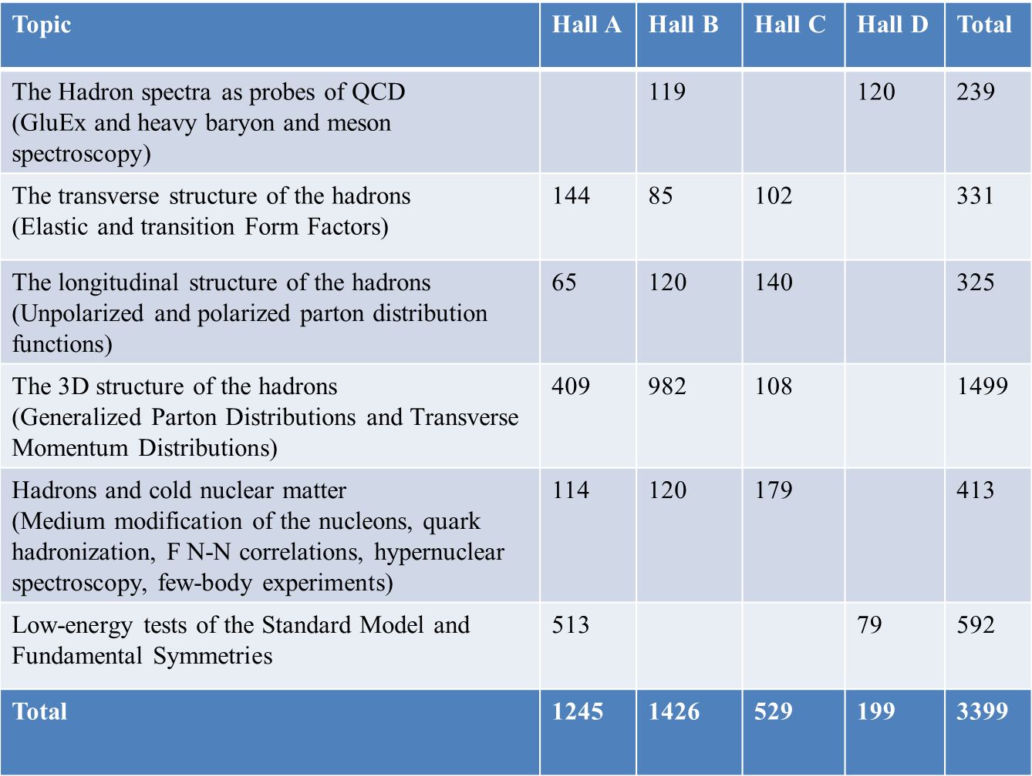
12 GeV Approved Experiments by PAC Days
More than 7 years of approved experiments

Slide 15
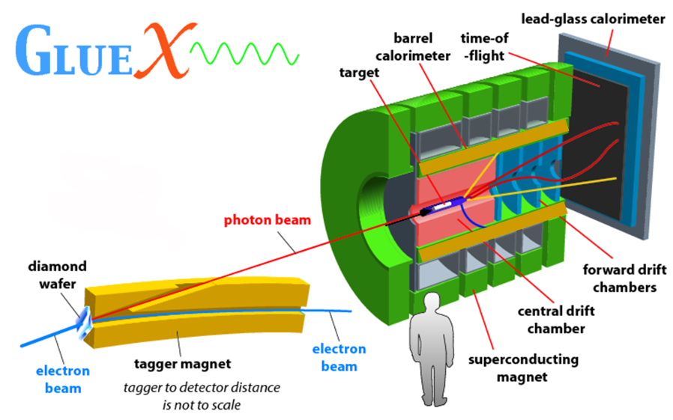
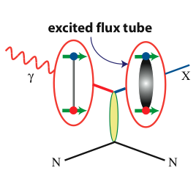
Hall D
FCAL
TOF
BCAL
start counter
FDC
CDC
BCAL

Slide 16
Quantum Numbers of Hybrid Mesons
Excited
Gluon Field
Quarks
Hybrid Meson
like
Exotic
like
Gluonic excitation (and parallel quark spins) lead to exotic J^{PC}

Slide 17
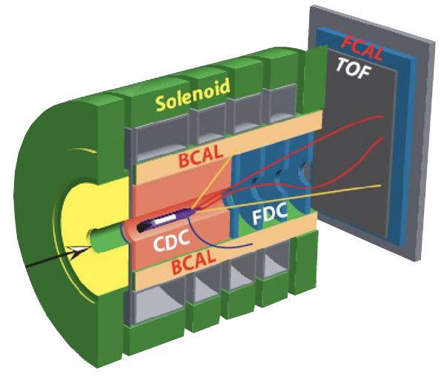

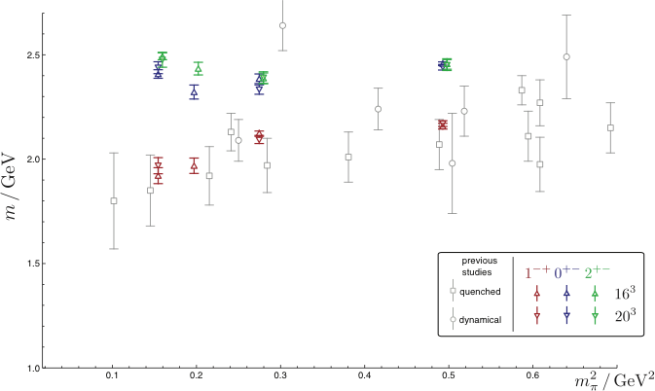
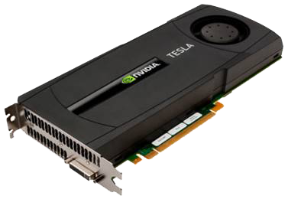

Isovector Meson Spectrum
Hall D@JLab
States with Exotic Quantum Numbers
2
+-
0
+-
1
-+
Dudek et al.

Slide 18
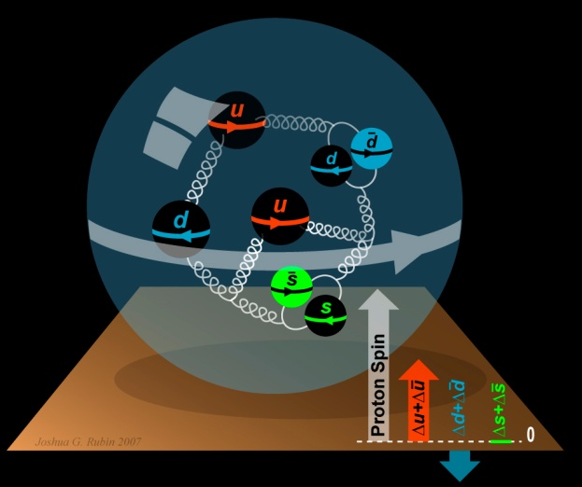
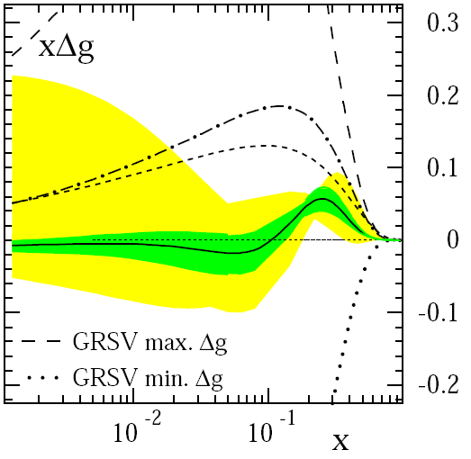
The Incomplete Nucleon: Spin Puzzle
1
1
ΔΣ
+
L_{q}
+
J_{g}
=
2
2
[X. Ji, 1997]
DIS → ΔΣ ≅ 0.25
RHIC + DIS → ΔG« 1
→ L_{q}
D. de Florian et al., PRL 101 (2008) 072001

Slide 19
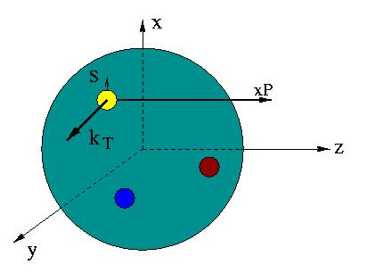
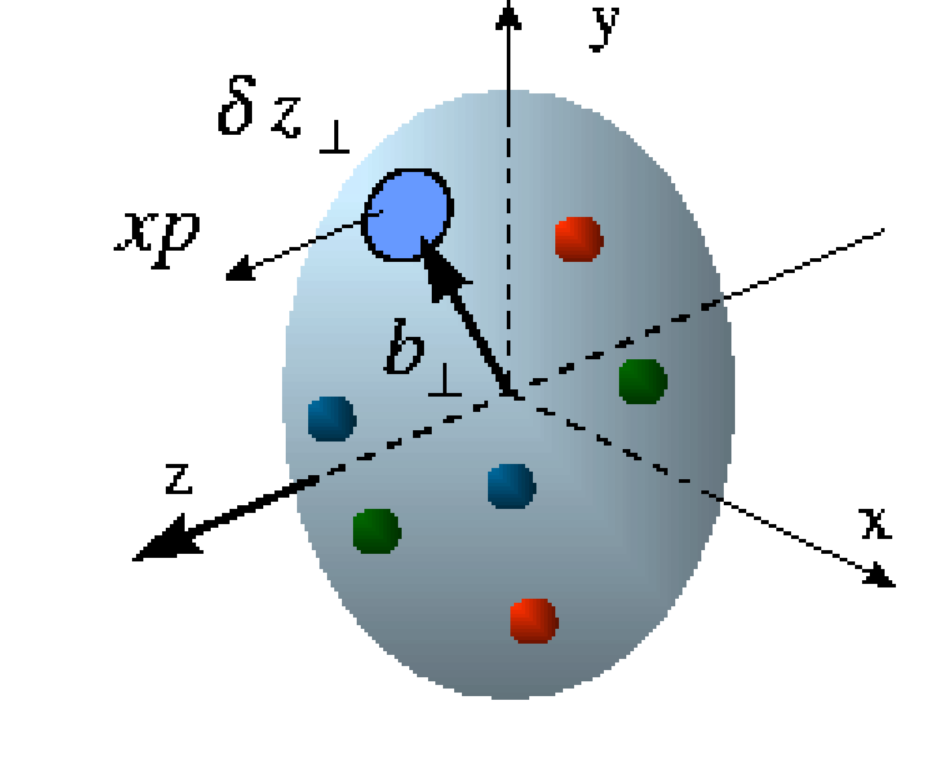
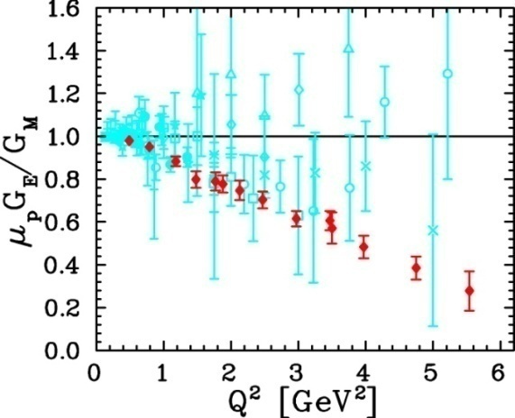
Unified View of Nucleon Structure
W_{p}^{u}(x,k_{T},r ) Wigner distributions
6D Dist.
d³r
d²k_{T} dr_{z}
TMD PDFs f₁^{u}(x,k_{T}), .. h₁^{u}(x,k_{T})‏
GPDs/IPDs
3D imaging
dx &
Fourier Transformation
d²k_{T}
d²r_{T}
Form Factors
G_{E}(Q²),
G_{M}(Q²)‏
PDFs
f₁^{u}(x), .. h₁^{u}(x)‏
1D

Slide 20
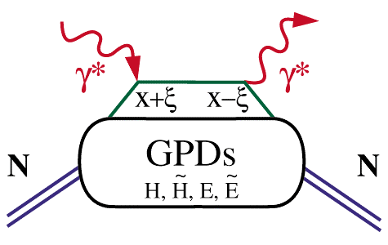
Extraction of GPD’s
Cleanest process: Deeply Virtual Compton Scattering
hard vertices
σ⁺ − σ⁻
σ⁺ + σ⁻
Δσ
2σ
A =
=
ξ=x_{B}/(2-x_{B})
t
Polarized beam, unpolarized target:
~
H(ξ,t)
Δσ_{LU}~ sinφ{F₁H+ ξ(F₁+F₂)H+kF₂E}dφ
Unpolarized beam, longitudinal target:
~
~
Δσ_{UL}~ sinφ{F₁H+ξ(F₁+F₂)(H+ξ/(1+ξ)E)}dφ
H(ξ,t)
Unpolarized beam, transverse target:
Δσ_{UT}~ sinφ{k(F₂H – F₁E)}dφ
E(ξ,t)

Slide 21
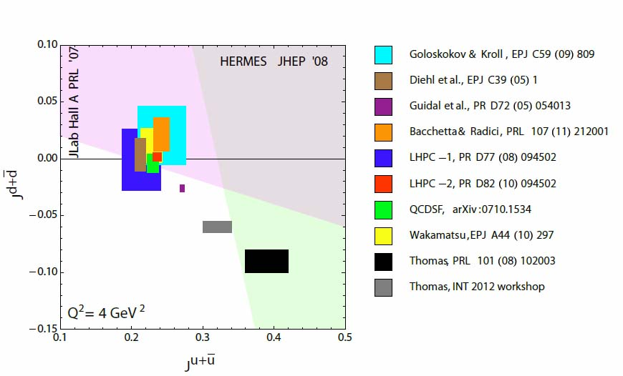
Quark Angular Momentum
→ Access to quark orbital angular
momentum

Slide 22
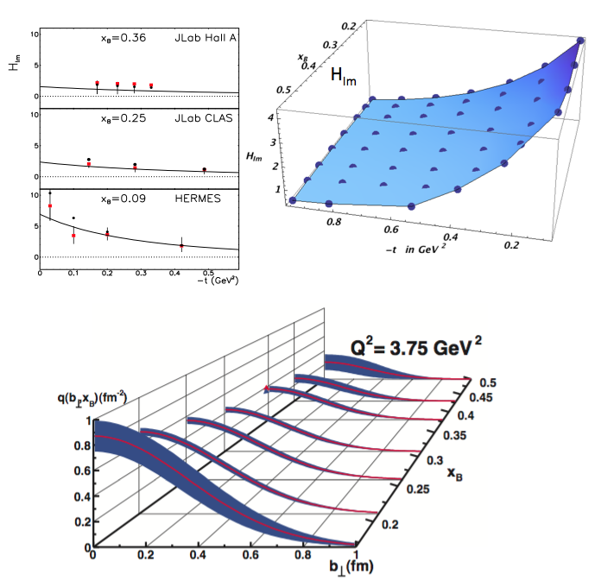
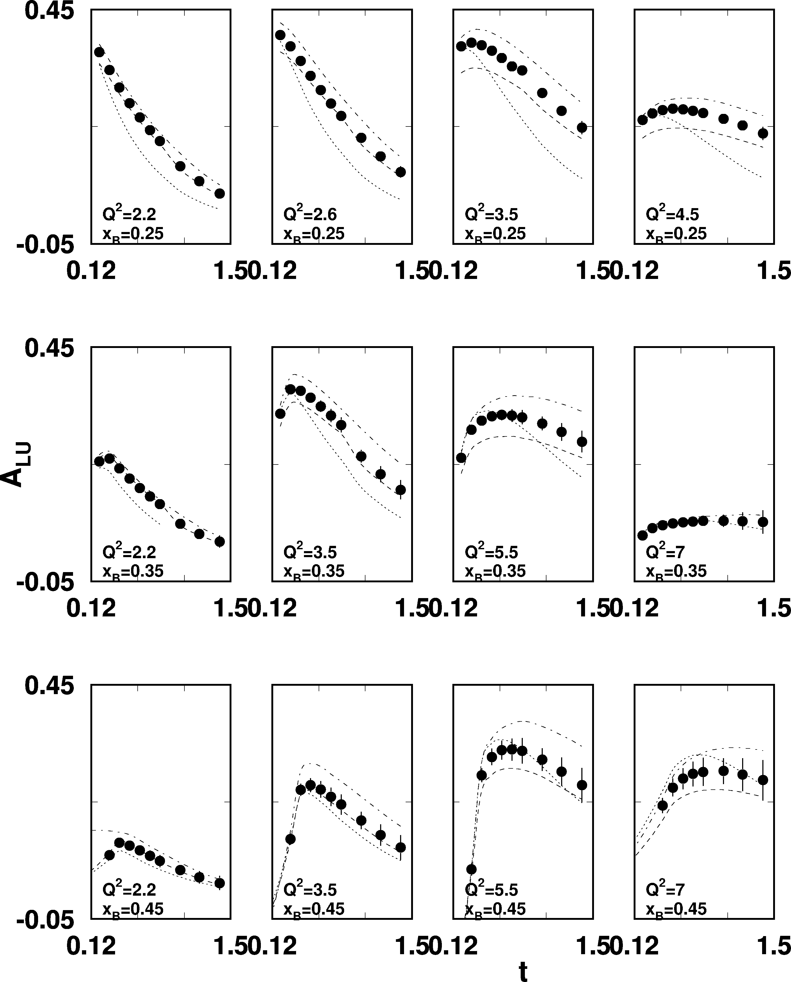
DVCS beam asymmetry at 12 GeV
CLAS12
sinφ moment of A_{LU}
ep epγ
High luminosity and large acceptance allows wide coverage
in Q² < 8 GeV², x_{B}< 0.65, and
t< 1.5GeV²

Slide 23




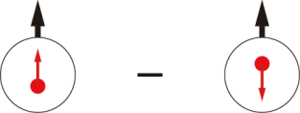
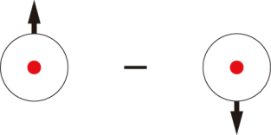
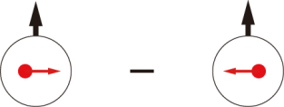

Transverse Momentum Dependent Parton Distributions (TMDs)
Leading Twist
Nucleon Spin
Quark Spin
 |  | Quark polarization
 |  | Un-Polarized | Longitudinally Polarized | Transversely Polarized
Nucleon Polarization | U
 | L
 | T
h₁⊥ =
f₁ =
Boer-Mulder
g₁ =
h_{1L}⊥ =
Helicity
h_{1T} =
f _{1T}⊥ =
g_{1T} ⊥ =
Transversity
h_{1T}⊥ =
Sivers
Pretzelosity
Notes:
Beside the three parton distribution functions which survive the integration over the quark transverse momentum there are five more transverse momentum dependent distribution functions at leading twist.
Here is a table of all the 8 leading twist TMDs, the cartoons on the right hand side of each name tell you the meaning of each TMDs. Again, the virtual photon is supposed to go out of the paper and that’s our longitudinal direction. The red circle and arrow are the quark and it’s spin, and black circle and arrow are the nucleon and it’s spin. The blue arrow shows the momentum direction of the quark.
An important information these 5 new TMDs will tell you is the quark oribtal angular motion. They will vanish without orbital angular momentum.
In particular, the Sivers function directly tells you the quark orbital angular momentum in a transverse polarized target, Boer-Mulder tells you the correlation of the quark orbital momentum and it’s spin inside a unpolarized nucleon and Pretzelosity, in certain model context, direct measures the relativistic nature of the nucleon.
Blue: no kt dependence and T-even
Red: T-odd with kt dependence
Other: kt dependence and T-even

Slide 24
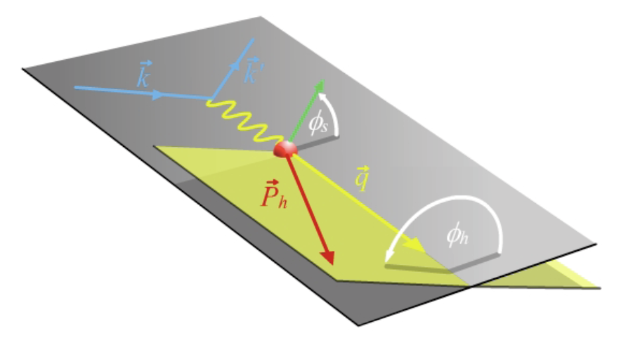
SIDIS Electroproduction of Pions
Separate Sivers and Collins effects
Sivers angle, effect in distribution function: (φ_{h}-φ_{s})
Collins angle, effect in fragmentation function: (φ_{h}+φ_{s})
Previous data from HERMES,COMPASS
New landscape of TMD distributions
Access to orbital angular momentum
target angle
hadron angle
Scattering Plane

Slide 25
SIDIS Studies with 12 GeV at JLab
CLAS12 in Hall B
General survey, medium lumi
SHMS- HMS in Hall C
L-T studies, precise π⁺/π⁻ ratios
SBS in Hall A
High x, High Q², 2-3D
SOLID in Hall A
High Lumi and acceptance – 4D

Slide 26

SoLID Transversity Projected Data
Total 1400 bins in x, Q², P_{T} and z for 11/8.8 GeV beam.
z ranges from 0.3 ~ 0.7, only one z and Q² bin of 11/8.8 GeV is shown here. π⁺ projections are shown, similar to the π⁻ .

Slide 27




Qweak
Precise determination of
the weak charge of the proton
Q_{w}= -2(2C_{1u}+C_{1d})
=(1 – 4 sin² θ_{W})
2.2 kW
Luminosity
monitors
Luminosity
monitors
scanner

Slide 28

Future PV Program at JLab
PV Moller Scattering:
Custom Toroidal Spectrometer
5kW LH Target
SOLID (PVDIS):
High Luminosity on LD2 and LH2
Better than 1% errors for small bins
Large Q² coverage
x-range 0.25-0.75
W²> 4 GeV²

Slide 29

Projected Results

Slide 30


Cosmology and Dark Matter
Dark sector is new physics, beyond the standard model
Many direct searches for dark matter interacting with
sensitive detectors (hints, no established signal yet…)
Controversial evidence for
excess astrophysical positrons…

Slide 31




PAMELA Data on Cosmic Radiation
Surprising rise in e⁺ fraction
But not p
Could indicate low mass A’ (M_{A’} < 1 GeV )
Or local astrophysical origin??

Slide 32


New Opportunity: Search for A’ at Jefferson Lab
Produce A’ with electron beam
Detect pair decays (narrow peak above background)
g – 2 preferred!
3 Jefferson Lab proposals:
APEX (Hall A) – test run published
HPS (Hall B) – tested with photon beam
DarkLight (FEL) – test run complete

Slide 33

New Opportunity: Search for A’ at Jefferson Lab
BNL “g-2” expt: Δa_{μ}(expt-thy) = (295±88) x 10⁻¹¹ (3.4 σ)
No evidence for SUSY at LHC (yet)
Another solution: A’, a massive neutral vector boson
3 Jefferson Lab proposals
g – 2 preferred!
APEX (Hall A) – test run published
HPS (Hall B) – tested with photon beam
DarkLight (FEL) – test run complete

Slide 34
12 GeV JLab – The Potential
Opportunity to discover and study new exotic mesons to elucidate the mechanism of confinement.
Opportunity to discover and study new exotic mesons to elucidate the mechanism of confinement.
Open a new landscape of nucleon tomography, with potential to identify the missing angular momentum.
Establish the quantitative foundation for the short-distance behavior in nuclei, underpinning the development of precision nuclear structure studies.
Provide stringent new tests of the standard model and extensions, complementing the information obtained at LHC.
Establish a firm basis for higher energy studies with a future
Electron Ion Collider

Slide 35
Electron Ion Collider
NSAC 2007 Long-Range Plan:
“An Electron-Ion Collider (EIC) with polarized beams has been embraced by the U.S. nuclear science community as embodying the vision for reaching the next QCD frontier. EIC would provide unique capabilities for the study of QCD well beyond those available at existing facilities worldwide and complementary to those planned for the next generation of accelerators in Europe and Asia.”
EIC “collaboration” – Milner & Deshpande contact persons, involves BNL and JLab communities
JLab and BNL are both developing “staged” designs
EICAC advisory comm. → Montgomery & Aronson (BNL)
Next NSAC Long Range Plan?

Slide 36



Into the “sea”: EIC
An EIC aims to study the sea quarks, gluons, and scale (Q²) dependence.
With 12 GeV we study mostly the valence quark component
mEIC
EIC
12 GeV

Slide 37
EIC Science Frontier
Explore the nuclear landscape at low x to:
Discover the collective effects of gluons in nuclei
Complete the map of the spin and spatial structure of sea quarks and gluons in nucleons
Understand the emergence of hadronic matter from quarks and gluons

Slide 38



Medium Energy EIC@JLab
Warm large booster
(up to 20 GeV)
transfer beam line
Pre-booster
SRF linac
Ion
source
Cold ion
collider ring
(up to 100 GeV)
Medium energy IP
Electron collider ring
(3 to 11 GeV)
Injector
12 GeV CEBAF
JLAB Concept
Initial configuration (MEIC):
  3-11 GeV on 20-100 GeV ep/eA collider
  fully-polarized, longitudinal and transverse
  luminosity: up to few x 10³⁴ e-nucleons cm⁻² s⁻¹
    Upgradable to higher energies (250 GeV protons)

Slide 39
Envisioned EIC Timeline
Activity Name | 2010 | 2011 | 2012 | 2013 | 2014 | 2015 | 2016 | 2017 | 2018 | 2019 | 2020 | 2021 | 2022 | 2023 | 2024 | 2025
12 Gev Upgrade
FRIB
EIC Physics Case
NSAC LRP
EIC CD0
EIC Machine Design/R&D
EIC CD1/Downsel
EIC CD2/CD3
EIC Construction

Slide 40
A Laboratory for Nuclear Science
The Jefferson Lab electron accelerator is a unique world-leading facility for nuclear physics research
12 GeV upgrade ensures at least a decade of excellent opportunities for discovery
– New vistas in QCD
– Growing program Beyond the Standard Model
EIC moving forward:
– Strong science case, much builds on JLab 12 GeV program
– MEIC design well developed – time scale following 12 GeV program is “natural”

