Slide 1

Quark Loop Effects on the Gluon Propagator
Arlene Cristina Aguilar
Centre for Natural Sciences and Humanities - CCNH
Federal University of ABC, São Paulo, Brazil
in collaboration with D. Binosi and J. Papavassiliou
[coming soon]
Workshop on Confinement Physics
March 12-15, 2012 - Jefferson Lab

Slide 2
Outline of the talk
Motivation
Transversality of the PT-BFM gluon SDE and the inclusion of the quark loop
The PT-BFM quark-gluon vertex and the non-perturbative calculation of the quark loop
The impact of the quark loops on the gluon propagator shape
Conclusions

Slide 3
Motivation
In recent years, a substantial progress has been made in our understanding of various aspects of the nonperturbative dynamics of Yang-Mills theories, through the fruitful combination lattice and SDE.
A significant part of the existing SD analysis has focused on the study of Green's functions at the level of a pure Yang-Mills theory, without the inclusion of quarks (majority of lattice simulations work in the quenched limit)
Here we carry out a nonperturbative computation of the effects that the quark loops induce to the gluon propagator.
Using as input the non-perturbative quark propagators obtained from the gap equation, and the fully-dressed quark-gluon vertex that satisfies the correct WI, and (ii) adding the resulting effect to the quenched gluon propagator obtained from the large-volume lattice simulations

Slide 4
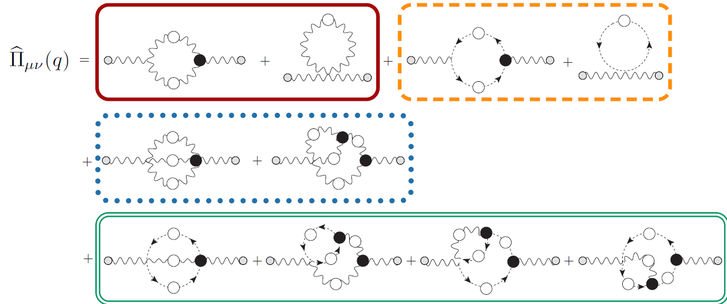



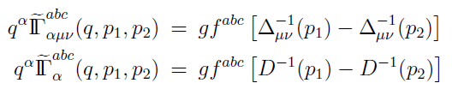

The PT-BFM Schwinger Dyson series
Transversality enforced loop-wise and field-wise
because vertices satisfies:
A.C.A and J.P, JHEP 0612, 012 (2006)
A.C.A, D.B. and J. P., Phys.Rev.D78, 025010 (2008)
D.B. and J.P., Phys.Rev.D77, 061702 (2008); JHEP 0811:063,2008, Phys. Rept. 479, 1-152 (2009)

Slide 5
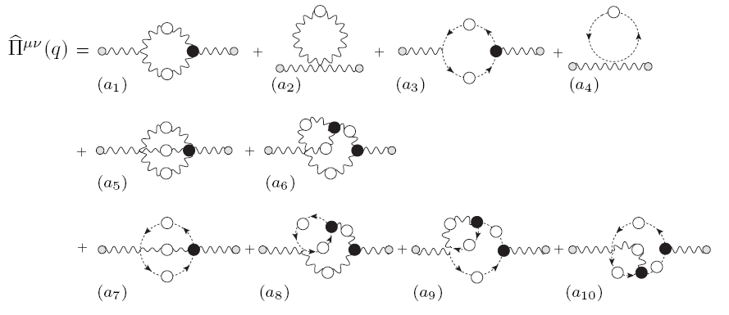
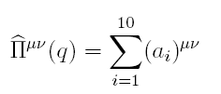

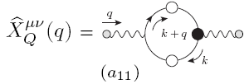



Adding quarks to the gluon propagator
Quenched gluon propagator
Auxilary function conecting the
conventional to the PT-BFM propagator
Suffix Q indicates the effects of the presence of the quark loops

Slide 6

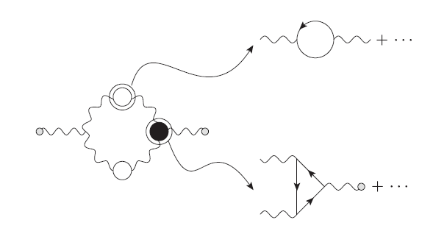
The nonlinear propagation of the presence of the quark in the other diagrams
Why
There will be a nonlinear propagation of the changes induced due to X(q), which will also affect the original subset of purely Yang-Mills graphs (a₁ –a₁₀) → Internal gluon propagator and the three-gluon vertex gets modified.
We assume that the inclusion of two light quark flavors (m = 300 MeV) may be considered as a “perturbation” to the quenched case.
Our operating assumption is that these effects may be relatively small compared to those originating from graph a₁₁ (quark loop)

Slide 7
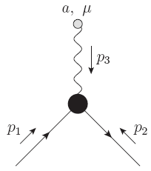
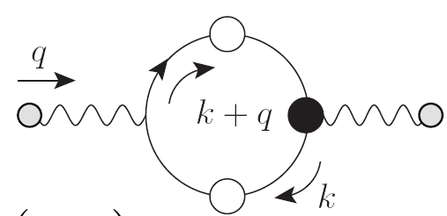

The quark-gluon vertex
In the PT-BFM scheme, the contribution to the gluon self-energy due to the quark loop has a special ingredient: the fully-dressed quark-gluon vertex
PT-BFM quark-gluon vertex
The PT-BFM quark-gluon vertex satisfies the Ward identity
Instead the conventional Slavnov-Taylor identity
Quark propagator
Quark-ghost scattering kernel

Slide 8


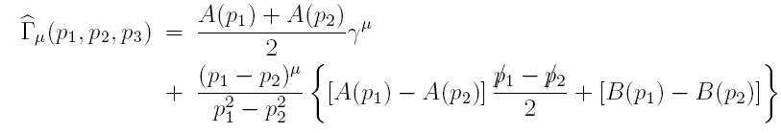
The structure of the quark-gluon vertex
The most general Ansatz for the longitudinal part of
The form factor are
where the functions A(p) and B(p)
and the dynamical mass is defined as the ratio
The resulting vertex is known as Ball Chiu (BC) vertex
J.S. Ball and T.W. Chiu, Phys.Rev. D 22, 2542 (1980).

Slide 9

Other possibility is the Curtis-Pennington (CP) vertex :
Differs from the BC vertex by adding a tranversal piece (automatically conserved) - MR
  where
We will use both BC and CP vertices, and compare the difference they induce to the quantities of interest.
  D. C. Curtis and M. R. Pennington, Phys. Rev. D 42, 4165 (1990)

Slide 10
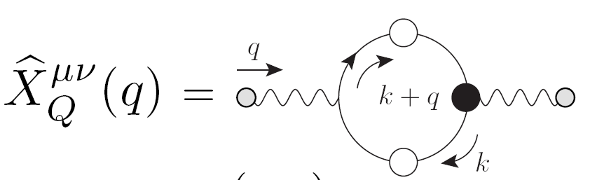



Nonperturbative calculation of the quark loop
The quark-loop of the PT-BFM scheme
where d_{f} = ½ for SU(3)
Notice that the quark loop is transverse, i.e.
After inserting the BC vertex and taking the trace, we find

Slide 11
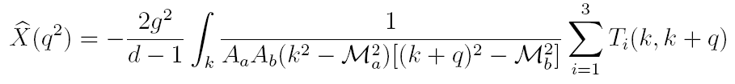
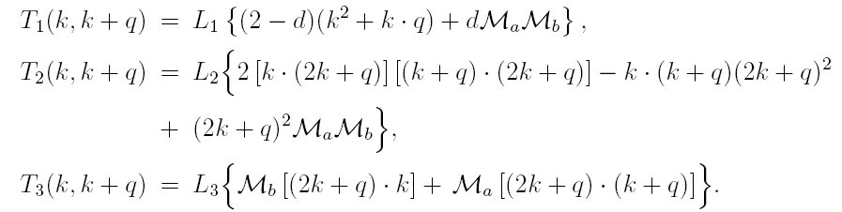
where the subindex “a” → function evaluated at k and “b” at (k+q)
We find a term for each form factor L_{i} of the BC vertex
In the limit of q² → 0 , we have

Slide 12



Contribution at zero momentum
It is important to notice that the integral
vanishes by virtue of an identity valid in dimensional regularization know as “seagull identity”
Assuming that
We obtain
Notice that at one loop , A(k)=1 and M ² (k) =m², this result was already expected!
A. C. A and J.Papavassiliou, Phys. Rev. D 81, 034003 (2010).
The quark -loop has no direct influence on the value of Δ(0) , its influence is through the nonlinear propagation

Slide 13



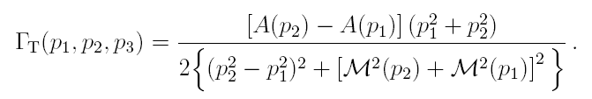



For the CP vertex, the answer will be expressed as a deviation from
where is giving by the integral
where
Notice that in the limit of we have
Therefore the result persists for the CP vertex .

Slide 14


Nonlinear propagation changes de value of the gluon mass
Let us cast the quenched gluon propagator Δ(q²) into the form
where J(q²) is the “kinetic term”, or “wave function” contribution, whereas the m²(q²) is the momentum-dependent mass
In the presence of quarks , we have
Notice that m² (q²) will change, despite the fact that X(q), does not contribute at q² = 0, since X(0) = 0 .
X(q²) does not affect directly the gluon mass equation; instead, the modification induced is indirect, due to the change in the overall shape of Δ(q²) throughout the entire range of momenta.
When:
q² → 0 q² J(q²) → 0
m² (0) ≠ 0
Then
Δ⁻¹(0) ≠ 0
A. C. A., D. Binosi and J. Papavassiliou, JHEP 1201, 050 (2012)

Slide 15


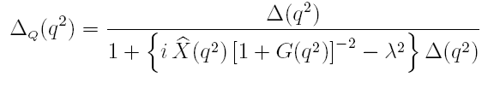
Let us denote
A reliable first-principle determination of λ² is not possible at the moment (we need to use the 2-loop mass equation)
In the analysis presented here we will extract an approximate range for λ² , through extrapolation towards the deep IR of the curves obtained for intermediate momenta.
To estimate the effect of the quark loop(s) on the gluon propagator, we will suppose that the main bulk of correction comes from the extra diagram a₁₁ . Therefore
Then

Slide 16








Renormalization
We will renormalize MOM scheme which the condition is given by
where
For large values of q² we obtain
which is the correct one-loop result (in the Landau gauge).
Euclidean version

Slide 17
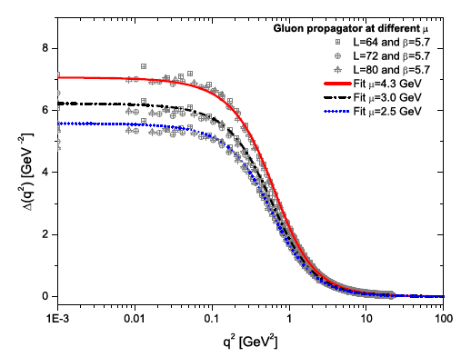



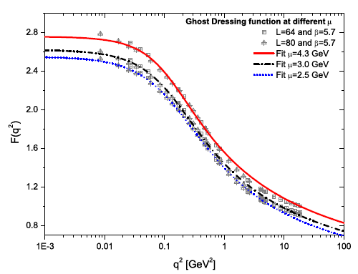
Ingredients
Use the relation
A.C.A, D.Binosi, J.Papavassiliou and J.Rodriguez-Quintero, Phys.Rev. D 80 085018 (2009)
I.L.Bogolubsky, et al , PoS LAT2007, 290 (2007)

Slide 18
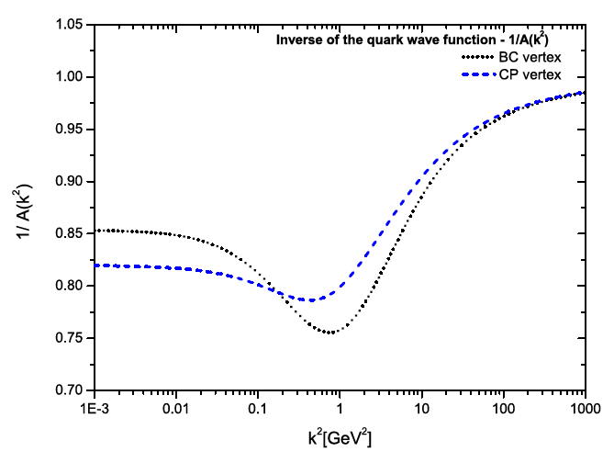
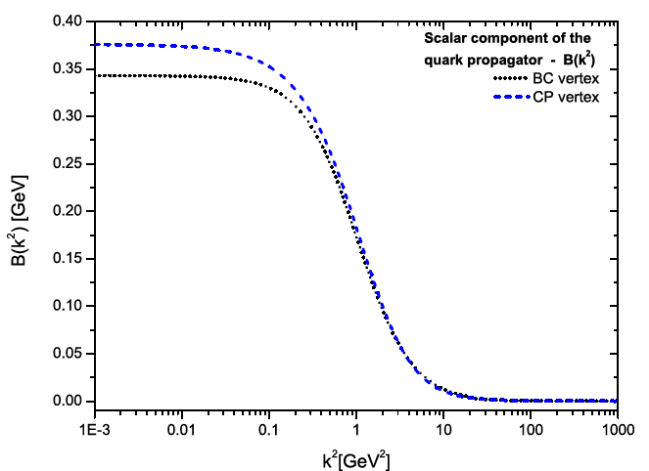
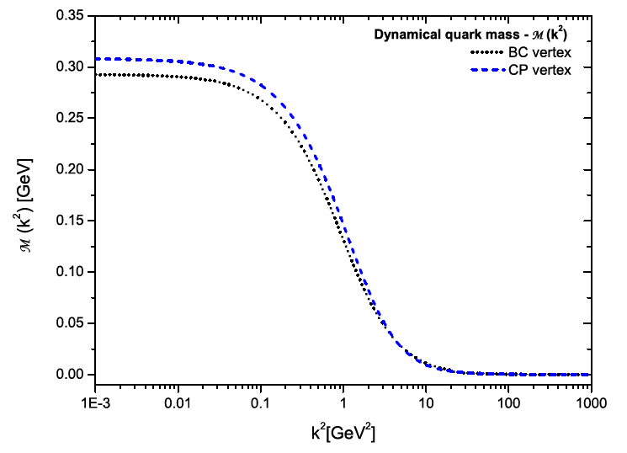
Using quark SDE with the lattice gluon and ghost propagators and a non-abelian improved version of the BC e CP vertex, we have obtained A(k), B(k) and M(k)
A.C.A and J. Papavassiliou, Phys. Rev. D83, 014013 (2011)

Slide 19
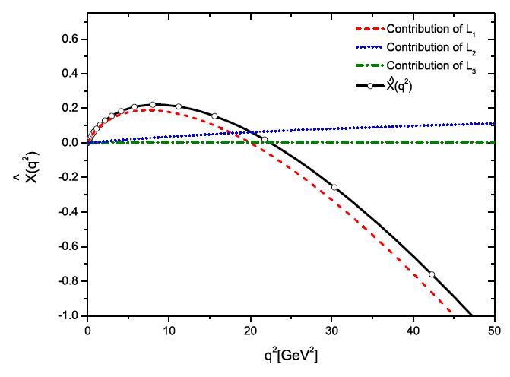
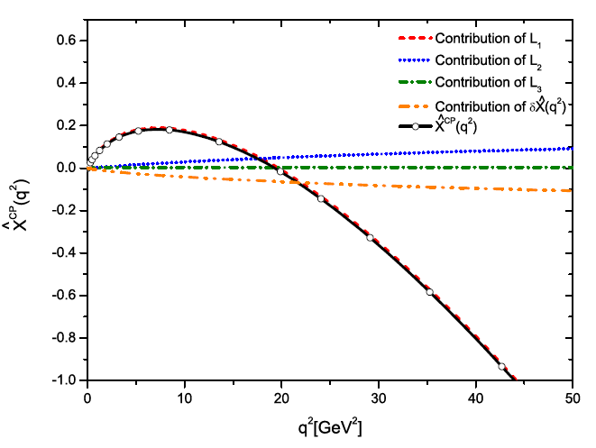
^
^
Results for the quark loop X(q²) and X^{CP}(q²)
Using BC vertex
Using CP vertex
Leading contribution comes from L₁ (quark-gluon vertex form factor)

Slide 20
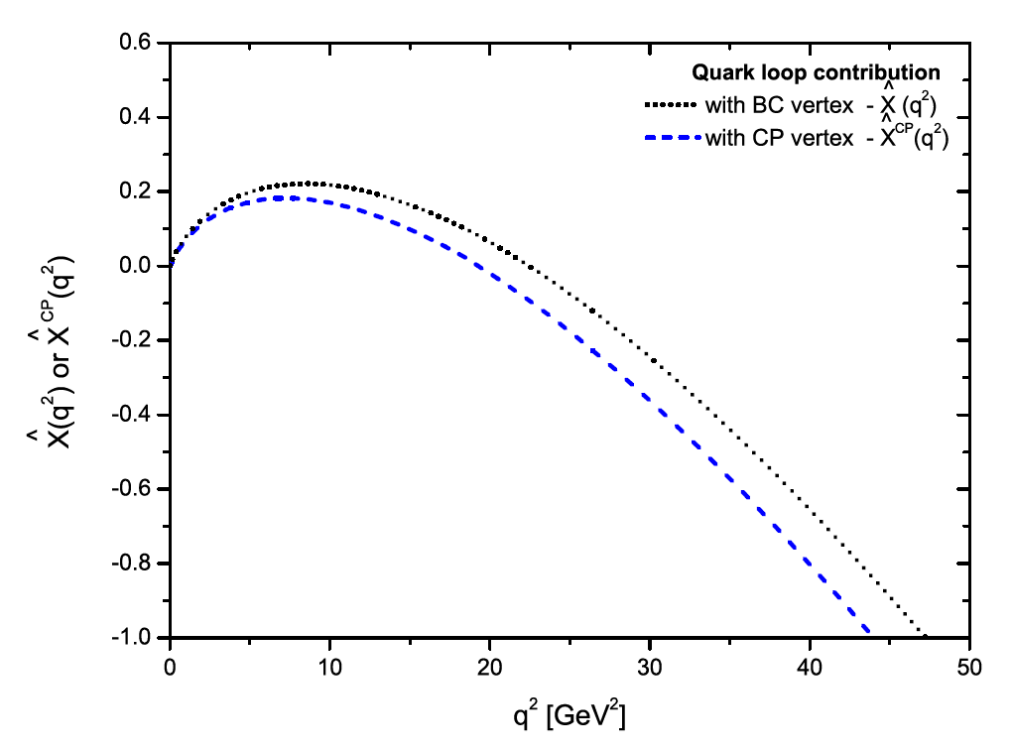
^
^
Comparison X(q²) and X^{CP}(q²)

Slide 21
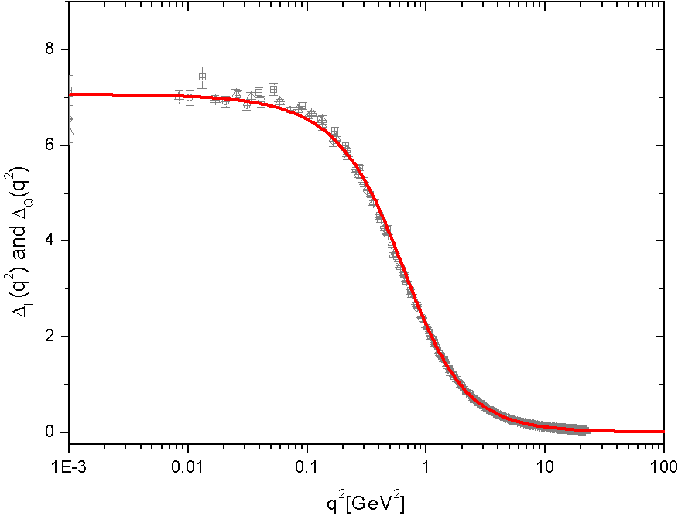
Effects on the gluon propagator

Slide 22
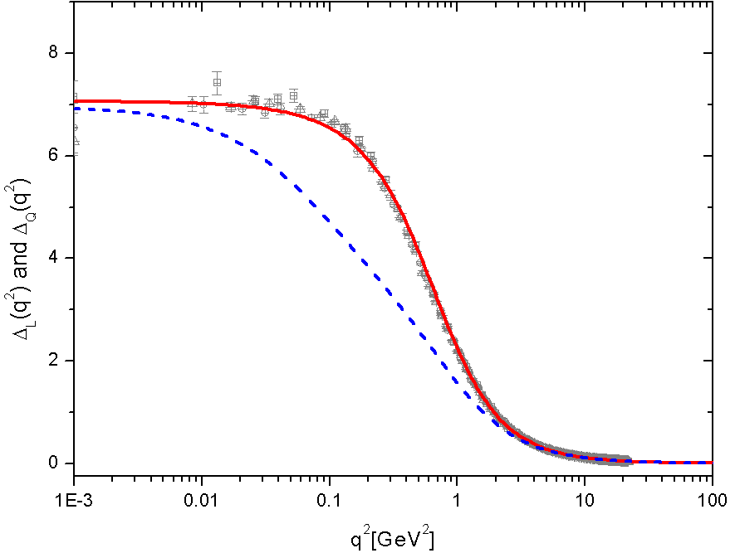
Effects on the gluon propagator
Due to the fact that X(0)=0 we obtain the freezing in the same point

Slide 23
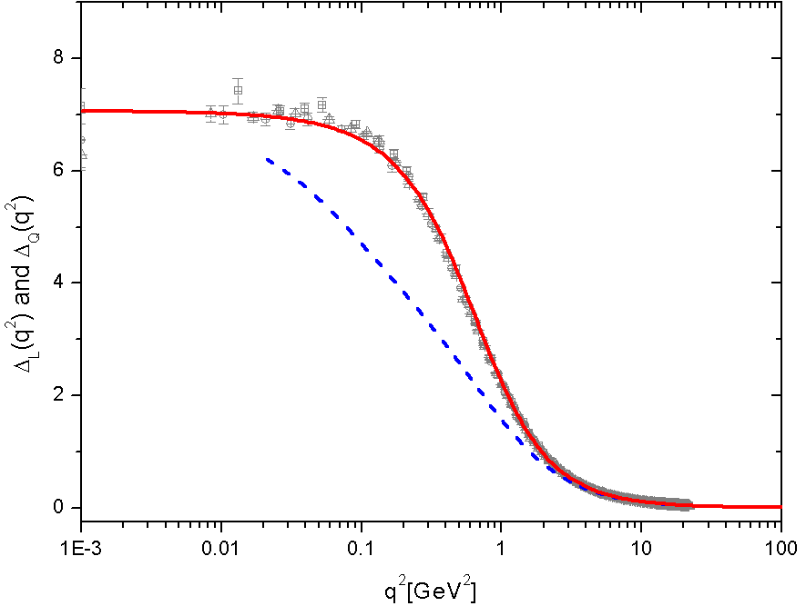
Effects on the gluon propagator
Cut the curve in the IR and extrapolate it. (Treat λ as a parameter )

Slide 24
Effects on the gluon propagator
Cut the curve in the IR and extrapolate it As if λ was treated as a parameter

Slide 25
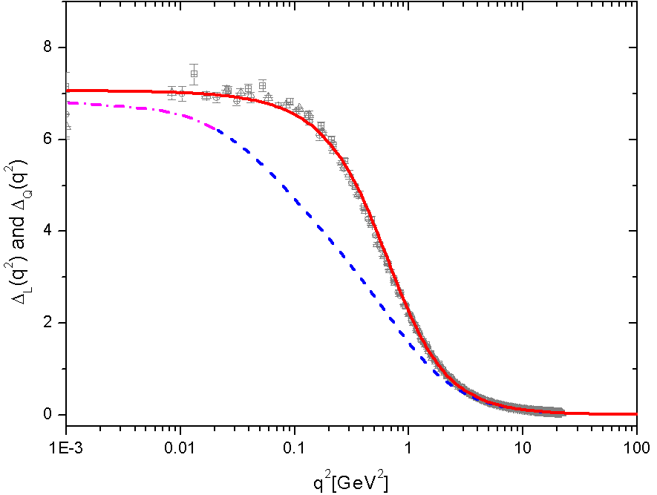
Effects on the gluon propagator
Cut at 0.02 GeV² - Δ_{Q} (0) = 6.8 GeV⁻²

Slide 26
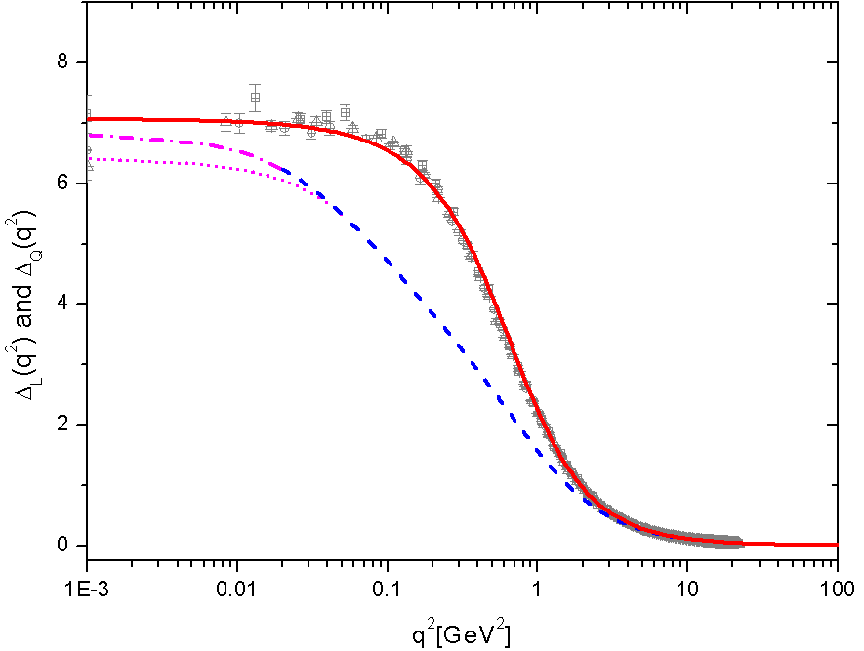
Effects on the gluon propagator
Cut at 0.05 GeV² - Δ_{Q} (0) = 6.4 GeV⁻²

Slide 27
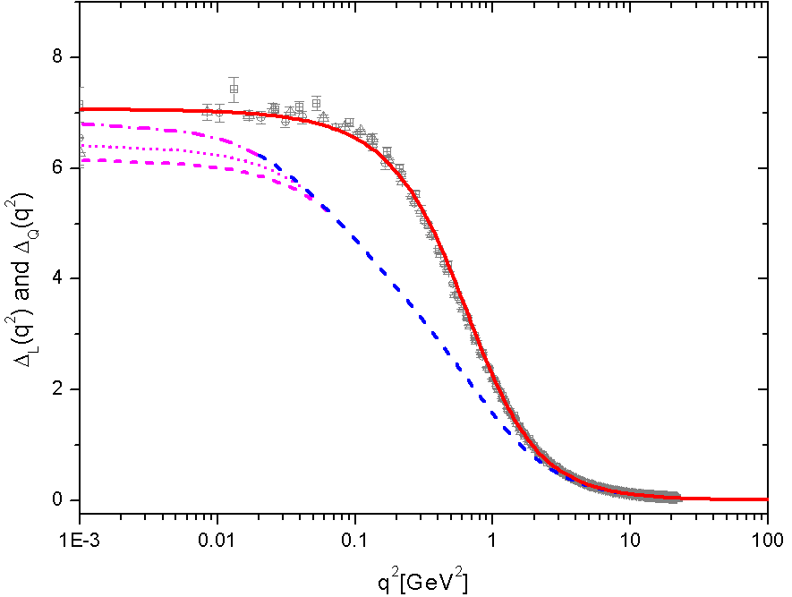
Effects on the gluon propagator
Cut at 0.07 GeV² - Δ_{Q} (0) = 6.15 GeV⁻²
Variation around 10% at the value of Δ_{Q} (0)
We will cut at 0.05 GeV²

Slide 28
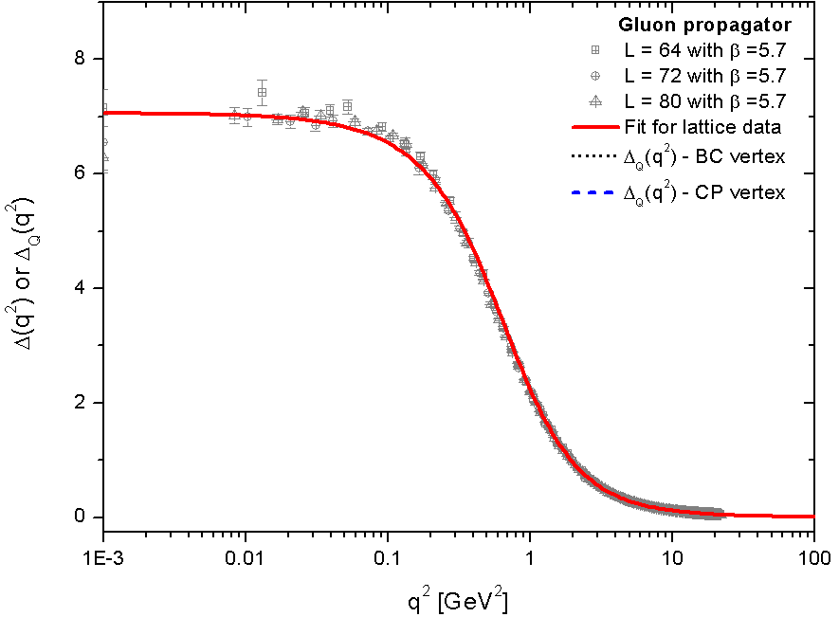
Effects on the gluon propagator

Slide 29
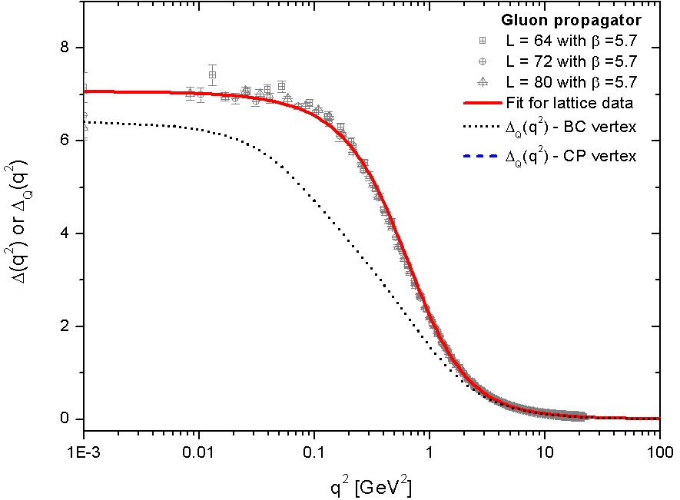
Comparision of the unquenched gluon propagator
with BC vertex

Slide 30
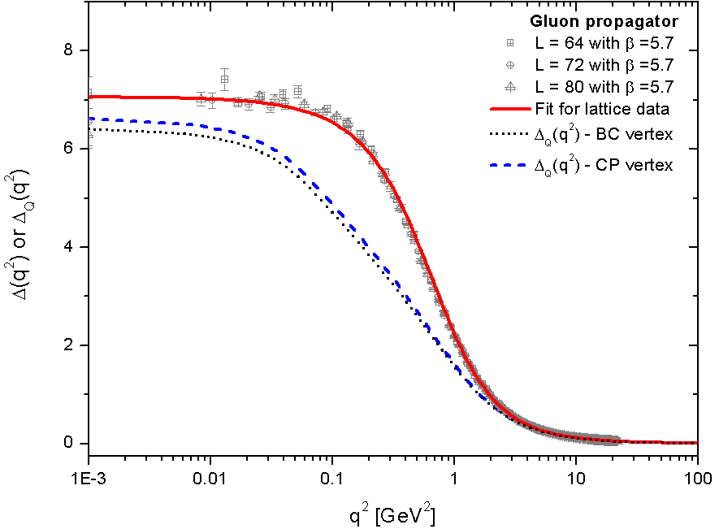
Comparision of the unquenched gluon propagator
with BC and CP vertex

Slide 31

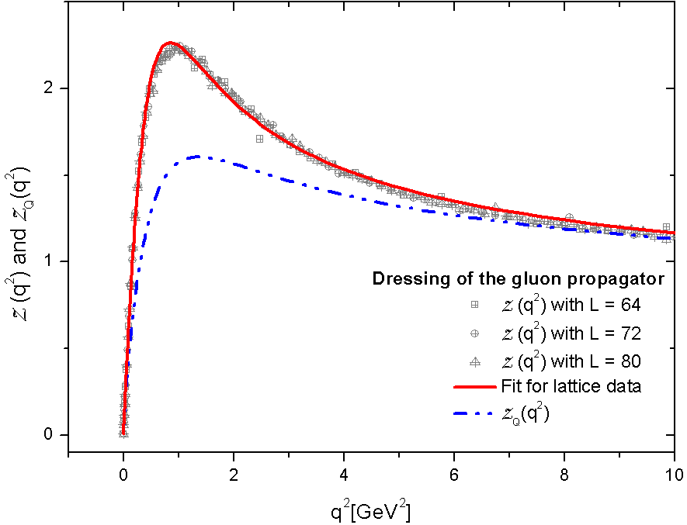
Comparision of the quenched and unquenched dressing gluon function

Slide 32
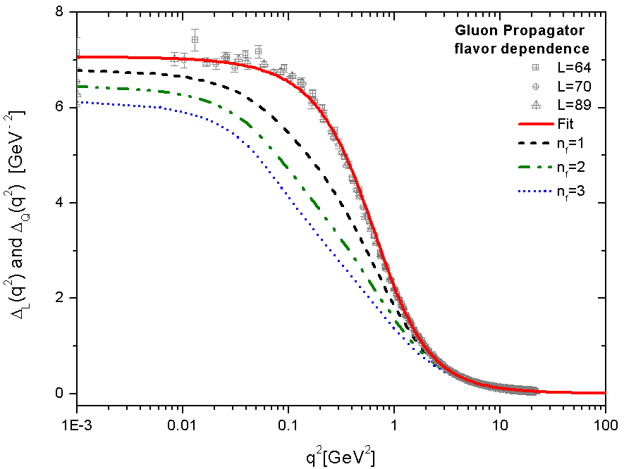
The effect of adding more quarks

Slide 33
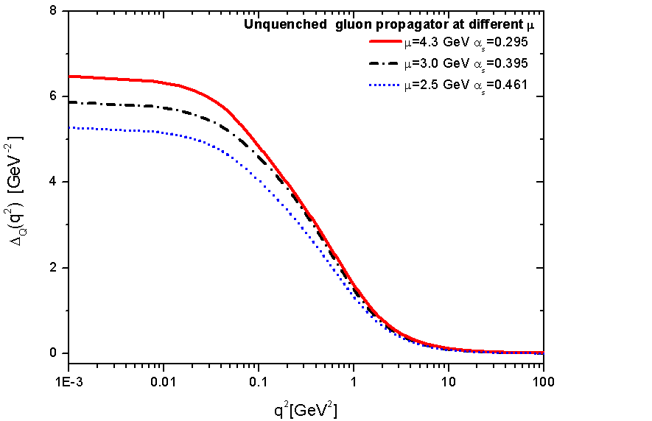

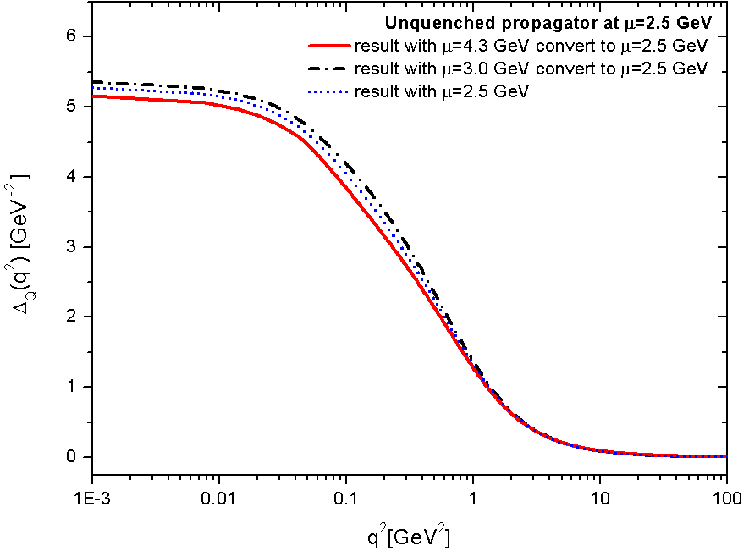
Dependence on the renormalization point μ
Small μ dependence the renormalization was carried out subtractively instead of multiplicatively.

Slide 34
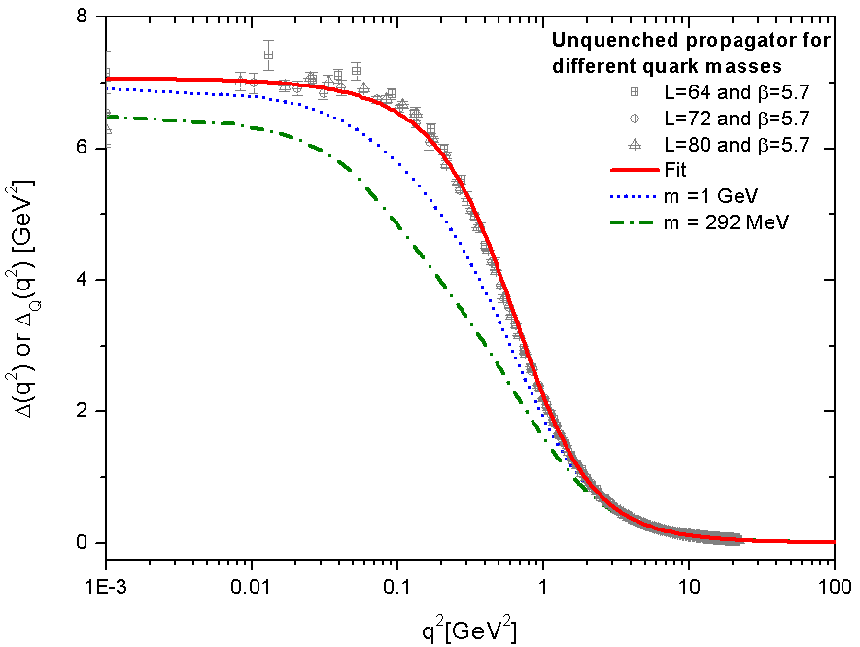
The inclusion of loops containing heavier quark masses
Heavy quarks → Give rise to numerically suppressed contributions.

Slide 35
Conclusions
We have studied the impact of the quark loop on the overall form of the gluon propagator.
The conventional and the PT-BFM framework allowed us to single out gauge-invariantly the “one-loop dressed” quark loop diagrams.
The difference is that in the PT-BFM the quark-gluon vertex appearing in the quark loop satisfies the WI instead of STI.
We have used to models for the gluon-quark vertex: BC and CP vertex
The presence of the quark loop suppress (by a nonlinear effect ) the IR freezing point of Δ_{Q}(q).

Slide 36
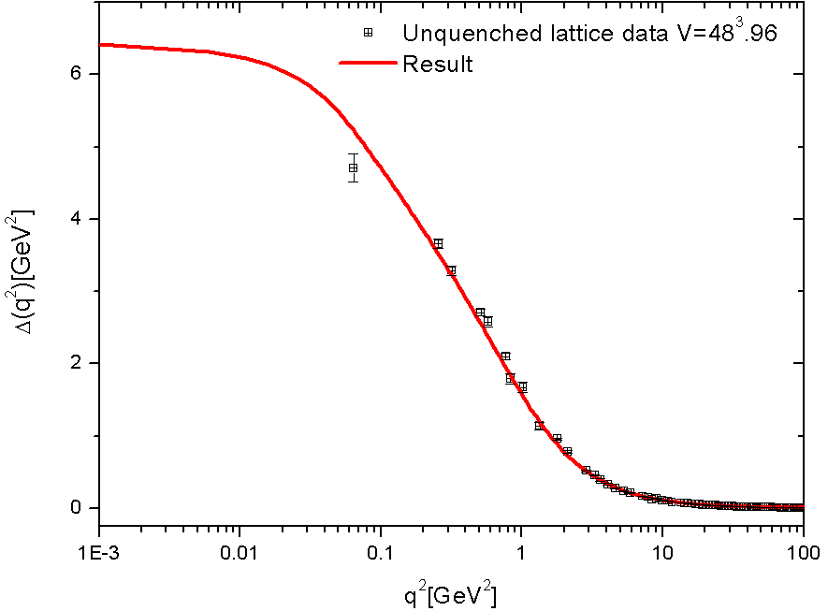
Comparison with the unquenched lattice

