Slide 1
Nucleon Resonances from DCC Analysis of Collaboration@EBAC for Confinement Physics
T.-S. Harry Lee
Argonne National Laboratory
Workshop on “Confinement Physics”
Jefferson Laboratory, March 12-15, 2012

Slide 2

Excited Baryon Analysis Center (EBAC) of Jefferson Lab
Founded in January 2006
http://ebac-theory.jlab.org/
Reaction Data
Objectives :
Perform a comprehensive analysis
of world data of πN, γN, N(e,e’) reactions,
Determine N* spectrum (pole positions)
Extract N-N* form factors (residues)
Identify reaction mechanisms
for interpreting the properties
and dynamical origins of N* within
QCD
Dynamical Coupled-Channels Analysis @ EBAC
N* properties
Hadron Models
Lattice QCD
QCD

Slide 3
Explain :
1. What is the dynamical coupled-channel (DCC) approach ?
2. What are the latest results from Collaboration@EBAC ?
3. How are DCC-analysis results related to Confinement ?
4. Summary and future directions
5. Remarks on numerical tasks

Slide 4
What are nucleon resonances ?
Experimental fact:
Excited Nucleons (N*) are unstable and coupled
with meson-baryon continuum to form
nucleon resonances
Nucleon resonances contain information on
Structure of N*
Meson-baryon Interactions

Slide 5
Extraction of Nucleon Resonances from data is an
important subject and has a long history
How are Nucleon Resonances extracted
from data ?

Slide 6
Assumptions of Resonance Extractions
Partial-wave amplitudes are analytic functions
F (E) on the complex E-plane
F (E) are defined uniquely by the partial-wave
amplitudes A (W) determined from accurate
and complete experiments on physical W-axis
The Poles of F(E) are the masses of Resonances
of the underlying fundamental theory (QCD).

Slide 7
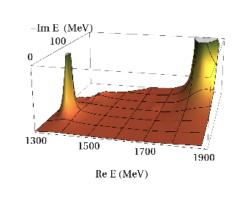
Analytic continuation
F (E) A (W)
Data
F (E)
A (W)
W =

Slide 8
Theoretical justification:
(Gamow, Peierls, Dalitz, Moorhouse, Bohm….)
Resonances are the eigenstates of the Hamiltonian
with outgoing-wave boundary condition

Slide 9
Procedures:
If high precision partial-wave amplitudes A (W) from complete and accurate experiments are available
Fit A (W) by using any parameterization
of analytic function F(E) in E = W region
Extract resonance poles and residues from F (E)

Slide 10
Examples of this approach:
F (E) = polynominals of k
F (E) = g²(k)/(E – M₀)+ i Γ(E)/2)
g₀ (k²/(k²+C²))^{2n}
k : on-shell momentum
Breit-Wigner form

Slide 11
Reality:
Data are incomplete and have errors
Extracted resonance parameters depend on the
parameterization of F (E) in fitting
the Data A (W) in E = W physical region

Slide 12
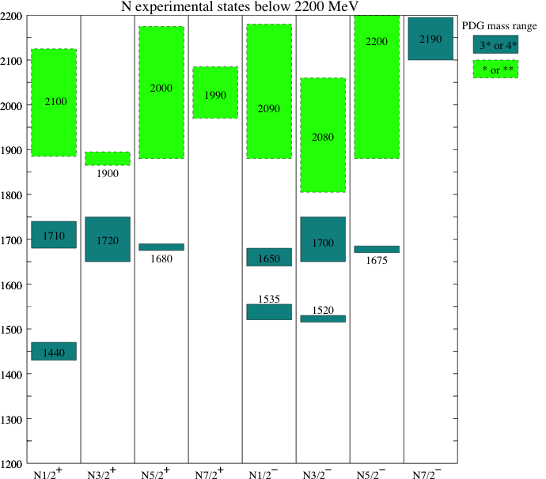
N* Spectrum in PDG

Slide 13
Solution:
Constraint the parameterization of
F (E) by theoretical assumptions
Reduce the errors due to the
fit to Incomplete data

Slide 14
Approaches:
Impose dispersion-relations on F (E)
F (E) : K-matrix + tree-diagrams
F (E) : Dynamical Scattering Equations
Collaboration @ EBAC
Juelich, Dubna-Mainz-Taiwan
Sato-Lee, Gross-Surya, Utrech-Ohio
etc…

Slide 15
Objectives of the Collaboration@EBAC :
Reduce errors in extracting nucleon resonances
in the fit of incomplete data
Implement the essential elements of
non-perturbative QCD in determining F(E) :
Confinement
Dynamical chiral symmetry breaking
Provide interpretations of the extracted
resonance parameters.

Slide 16
Develop Dynamical Reaction Model based
on the assumption:
Baryon is made of a confined quark-core
and meson cloud
Meson cloud
Confined core

Slide 17
Model Hamiltonian :
(A. Matsuyama, T. Sato, T.-S. H. Lee, Phys. Rept, 2007)
H = H₀ + H_{int}
H_{int} = h_{N*,} _{MB} + v_{MB,M’B’}
N* : Confined quark-gluon core
MB : Meson-Baryon states
Note:
An extension of Chiral Cloudy Bag Model
to study multi-channel reactions

Slide 18
Solve
T(E)= H_{int}+ H_{int} H_{int}
T(E) observables of Meson-Baryon Reactions
First step:
How many Meson-Baryon states ????
1
E-H+ie

Slide 19
Total cross sections of meson photoproduction
Unitarity Condition
Coupled-channel
approach is needed
MB : γN, πN, 2π-N, ηN, KΛ, KΣ, ωN

Slide 20


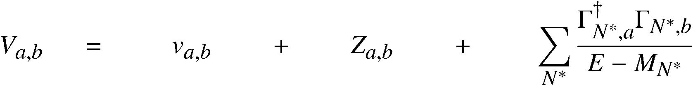
Dynamical coupled-channels (DCC) model for meson production reactions
For details see Matsuyama, Sato, Lee, Phys. Rep. 439,193 (2007)
Partial wave (LSJ) amplitudes of a → b reaction:
Reaction channels:
Transition Potentials:
t-channel
contact
s-channel
u-channel
π, ρ, σ, ω,..
N
N, Δ
π
coupled-channels effect
ρ, σ
Δ
π
Exchange potentials
π
N
N
Δ
π
Δ
Can be related to hadron structure calculations
(quark models, DSE, etc.) excluding meson-baryon continuum.
Z-diagrams
N*_{bare}
Bare N* states
Exchange potentials
Z-diagrams
bare N* states

Slide 21
Dynamical Coupled-Channels analysis
Fully combined analysis of γN , πN → πN , ηN , KΛ, KΣ reactions !!
2006-2009
6 channels
(γN,πN,ηN,πΔ,ρN,σN)
< 2 GeV
< 1.6 GeV
< 2 GeV
―
―
―
2010-2012
8 channels
(γN,πN,ηN,πΔ,ρN,σN,KΛ,KΣ)
< 2.1 GeV
< 2 GeV
< 2 GeV
< 2 GeV
< 2.2 GeV
< 2.2 GeV
# of coupled
channels
    πp → πN
    γp → πN
    π-p → ηn
    γp → ηp
    πp → KΛ, KΣ
    γp → KΛ, KΣ
Kamano, Nakamura, Lee, Sato, 2012

Slide 22
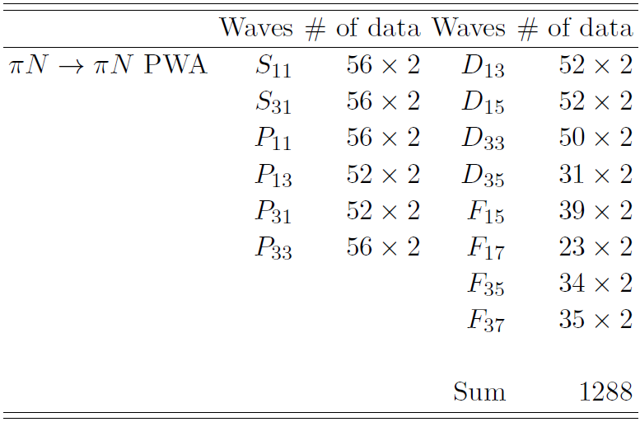
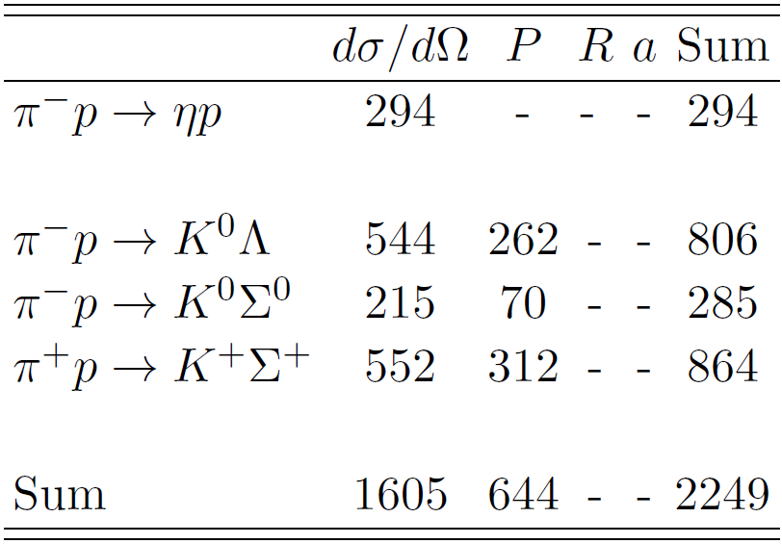
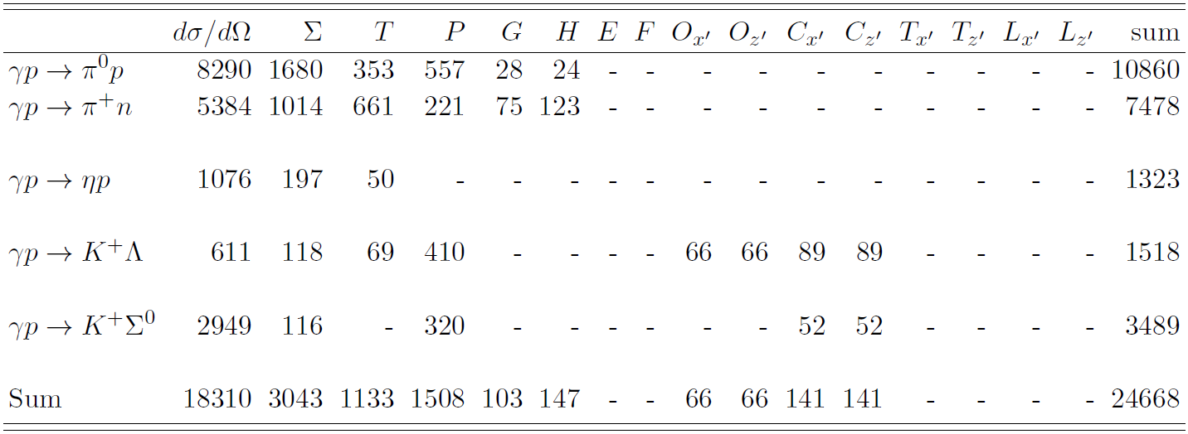
Analysis Database
Pion-induced
reactions
(purely strong
reactions)
SAID
~ 28,000 data points to fit
Photo-
production
reactions

Slide 23
Parameters :
1. Bare mass M
2. Bare vertex N* -> MB (C , Λ )
N = 14 [ (1 + 8 2 ) n ], n = 1 or 2
= about 200
Determined by χ -fit to about 28,000 data points
N*
N*,MB
N*,MB
N*
N*
2

Slide 24
Results of 8-channel analysis
Kamano, Nakamura, Lee, Sato, 2010-2012

Slide 25
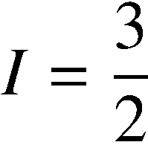
Partial wave amplitudes of pi N scattering
Real part
Kamano, Nakamura, Lee, Sato, 2012
Previous model
(fitted to πN → πN data only)
[PRC76 065201 (2007)]
Imaginary part

Slide 26




Pion-nucleon elastic scattering
Angular distribution
Target polarization
1234 MeV
1449 MeV
1678 MeV
1900 MeV
Kamano, Nakamura, Lee, Sato, 2012

Slide 27



Single pion photoproduction
Kamano, Nakamura, Lee, Sato, 2012
Angular distribution
Photon asymmetry
1137 MeV
1232 MeV
1334 MeV
1137 MeV
1232 MeV
1334 MeV
1462 MeV
1527 MeV
1617 MeV
1462 MeV
1527 MeV
1617 MeV
1729 MeV
1834 MeV
1958 MeV
1729 MeV
1834 MeV
1958 MeV
Kamano, Nakamura, Lee, Sato, 2012
Previous model (fitted to γN → πN data up to 1.6 GeV) [PRC77 045205 (2008)]

Slide 28
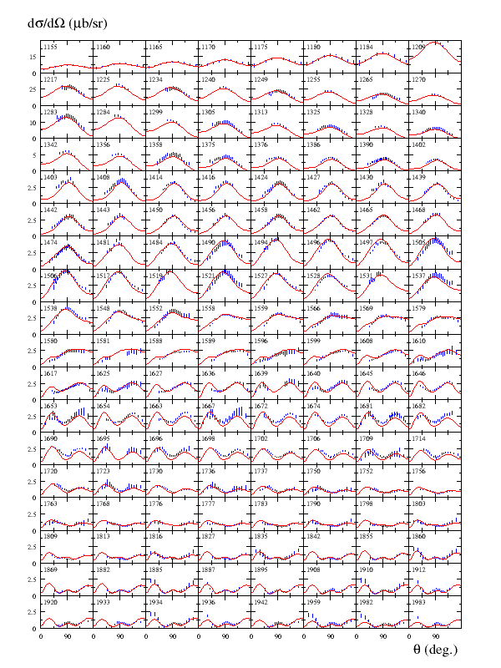
Kamano, Nakamura, Lee, Sato, 2012

Slide 29
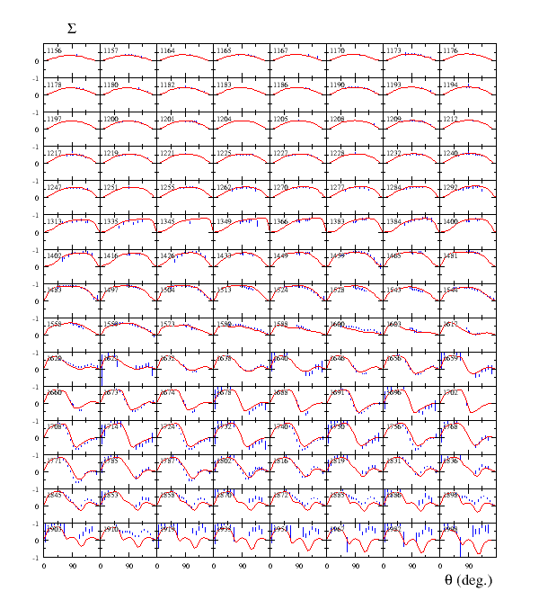
Kamano, Nakamura, Lee, Sato, 2012

Slide 30

Eta production reactions
Kamano, Nakamura, Lee, Sato, 2012

Slide 31
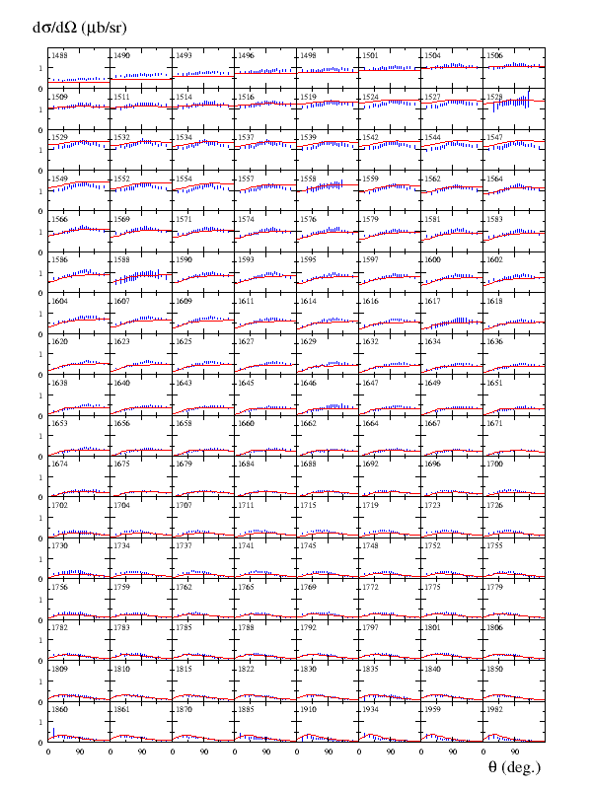

Kamano, Nakamura, Lee, Sato, 2012

Slide 32
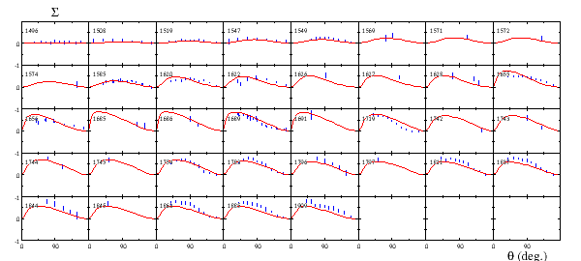
Kamano, Nakamura, Lee, Sato, 2012

Slide 33



KY production reactions
Kamano, Nakamura, Lee, Sato, 2012
1732 MeV
1757 MeV
1792 MeV
1845 MeV
1879 MeV
1879 MeV
1985 MeV
1966 MeV
1966 MeV
2031 MeV
2059 MeV
2059 MeV

Slide 34
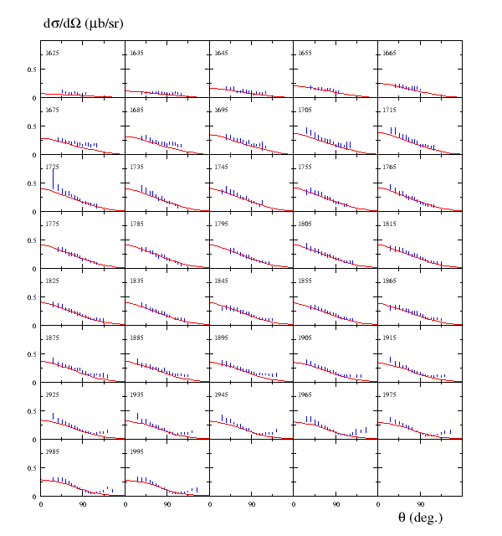

Kamano, Nakamura, Lee, Sato, 2012

Slide 35
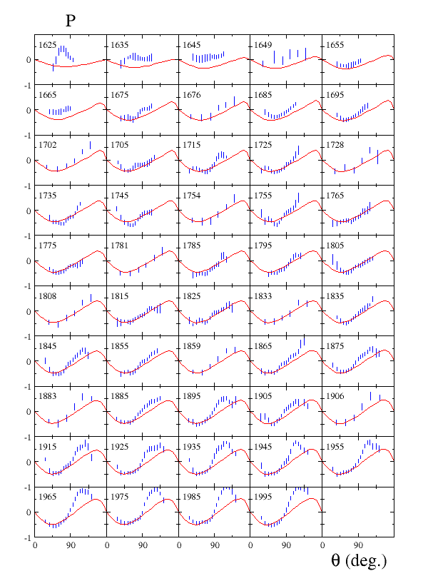
Kamano, Nakamura, Lee, Sato, 2012

Slide 36
8-channel model parameters have been
determined by the fits to the data of
πΝ, γΝ -> πΝ, ηΝ, ΚΛ, ΚΣ
Extract nucleon resonances

Slide 37
Extraction of N* information
Definitions of
N* masses (spectrum) ➔ Pole positions of the amplitudes
N* → MB, γN decay vertices ➔ Residues^{1/2} of the pole
N* → b
decay vertex
N* pole position
( Im(E₀) < 0 )

Slide 38
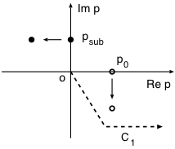
Suzuki, Sato, Lee, Phys. Rev. C79, 025205 (2009)
Phys. Rev. C 82, 045206 (2010)
On-shell momentum
E = W
E = M – i Γ
R

Slide 39
Delta(1232) : The 1st P33 resonance
Suzuki, Julia-Diaz, Kamano, Lee, Matsuyama, Sato, PRL104 042302 (2010)
Complex E-plane
Real energy axis
“physical world”
P33
πN physical & πΔ physical sheet
Im (E)
π N
Re (E)
πN unphysical & πΔ physical sheet
π Δ
In this case, BW mass & width can be
a good approximation of the pole position.
1211-50i
pole 1211 , 50
Small background
Isolated pole
Simple analytic structure
of the complex E-plane
BW 1232 , 118/2=59
πN unphysical & πΔ unphysical sheet
Riemann-sheet for other channels: (ηN,ρN,σN) = (-, p, -)

Slide 40
Two-pole structure of the Roper P11(1440)
Suzuki, Julia-Diaz, Kamano, Lee, Matsuyama, Sato, PRL104 042302 (2010)
Complex E-plane
Real energy axis
“physical world”
P11
πN physical & πΔ physical sheet
Im (E)
π N
Re (E)
In this case, BW mass & width has NO
clear relation with the resonance poles:
Pole A cannot generate a resonance shape on
“physical” real E axis.
πN unphysical & πΔ physical sheet
π Δ
Two 1356 , 78
poles 1364 , 105
A
1356-78i
?
1364-105i
B
BW 1440 , 300/2 = 150
πN unphysical & πΔ unphysical sheet
Riemann-sheet for other channels: (ηN,ρN,σN) = (p,p,p)

Slide 41
Dynamical origin of P11 resonances
Suzuki, Julia-Diaz, Kamano, Lee, Matsuyama, Sato, PRL104 065203 (2010)
Bare N* = states of hadron calculations
excluding meson-baryon continuum
(quark models, DSE, etc..)

Slide 42

Spectrum of N* resonances
Kamano, Nakamura, Lee, Sato ,2012
Real parts of N* pole values
Ours
PDG 4*
 | PDG | Ours
N* with 3*, 4* | 18 | 16
N* with 1*, 2* | 5
PDG 3*
L_{2I 2J}

Slide 43

Width of N* resonances
Kamano, Nakamura, Lee, Sato 2012

Slide 44
N-N* form factors at Resonance poles
Suzuki, Julia-Diaz, Kamano, Lee, Matsuyama, Sato, PRL104 065203 (2010)
Suzuki, Sato, Lee, PRC82 045206 (2010)
Nucleon - 1st D13 e.m. transition form factors
Real part
Imaginary part
Complex : consequence of analytic continuation
Identified with exact solution of fundamental theory (QCD)

Slide 45
Interpretations :
Delta (1232)
Roper(1440)

Slide 46
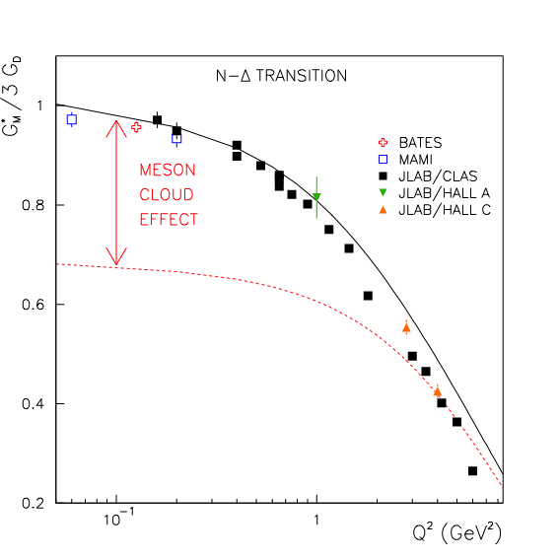
G_{M}(Q²) for γ N → Δ (1232) transition
Note:
Most of the available static
hadron models give G_{M}(Q²)
close to “Bare” form factor.
Full
Bare

Slide 47
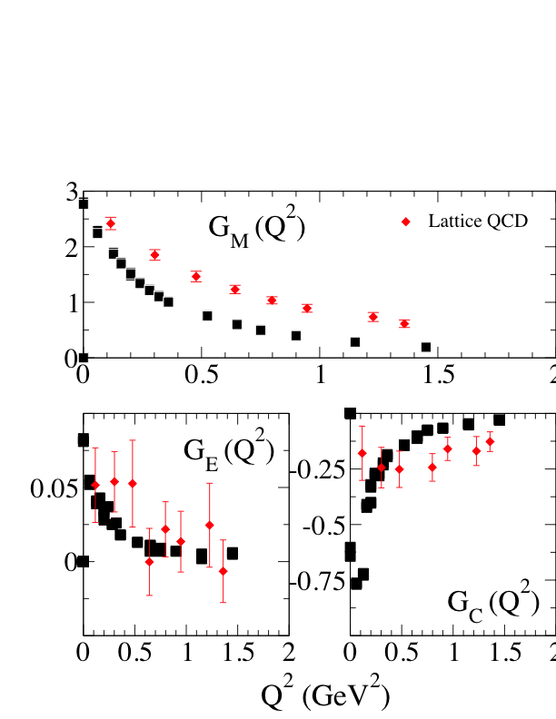
γ N → Δ(1232) form factors
compared with Lattice QCD data (2006)
DCC

Slide 48
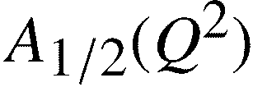
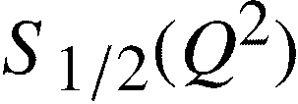

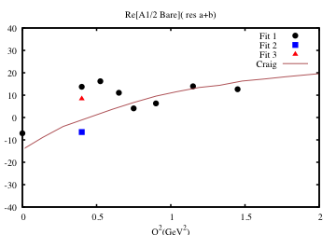
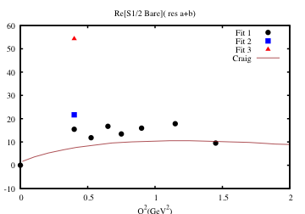
γ p → Roper e.m. transition
“Bare” form factor
determined from
our DCC analysis (2010).
“Static” form factor from
DSE-model calculation.
(C. Roberts et al, 2011)

Slide 49
Much more to be done for interpreting
the extracted nucleon resonances !!!

Slide 50
Summary and Future Directions
2006 – 2012
a. Complete analysis of πΝ, γΝ -> πΝ, ηN, ΚΛ, ΚΣ
b. N* spectrum in W < 2 GeV has been determined
c. γΝ->N* at Q =0 has been extracted
Has reached DOE milestone HP3:
2
“Complete the combined analysis of available single pion, eta, kaon
photo-production data for nucleon resonances and incorporate
analysis of two-pion final states into the coupled-channels analysis
of resonances”

Slide 51
Next tasks :
1. Results from DCC analysis of 2006-2009:
6-channel model can only obtain γΝ->N*
form factor from N(e,e’π) data in W < 1.6 GeV
Apply 8-channel model to extract
γΝ->N* form factor for N* in W < 2 GeV

Slide 52


Single pion electroproduction (Q² > 0)
Julia-Diaz, Kamano, Lee, Matsuyama, Sato, Suzuki, PRC80 025207 (2009)
Fit to the structure function data from CLAS
p (e,e’ π⁰) p
W < 1.6 GeV
Q² < 1.5 (GeV/c)²
is determined
at each Q².
γ
q
(q² = -Q²)
N
N*
N-N* e.m. transition
form factor

Slide 53
2. Improve analysis of two-pion production :
Results of 6-channel analysis of 2006-2009:
1. Coupled-channel effects are crucial
2. Only qualitatively describe πΝ -> ππN
3. Over estimate γΝ -> ππN by a factor of 2

Slide 54
pi N → pi pi N reaction
Parameters used in the calculation are from πN → πN analysis.
Full result
C.C. effect off
Kamano, Julia-Diaz, Lee, Matsuyama, Sato, Phys. Rev. C, (2008)

Slide 55



Double pion photoproduction
Kamano, Julia-Diaz, Lee, Matsuyama, Sato, PRC80 065203 (2009)
Parameters used in the calculation are from πN → πN & γN → πN analyses.
Good description near threshold
Reasonable shape of invariant
mass distributions
Above 1.5 GeV, the total cross
sections of pπ⁰π⁰ and pπ⁺π⁻
overestimate the data by factor of 2

Slide 56
Difficulty :
Lack of sufficient πΝ -> ππ N data to
pin down N* -> πΔ, ρΝ, σN -> ππΝ
Two-pion data are not in 8-channel analysis
Progress:
A proposal on πΝ -> ππN is being considered
at J-PARC

Slide 57
Next Tasks
By extending the ANL-Osaka collaboration (since 1996)
1. Complete the extraction of N-N* form factors to reach DOE
milestone HP7:
2. Make predictions for J-PARC projects on πΝ -> ππΝ, ΚΛ…
In progress
3. Analyze the data from “complete experiments”
(in collaboration with A. Sandorfi and S. Holbit)
“Measure the electromagnetic excitations of low-lying baryon
states (< 2GeV) and their transition form factors ….”

Slide 58
Collaborators
J. Durand (Saclay)
B. Julia-Diaz (Barcelona)
Kamano (RCNP,JLab)
T.-S. H. Lee (ANL,JLab)
A. Matsuyama(Shizuoka)
S. Nakamura (JLab)
B. Saghai (Saclay)
Sato (Osaka)
C. Smith (Virginia, Jlab)
Suzuki (Osaka)
K. Tsushima (JLab)

Slide 59
Remarks on numerical tasks :
DCC is not an algebraic approach like
analysis based on polynomials or K-matrix
Solve coupled integral equations with 8 channels
by inverting 400 400 complex matrix formed
by about 150 Feynman diagrams for each partial
waves (about 20 partial waves up to L=5)

Slide 60
2. Fits to about 28,000 data points
To fit new data, we usually need to improve
or extend the model Hamiltonian theoretically,
not just blindly vary the parameters
4. Analytic continuation requires careful analysis
of the analytic structure of the driving terms
(150 Feynman amplitudes) of the coupled
integral equations, no easy rules to use blindly

Slide 61
5. Typically, we need
240 processors
using supercomputer Fusion at ANL
NERSC at LBL
We have used 200,000 hours in
January-February, 2012 for 8-channel
analysis

Slide 62



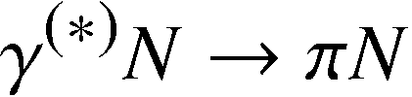


Strategy for N* study @ EBAC
Application
Extract N* → ηN, KY, ωN
Feedback
Fit hadronic part
of parameters
Refit hadronic part
of parameters
Application
Pass hadronic parameters
Pass hadronic parameters
Feedback
Fit electro-magnetic
part of parameters
Refit electro-magnetic
part of parameters
Application
Application
Extract N* → ηN, KY, ωN

Slide 63
Thanks to the support from JLab !!

Slide 64
back up

Slide 65
r
i(k - ik )
e
R
I
-
ψ(r)
f(θ)
Resonance
r
k , k > 0
R
I
ik r
-ik r
e
ψ(r)
e
+
-
Scattering
f(θ)
r

Slide 66
Search poles on 2^{n} sheets of Riemann surface
n = 8
Search on the sheets where
a. close channels: physical (k_{I} > 0)
b. open channels: unphysical (k_{I} < 0)
Near threshold :
search on both physical and unphysical
k = k_{R} + i k_{I} on-shell momentum

Slide 67
Single pion electroproduction (Q² > 0)
Julia-Diaz, Kamano, Lee, Matsuyama, Sato, Suzuki, PRC80 025207 (2009)
Five-fold differential cross sections at Q² = 0.4 (GeV/c)²
p (e,e’ π⁰) p
p (e,e’ π⁺) n

Slide 68

Dynamical coupled-channels model of EBAC
For details see Matsuyama, Sato, Lee, Phys. Rep. 439,193 (2007)

Slide 69
Improvements of the DCC model
Processes with 3-body ππN unitarity cut
The resulting amplitudes are now completely unitary in
channel space !!

Slide 70
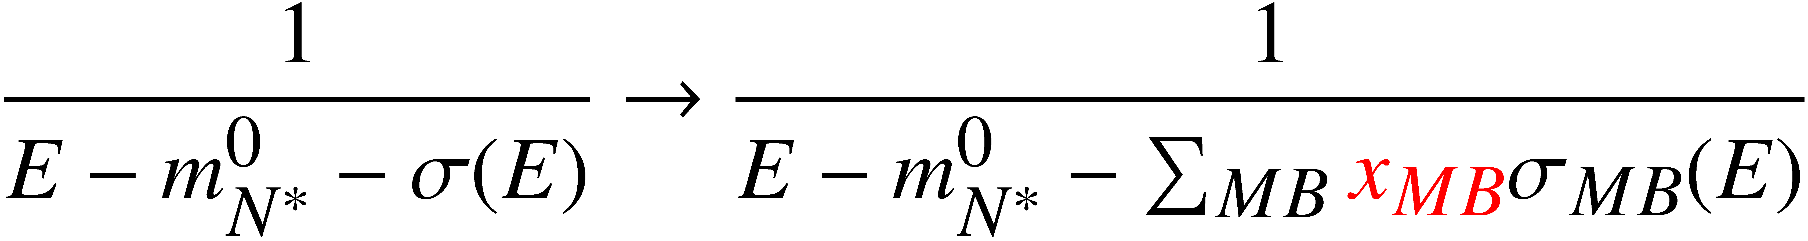


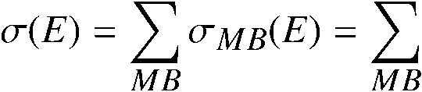




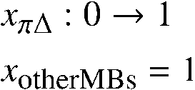
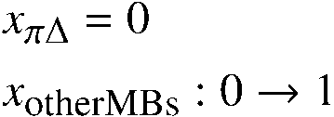
Dynamical origin of P11 resonances
Suzuki, Julia-Diaz, Kamano, Lee, Matsuyama, Sato, PRL104 042302 (2010)
Pole trajectory
of N* propagator
self-energy:
Bare state
ηN threshold
πΔ threshold
(ηN, ρN, πΔ) = (p, u, u)
Im E (MeV)
A:1357–76i
(ηN, ρN, πΔ) = (p, u, －)
ρN threshold
(ηN, ρN, πΔ) = (p, u, p)
(ηN, ρN, πΔ) = (u, u, u)
B:1364–105i
C:1820–248i
(πN,σN) = (u,p)
for three P11 poles
Re E (MeV)

Slide 71
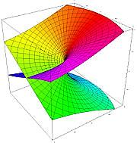
Multi-layer structure of the scattering amplitudes
e.g.) single-channel meson-baryon scattering
physical sheet
2-channel case (4 sheets):
(channel 1, channel 2) =
(p, p), (u, p) ,(p, u), (u, u)
p = physical sheet
u = unphysical sheet
Scattering amplitude is a double-valued function of complex E !!
Essentially, same analytic structure as square-root function: f(E) = (E – E_{th})^{1/2}
unphysical sheet
N-channels → Need 2^{N} Riemann sheets
physical sheet
unphysical sheet
Re(E) + iε ＝“physical world”
Im (E)
0
Im (E)
0
E_{th}
(branch point)
E_{th}
(branch point)
Re (E)
Re (E)

